Slide 1

WELCOME TO YEAR 3
St Thomas of Canterbury RC Primary School

Slide 2
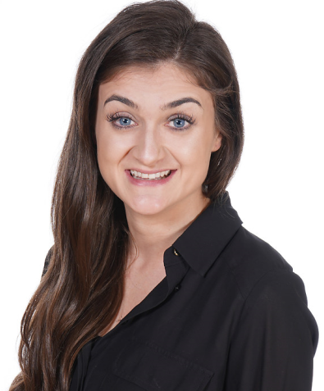
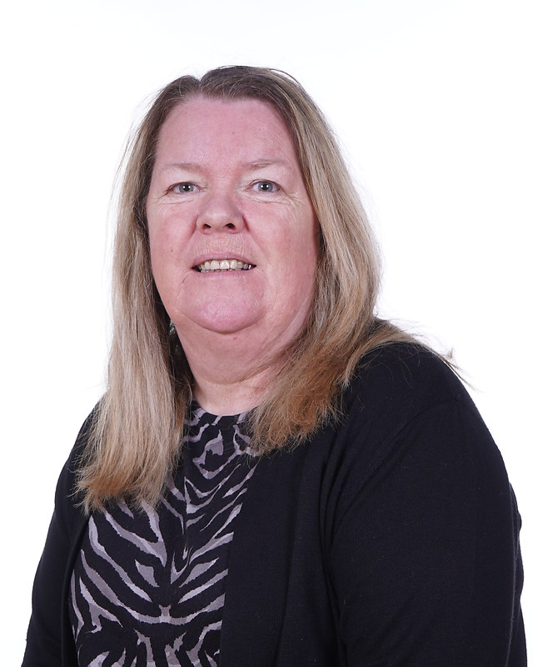
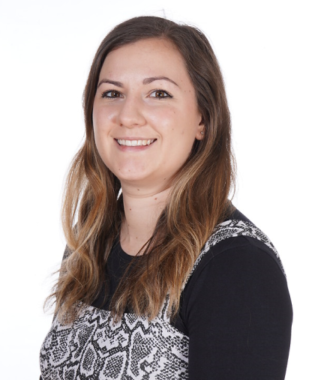
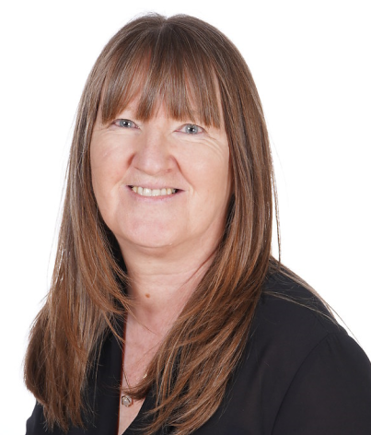
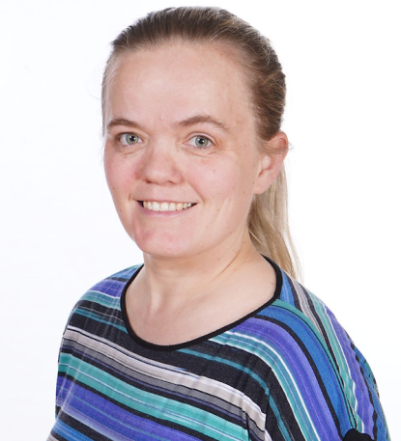
Year 3 team
Year 3C
Miss Camilleri Miss Owens
Year 3H
Mrs Hawkins Miss Delaney
Miss Ireland

Slide 3
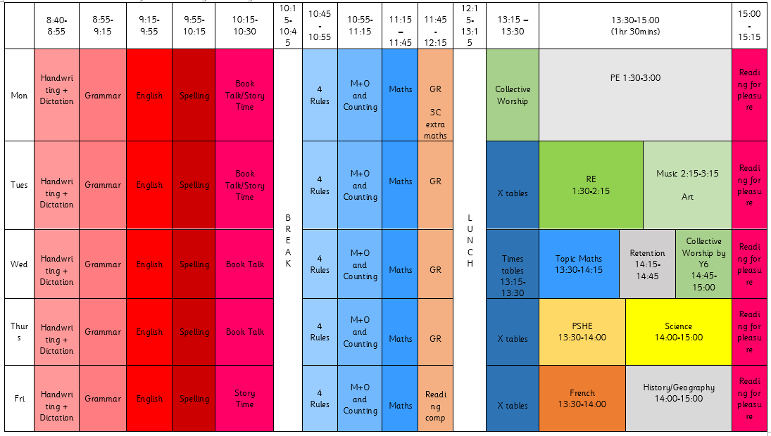
TIMETABLE
Notes:
- Here is an overview of our timetable. There is some variation between the classes, e.g. Music instead of Art, but the hours dedicated to each subject are the same across the year group. DT and Computing blocks.
When art is being taught, please bring an old t-shirt that you don’t mind getting dirty.

Slide 4





SWIMMING
Swimming takes place on Fridays.
3C – September until February half term
3H – after the February half term until the end of the school year
Full swimming kit is required. This consists of swimming cap, swimming trunks or shorts (not too long below the knee) or a swimming costume. Bikinis must not be worn. Earrings and jewellery must not be worn on these days. Towels are needed in their swimming bags.

Slide 5
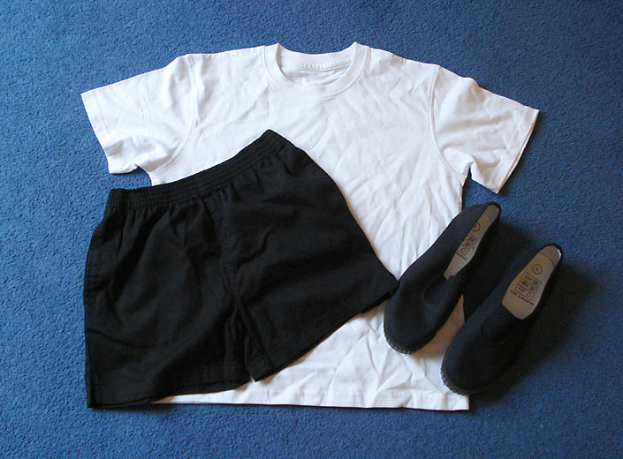
PE
PE is taught on Mondays. We ask that the children wear their PE kits for school. This is a plain white T-shirt, black shorts or leggings and pumps or trainers. If it is cold, the children can wear black tracksuit trousers and a school jumper over this kit.

Slide 6

HOMEWORK
Homework will consist of 3 things
1.Daily reading ( begin to write a sentence)
Two books once a week.
2. x tables practice (TTRS)
3.Spelling worksheet (Every Friday)
Notes:
Username and passwords will be stuck in the front of their reading diaries.
Finish reading – re read. a few pages a night will be fine.
Great for fluency understanding the words.

Slide 7

TTRS
TTRS practice should be daily to prepare the children to sit their multiplication check in Year 4.
There will be a weekly competition between both classes.
Notes:
Log in will be in childrens diaries.

Slide 8
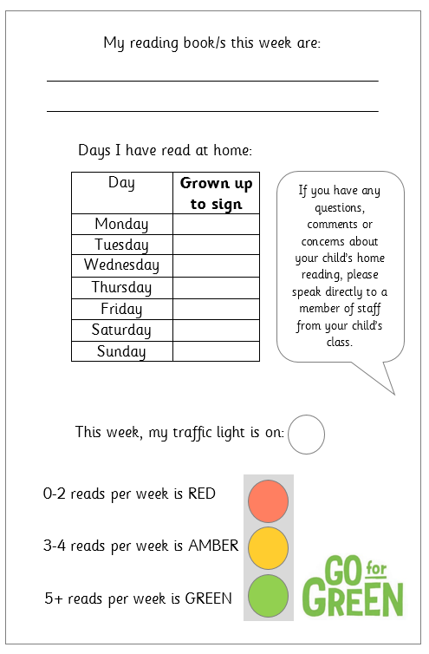

READING
Children will be expected to read every day an adult at home will sign their reading diaries 7 days a week.
The books will be checked by the adults in school daily.
Your child will have 2 new books every week.

Slide 9
FINAL REMARKS
Please keep us informed of any changes with regards to medication or dietary/allergy information.
We will send important information regarding trips etc through Parent Pay or in a letter.
Any questions, come let us know.

