Slide 1
Year 1 Parents’ Meeting
Y1C- Mrs Clifford
Y1E – Miss East

Slide 2
A typical Year 1 day
Morning
Phonics, handwriting, writing lesson
PLAYTIME (15 mins)
Maths
LUNCHTIME (1 hour)
Afternoon
Phonics, Reading Groups, Wider Curriculum (Religion, PE, Music, Geography, History, Art, Science)
Choosing time
7pm bedtime

Slide 3
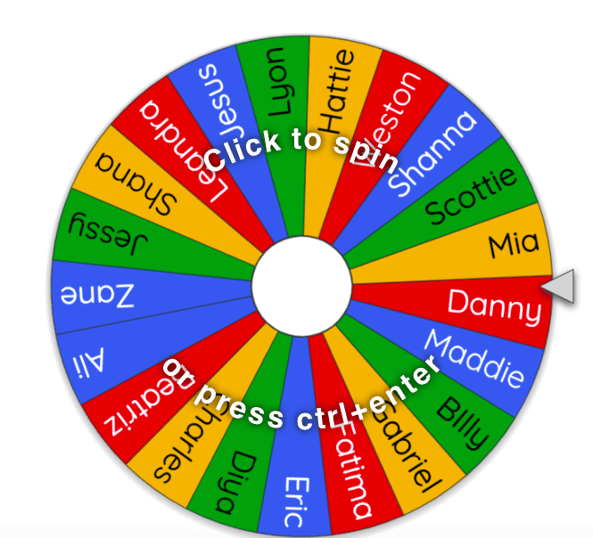

Drop off & Pick up
Classroom doors open at 8:40am
The school day begins at 8:45am
We politely ask all parents to remain on the playground at home time.
Notify class teacher if someone new is collecting your child.

Slide 4

Reading in Year 1
Your child will be assigned one e-book each week. This is the book they have read in school that week, which they should read fluently, or with very little support.
E-book logins are stuck on the inside front cover of reading diaries.
Your child will also bring home two phonics books each week. Please can you ensure reading books/diaries are in school every day. Please listen to your child read aloud every night and sign their reading diary, to show they have read.
Reading daily will not only improve your child’s fluency and confidence, but they will be able to take part in the reading rewards in their class- Traffic Light Treat Winner! ☺
Terrific Texts coming soon!

Slide 5
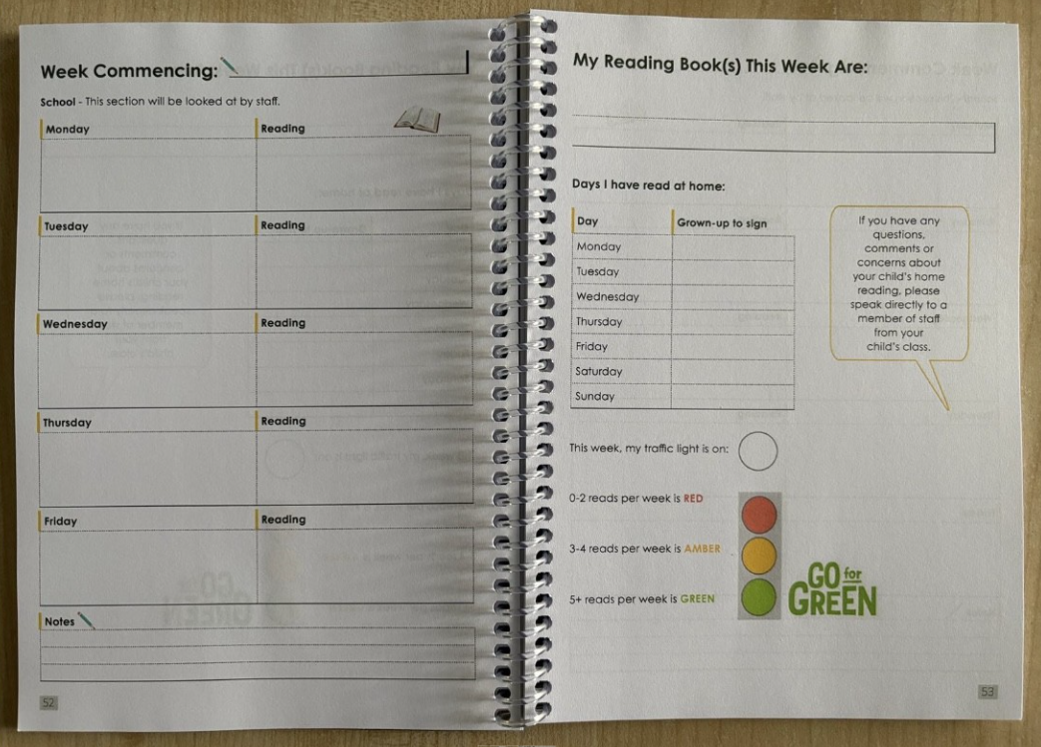
Reading

Slide 6
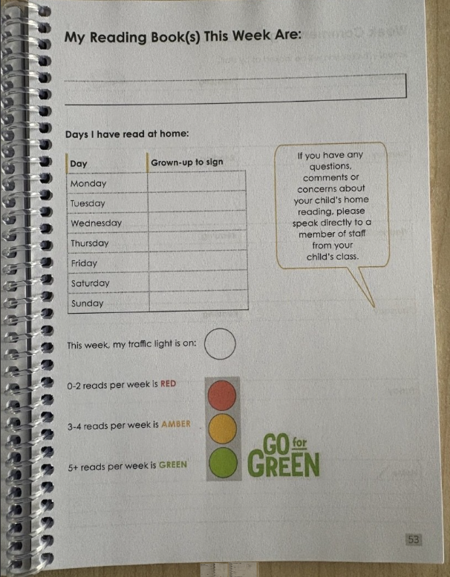

Slide 7
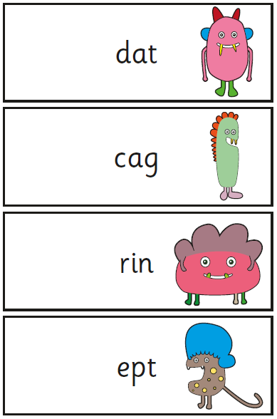
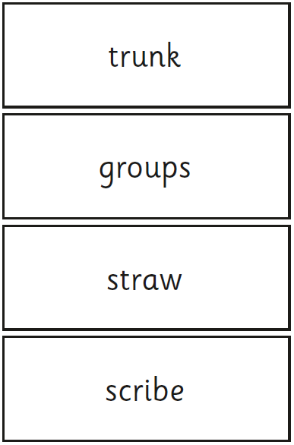
Year 1 Phonics Screening
Check
w/c Monday 14th June
20 real words
20 alien words

Slide 8

Weekly Spellings
Each week, we will send a word list home for your child to practise spelling, in preparation for a spelling quiz in school on a Friday.
The words will be decodable and tricky words taught in phonics that week so should be familiar to your child.
Please support your child to learn these words at home.

Slide 9
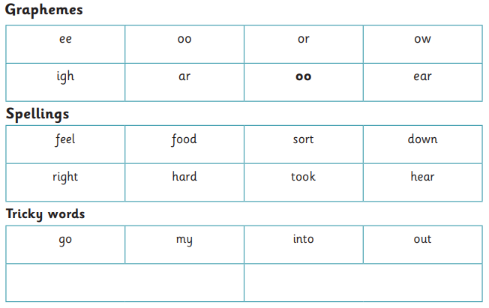

Slide 10
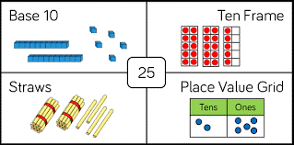
Maths
Key skills to practise:
Counting forwards and backwards within 100
Reading and writing numbers to 20
Writing number words to 20
Reading and writing numbers to 100 in numerals
1 more and 1 less – numbers up to 20
Ordering numbers within 100
Representing numbers in different ways (see example above)
Number bonds to 10 and then 20
Counting forwards and backwards within 100 in 2s, 5s and 10s.

Slide 11
PE
PE is every Friday.
Children should come to school wearing their PE kit.
PE kit should consist of plain black shorts/jogging bottoms/leggings and a white t-shirt with trainers/pumps.

Slide 12
Snack & Water
Children are encouraged to bring a (named) water bottle into school each day.
Children who have requested milk will receive it in the morning.
A fresh piece of fruit is provided at break time.
Your child may bring in a piece of fruit/healthy nut-free snack from home if they wish.

Slide 13






Healthy Snacks
Fresh vegetables or fruit
Dried fruit
Yogurt tube/pouch
Bread sticks
Cheese
Cereal bar (no nuts or chocolate)

Slide 14
Year 1
Polite reminder that birthday treats are not permitted in school, to safeguard children with allergies.
If you wish, a book can be purchased which we would add to the class library and share with the children during Story Time.
Name any items of clothing brought into school- coats, jumpers, cardigans
Any questions throughout the year, please do not hesitate to ask.
Best time to speak to teachers: 8.40am or end of the day.

Slide 15

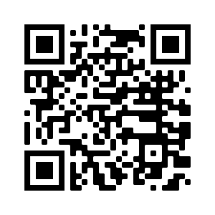
STOC Social Media @stthomassalford

Slide 16

Class Page

Slide 17

Thank you for coming!
Children will be released from the classrooms, in the usual way.

