Slide 1

Year 3: Parental Maths Workshop
Notes:
Good morning everyone, thank you for coming to our year 3 maths parental workshop.

Slide 2
Aims of the workshop
To give an insight into year 3 maths and some of the strategies we teach (including the language we use).
To aid you in supporting your child with their learning at home.
Notes:
Some strategies that the children come home and use may be different to the strategies that you learned as the curriculum is ever developing and changing. At the end of the powerpoint and on your hand outs are links to some fantastic maths resources which include video clips of taught sessions which are similar to the way that we teach these concepts in the classroom.

Slide 3
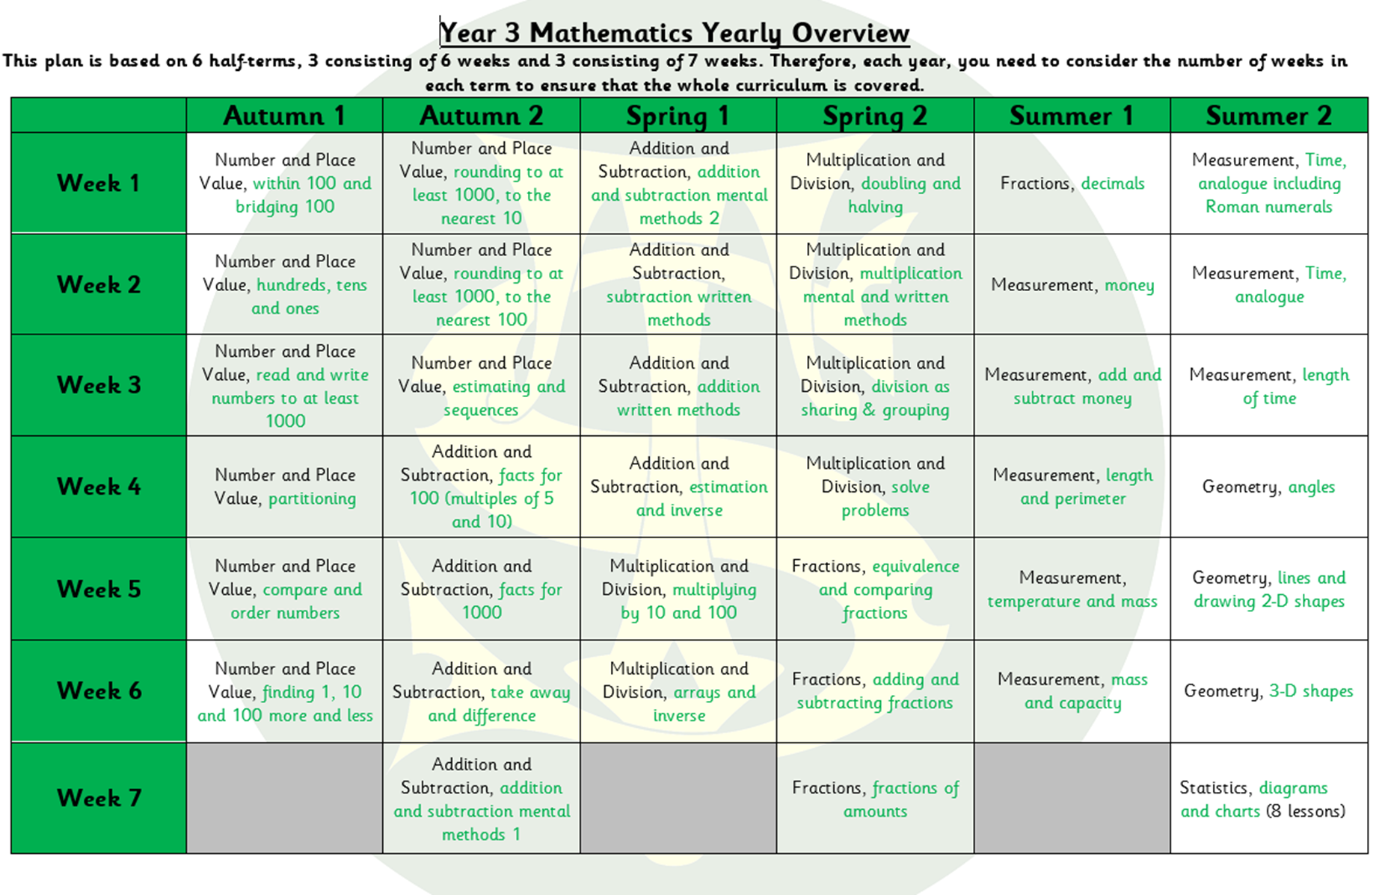
Our Maths Scheme
Notes:
This is the overview of what our year looks like for maths. We are in Spring 1 – Week 5 of our school year but are currently teaching content from Spring 1 – week 2. This is consistent across all year groups as we must consolidate learning before we move the children on in their learning. The children must have a secure understanding of place value and number, which is like the bread and butter, before they can explore layering anything further, being the four rules of number; addition, subtraction, multiplication and division.
Most parents at this point will ask what would be beneficial to teach children at home and we would recommend either revisiting what has already been taught or focusing on the summer content which explores more topical maths.
However, topics like time and statistics can be taught alongside.
We often find that children struggle with understanding the elements of time and also the concept of money as we use the concrete form of money less and less due to apple pay and card payments so getting a head start within these areas would also be beneficial.
Again the websites that you will find at the back of your maths packs have a range of online lessons, worksheets and support all free of charge and highly recommended.

Slide 4
What does a typical year 3 lesson look like?
10 minutes: 4 Rules
Recapping Year 2 objectives and teaching Year 3 objectives. Focus on the 4 rules of number: addition, subtraction, multiplication and division.
20 minutes: Mental and Oral & Counting
15 minutes revisiting learnt skills from Year 2 and 3.
5 minutes counting in 4’s, 8’s and 3’s (revisit 10’s, 5’s and 2’s from Year 2)
20 minutes: Maths lesson
Working through the Y3 maths scheme
15 minutes of Times Tables practice
Bespoke to the individuals
Notes:
There are many elements to a typical maths lesson and we break our learning into four steps.
The first being 4 rules
We begin the first half term recapping the previous year groups objectives before layering the year 3 objectives on top. 4-rules is almost a pre teach of skills that the children will be taught within the maths lesson and It gives them some prior knowledge before the lesson.

Slide 5
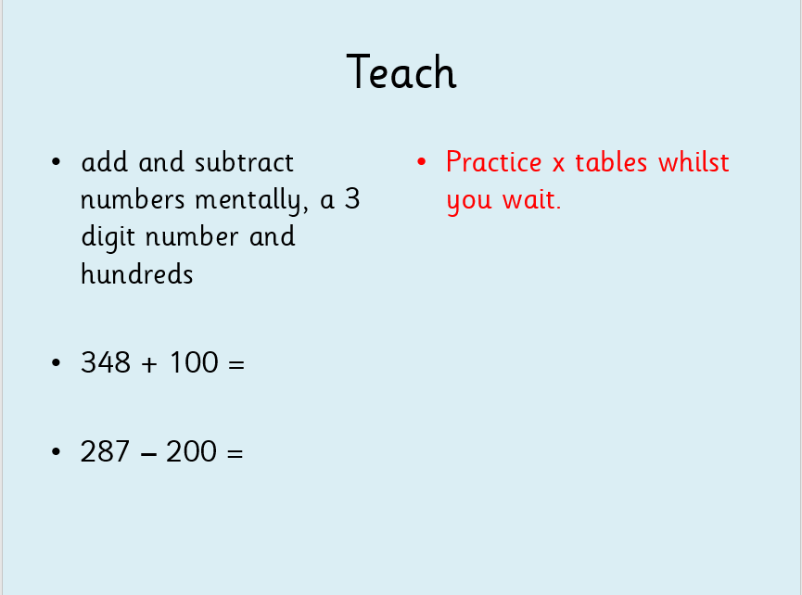
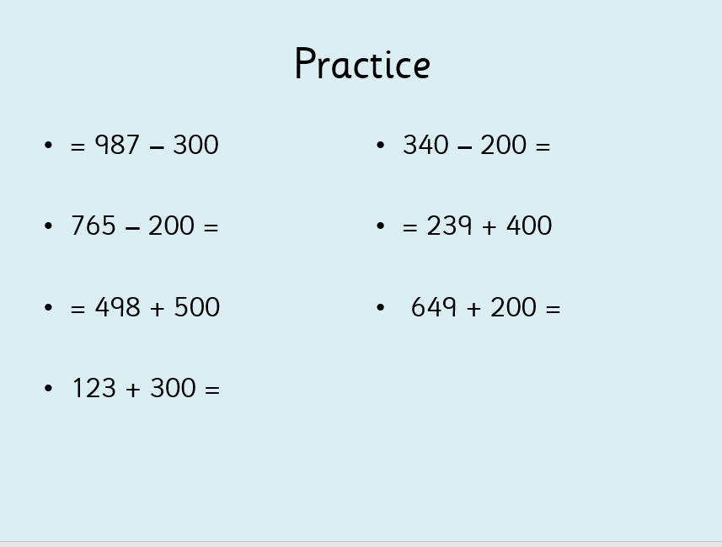
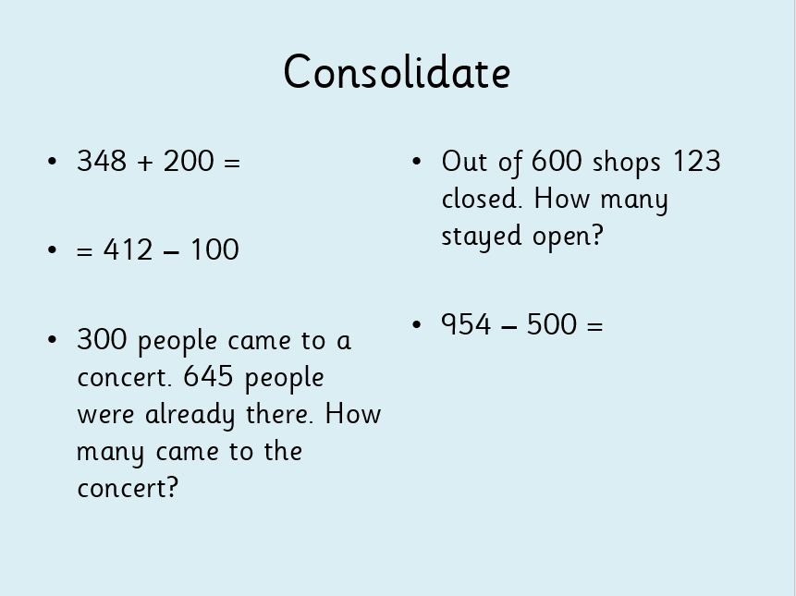
4 Rules
Notes:
In year 3, this lesson is typically displayed on the board as soon as the children walk into the classroom so it is important that the children are in on time as much as they possibly can be to ensure that they don’t miss out on this key learning.
We begin with a teaching element in which we will model the strategy in a number of ways and encourage the children to join in. Then they have a go of practicing this strategy independently before ‘consolidating’.
This is where they will be applying the new strategy in different ways including word problems.
By the end of consolidate section, we will be expecting the children to be able to explain how their strategy works. For this strategy for instance, we would expect the children to be explaining that when we are adding or subtracting a multiple of 100, the tens and the ones never change because they have a lesser value.
We need to focus on the hundreds column and can use facts that we already know to work the calculation out. 3+1=4 so 3 hundreds + one hundred would add up to 4 hundreds.

Slide 6
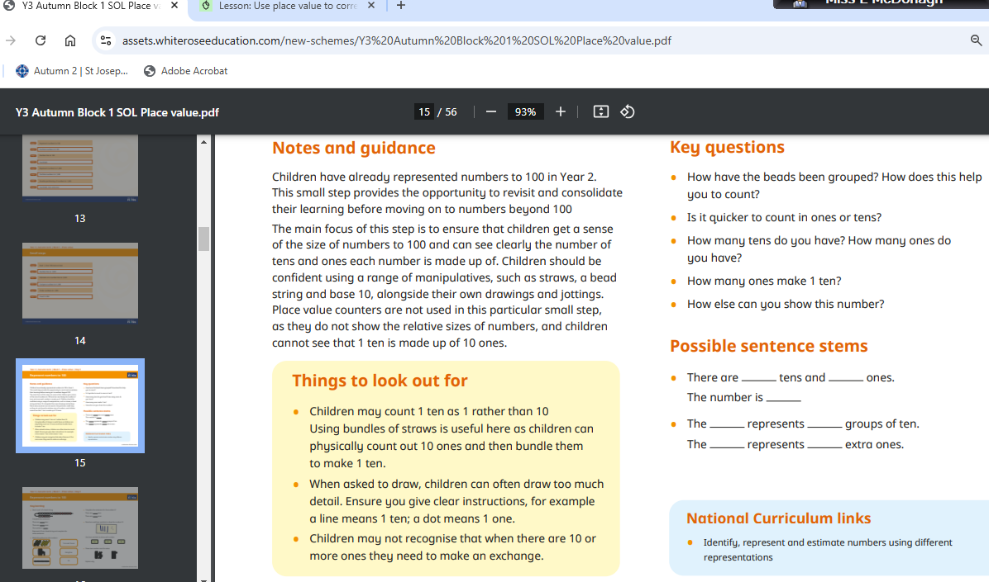
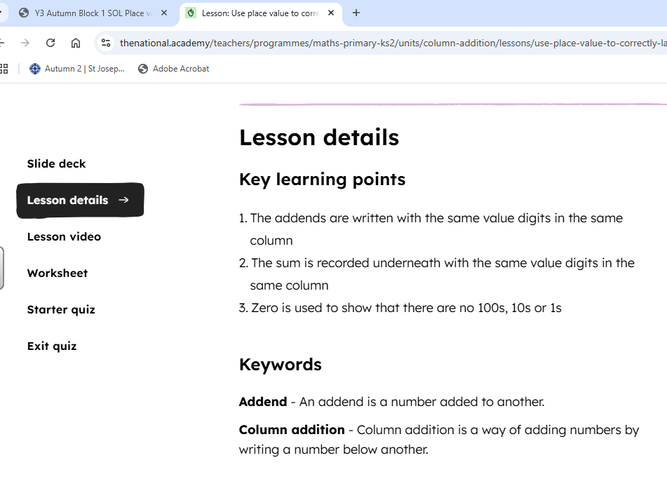
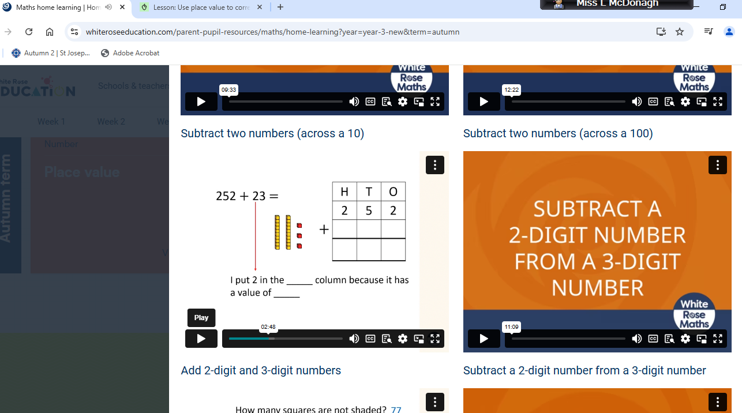
https://whiteroseeducation.com/parent-pupil-resources/maths/home-learning?year=year-3-new
https://www.thenational.academy/pupils/programmes/maths-primary-year-3/units
Notes:
If your concern is around the language of mathematics or how to pose questions, the online resources explain key vocabulary and also provide key questions for you to be asking the children which will mirror what is being taught in class.
Stem sentences are a good way to scaffold the learning for the children to be able to better explain strategies and their thinking.

Slide 7
What does a typical year 3 lesson look like?
10 minutes: 4 Rules
Recapping Year 2 objectives and teaching Year 3 objectives. Focus on the 4 rules of number: addition, subtraction, multiplication and division.
20 minutes: Mental and Oral & Counting
15 minutes revisiting learnt skills from Year 2 and 3.
5 minutes counting in 4’s, 8’s and 3’s (revisit 10’s, 5’s and 2’s from Year 2)
20 minutes: Maths lesson
Working through the Y3 maths scheme
15 minutes of Times Tables practice
Bespoke to the individuals
Notes:
We then move onto M+O
At the back of your packs there is an objectives sheet that looks like this which outlines the objectives that have already been taught. Frequent revisiting of previous skills allows the children to dip back into that long term memory and choose the most efficient strategy. We will then use lolly sticks like these to explore strategies and discuss the most beneficial one. This lesson is supposed to be quick as the children are required to use the most efficient mental strategy. Lets have a look at what a M+O lesson looks like.

Slide 8
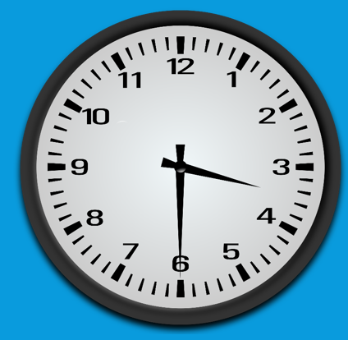
Mental and Oral
652-30=
360 + ___ = 1000
Halve this number
Choose two of these numbers and use the less than symbol.
Subtract 300
___ ÷ 3 = 11
Write these numbers in descending order.
What is the time?
Notes:
622
311
11
33
640 64 link
640, 622, 311, 33, 11

Slide 9
What does a typical year 3 lesson look like?
10 minutes: 4 Rules
Recapping Year 2 objectives and teaching Year 3 objectives. Focus on the 4 rules of number: addition, subtraction, multiplication and division.
20 minutes: Mental and Oral & Counting
15 minutes revisiting learnt skills from Year 2 and 3.
5 minutes counting in 4’s, 8’s and 3’s (revisit 10’s, 5’s and 2’s from Year 2)
20 minutes: Maths lesson
Working through the Y3 maths scheme
15 minutes of Times Tables practice
Bespoke to the individuals
Notes:
After the mental oral we move onto our main maths lesson which follows the CPA approach.

Slide 10
Place Value
Recognise the value of each digit in a 3-digit number.
In the number 854, the 8 represents 800 (or 8 hundreds), and the 5 represents 50 (or five tens) and the 4 represents 4 ones.
Recognise the value in tenths and hundredths in decimal numbers.
Counting:
In steps of 10, 5, 2, 4, 8, 3, 50, 100
Counting in 100s starting from 200: 200, 300, 400, etc.
Compare and order numbers up to 1,000.
Is 337 greater or smaller than 331?
Notes:
We can show you what the CPA approach looks like using place value.
Place value in year 3 explores…..

Slide 11
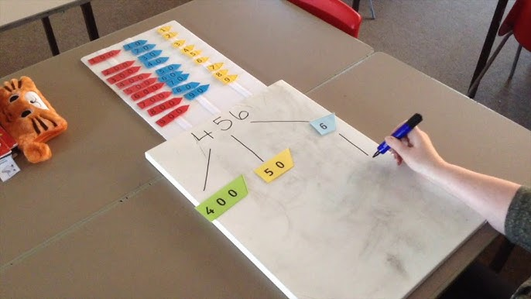
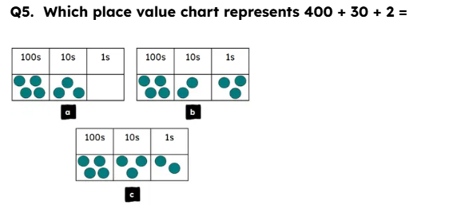
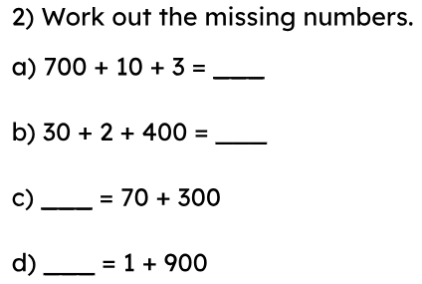
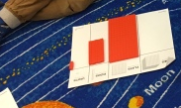
CPA approach – Represent numbers to 1,000
Concrete
Pictorial
Abstract
Notes:
We use concrete materials/resources to explore a new concept before moving onto the pictorial stage and finally recording abstractly which simply means recording the numerals without visualising the number or working with manipulatives.
If you are finding that your child is struggling with answering abstract questions like the one shown then they would benefit from going back to the concrete stage so that they can better visualise the question being asked and make links to the abstract and concrete stages.

Slide 12
How we teach maths at STOC
1. Fluency
2. Reasoning
3. Problem Solving
Applying fluency skills to explain and support their thinking
Fluency is efficient recall of key number facts and procedures
Applying and choosing the correct fluency skills to problems and make connections
Notes:
During the CPA approach, the children have been building their understanding of the key concept and their fluency. Once secure, we will move on to reasoning and finally embedding with problem solving.

Slide 13
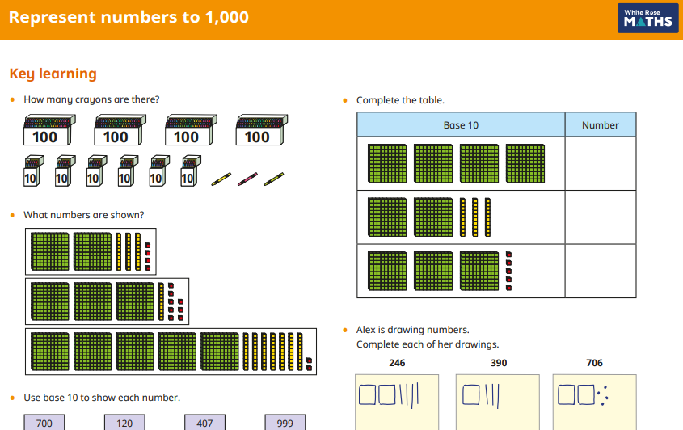
Teaching a new learning objective: Fluency
Notes:
This fluency is taken from the White rose maths and as you can see, the children are asked to recognise and represent number in a range of question styles.
This is really beneficial as they aren’t getting used to seeing questions appear in a simple abstract format.

Slide 14
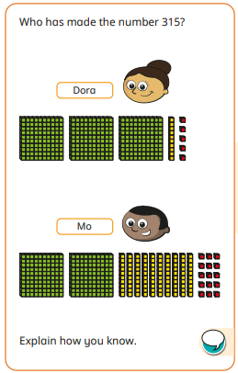
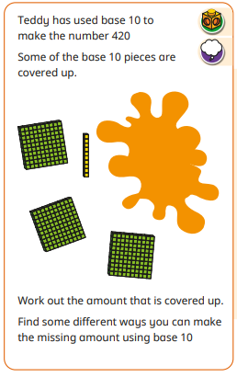
Reasoning and Problem Solving
Notes:
110 multiple possible answers, e.g. 1 hundred and 1 ten 11 tens 10 tens and 10 ones 50 ones and 6 tens

Slide 15
What does a typical year 3 lesson look like?
10 minutes: 4 Rules
Recapping Year 2 objectives and teaching Year 3 objectives. Focus on the 4 rules of number: addition, subtraction, multiplication and division.
20 minutes: Mental and Oral & Counting
15 minutes revisiting learnt skills from Year 2 and 3.
5 minutes counting in 4’s, 8’s and 3’s (revisit 10’s, 5’s and 2’s from Year 2)
20 minutes: Maths lesson
Working through the Y3 maths scheme
15 minutes of Times Tables practice
Bespoke to the individuals
Notes:
Finally we have our times tables practice which ends with a multiplication and division test on a Friday. This is bespoke to the children depending on whether they are skill working on learning their facts, practising their speed and some children who have passed all of the challenges in year 3 do work as experts to teach strategies and fact relationships to their peers.

Slide 16
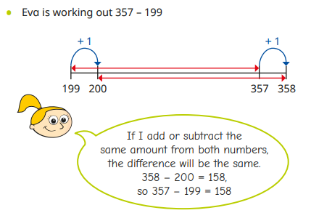
Addition and Subtraction – Mental Strategies
Mental Strategies:
Can help children become quick mathematicians.
60 + 30 = 90 (rounding and adding tens first).
Subtraction using a number line: 500 - 238.
Notes:
Mental strategies are required during our mental and oral stage of maths.

Slide 17
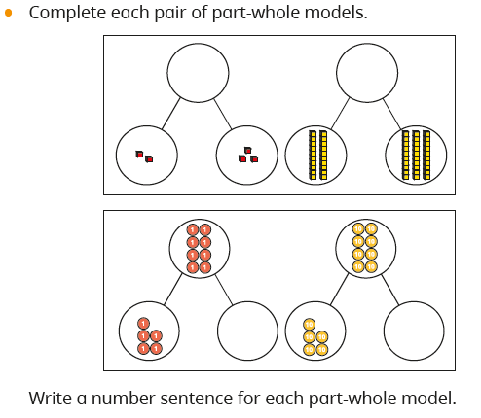
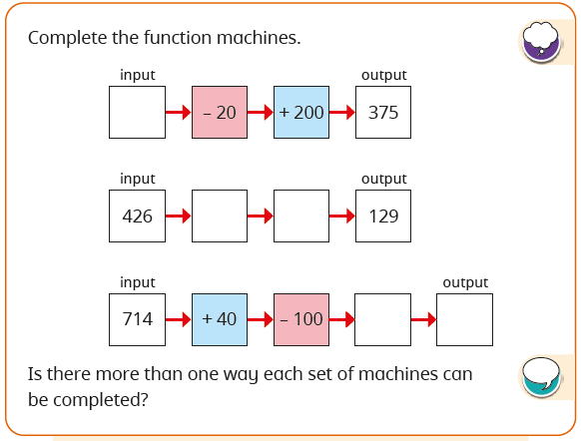
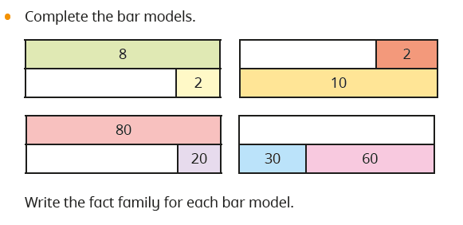
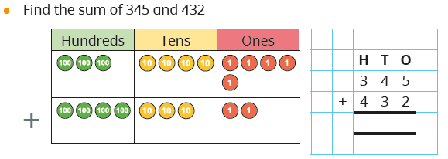
Addition and Subtraction – Column Method
Adding and subtracting numbers up to 3 digits using column method.
413 + 261 = 674
Different representations – bar model, word problems.
Challenge children – able to spot mistakes, inverse etc
Notes:
Going back to our maths learning, let’s look at a couple of learning objectives. In year 3, the children are taught to use a range of mental strategies to work out calculations.
Column method is a quick and efficient way for the children to work out calculations.
Explain language – carry 1 x exchange the 10 for 10 ones.

Slide 18
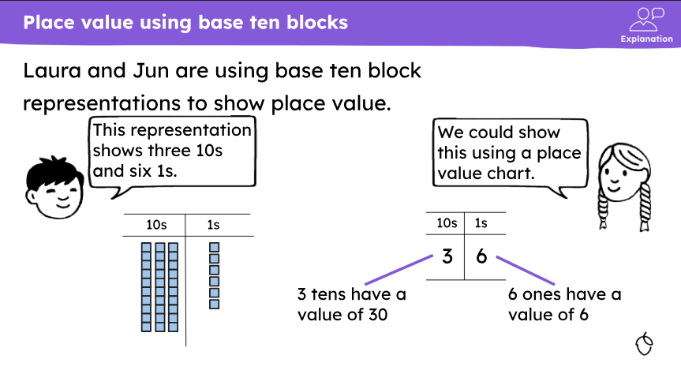
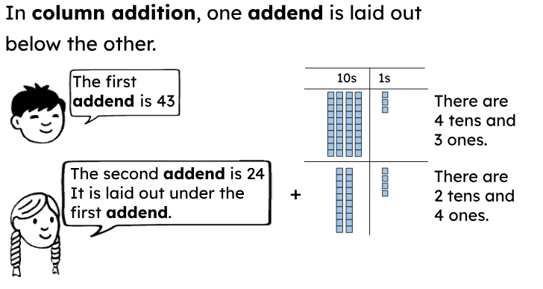
Notes:
The national academy is a fantastic resource that teaches the step by step lessons for each new concept
If we have a look at this lesson of column addition, it revisits prior learning to make links to new concepts.

Slide 19
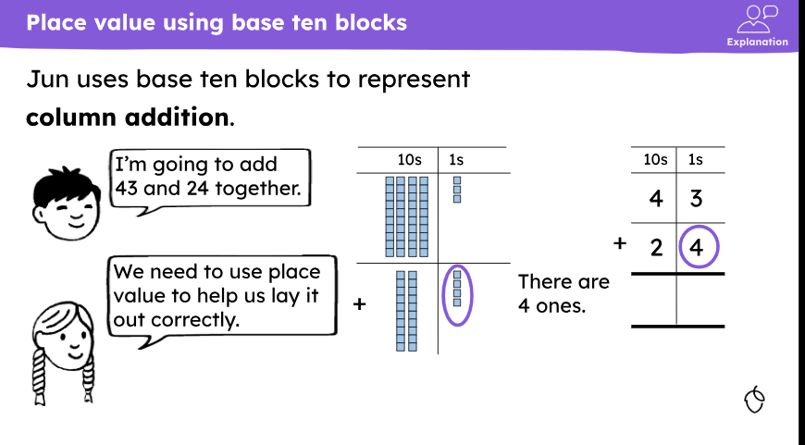
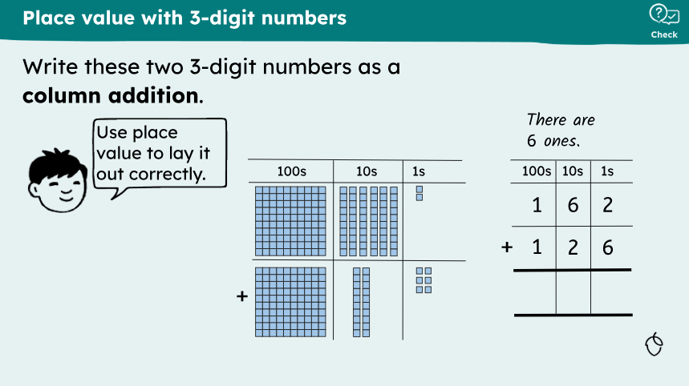

Slide 20
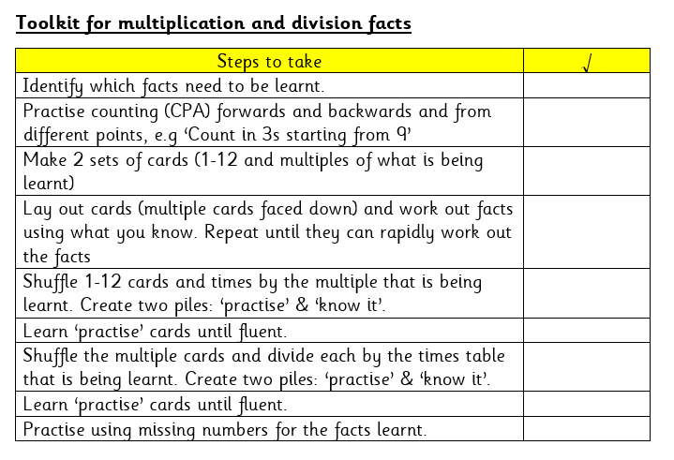
Multiplication and Division
Notes:
Let’s have a look at one of these lessons looks like. We have some volunteer children that will demonstrate the use of facts.
4s – How can you work out 9 x 4 based on the relationship with 10 x 4.

Slide 21
Multiplication and Division
Next year in year 4, children will take the multiplication tables check, required by the government. It comprises 25 questions and the children have 6 seconds to answer.
Important for children to know times tables before Y5 as the Y5 maths curriculum heavily relies on multiplication knowledge.
Times Table Rock Stars
Sing times tables songs. There are hundreds available! Put them on in the car, bath time or any ‘free’ time where you have a few spare minutes.
Chanting the old-fashioned way: rehearse the tables forwards and backwards, gradually increasing in speed.
Write out the tables. This can be in the form of a simple list or you could also be a bit more fun. Being creative will make writing and learning the tables more enjoyable.

Slide 22
Thank you!

