Slide 1

WELCOME TO YEAR 4
St Thomas of Canterbury RC Primary School
Notes:
Rosie

Slide 2
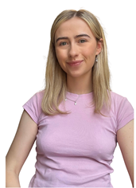

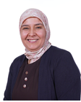
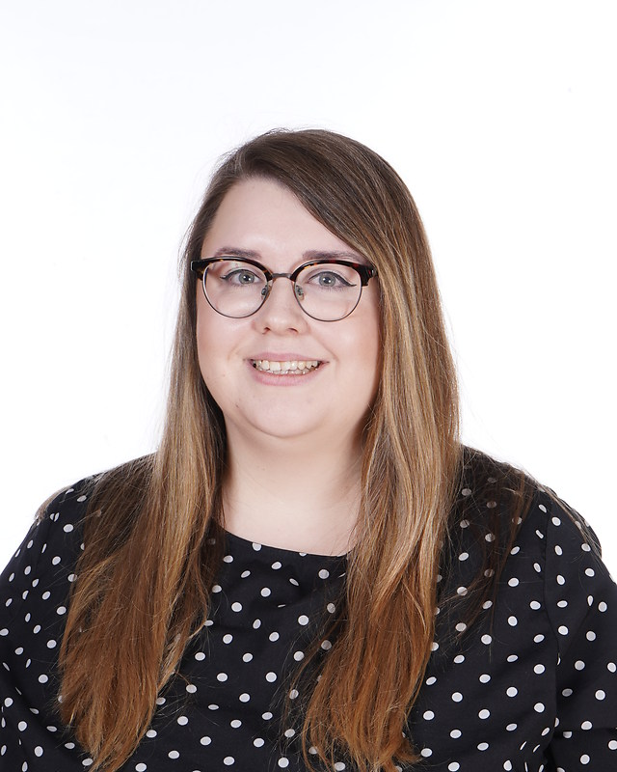
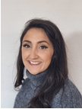

Year 4 team
Year 4C
Ms Camplin
Ms Fay
Ms Bouster
Year 4S
Ms Sale
Ms Albanese
Ms Carroll
Notes:
Rosie - The whole team are committed to giving your child the highest quality education possible and we promise to help them in as many ways as we can. If you have any questions about anything, please come and talk to us.

Slide 3
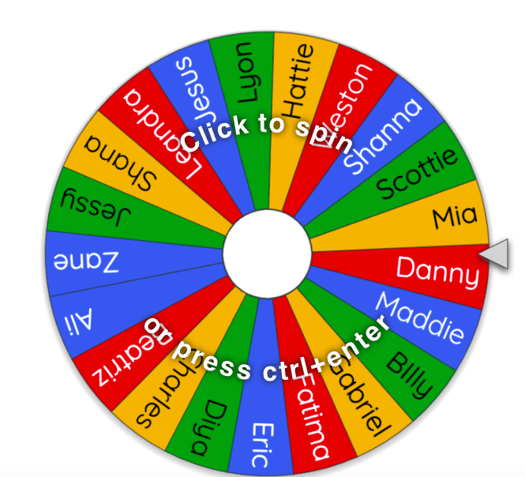

DROP OFF AND PICK UP
The school day begins at 8:45am
Classroom doors open at 8:40am
Collect your child promptly at 3:15pm
We politely ask all parents to remain on the playground at home time.
Notify class teacher if someone new is collecting your child.
Notes:
Zoe

Slide 4
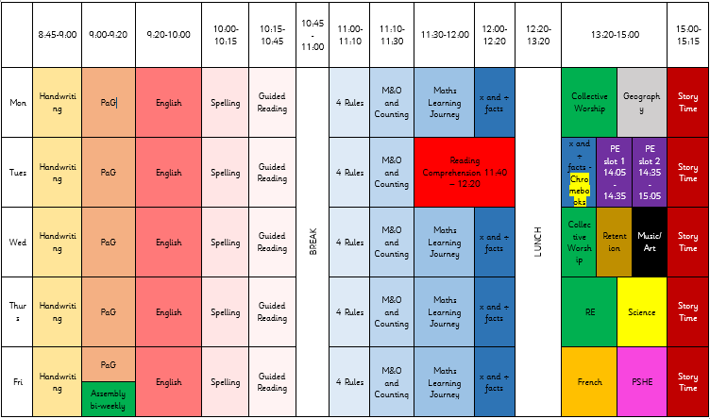
TIMETABLE
Notes:
Zoe - Here is an overview of our timetable. There is some variation between the classes, e.g. Music instead of Art, but the hours dedicated to each subject are the same across the year group. DT and Computing blocks.

Slide 5
A typical year 4 day
Morning
Handwriting, grammar, spellings, writing lesson
PLAYTIME (15 mins)
Maths, times tables
LUNCHTIME (1 hour)
Afternoon
Wider Curriculum (Religion, PE, Music, Geography, History, Art, Science)
7pm bedtime (9-11 hours)

Slide 6

READING
Children will be expected to read every day and sign their reading diaries 5 days a week. We expect them to do this by themselves.
We encourage the children to write a short summary of what they have read in the book. These will be checked by the adults.
Your child’s book will be changed every Friday.
Notes:
Rosie- Children may have the same book over a few weeks. Just ask them to write what page they are up to in the box. Children will read during break time if they haven’t read at home.

Slide 7
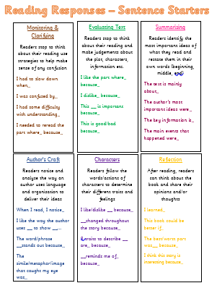
READING
Notes:
Rosie - Children may have the same book over a few weeks. Just ask them to write what page they are up to in the box. Children will read during break time if they haven’t read at home.

Slide 8
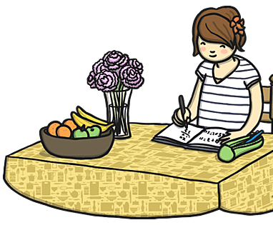
HOMEWORK
Homework will consist of 3 things
1.Daily reading (writing a summary sentence)
One book a week.
2. x tables practice (TTRS)
3.Spelling worksheet (Every Friday)
Notes:
Zoe- Username and passwords will be stuck in the front of their reading diaries.
Finish reading – re read. a few pages a night will be fine.
Great for fluency understanding the words.

Slide 9
HOMEWORK - Spellings
Homework will be given out every Friday (starting the Friday just gone) . This must be completed by the following Monday, giving children the weekend to complete the work.
If children do not do the homework over the weekend, they will complete it during break time.
Notes:
Zoe

Slide 10
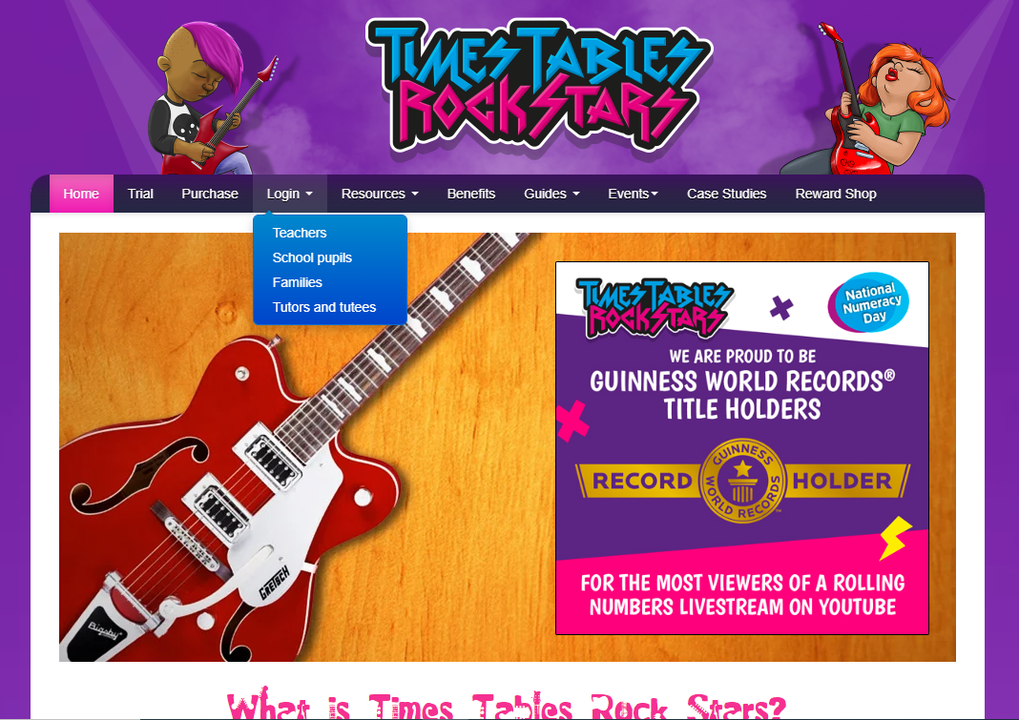
TTRS
TTRS practice should be daily to prepare the children to sit their multiplication check in Year 4.
There will be a weekly competition between both classes.
Notes:
Zoe Log in will be in childrens diaries.

Slide 11
Multiplication tables check (MTC)
All year 4 children will take the multiplication tables check, required by the government. It comprises 25 questions and the children have 6 seconds to answer.
TTRS is a brilliant way for children to learn their times tables.
Other useful websites – timestables.co.uk, top marks
Notes:
Rosie - As you may already know, Year 4 children across the country will be doing the statutory government MTC. The purpose of the MTC is to determine whether pupils can recall their times tables fluently, which is essential for future success in mathematics. It will help schools to identify pupils who have not yet mastered their times tables, so that additional support can be provided.

Slide 12
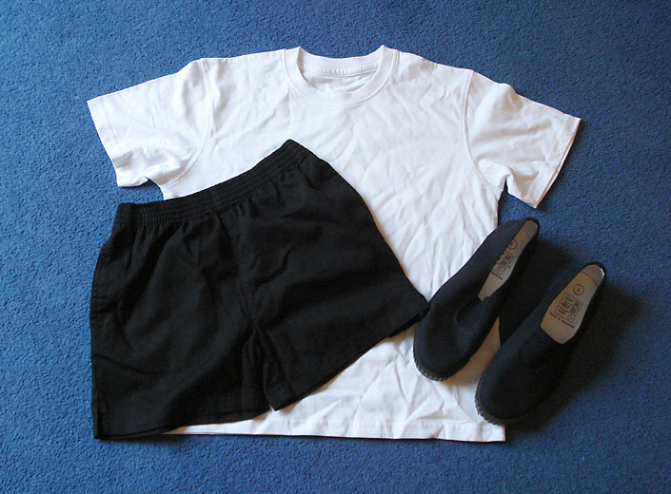
PE
PE is taught on Tuesdays. We ask that the children wear their PE kits for school. This is a plain white T-shirt, black shorts or leggings and pumps or trainers. If it is cold, the children can wear tracksuit trousers and a sweatshirt over this kit. We do gymnastics/dance on a Tuesday as well as games. The children need to have shorts and leggings for this as tracksuit trousers can catch on the equipment.
Notes:
Rosie

Slide 13
Birthdays
Polite reminder that birthday treats are not permitted in school, to safeguard children with allergies.
A book can be purchased which we would add to the class library and shared with the children.
Name any items of clothing brought into school- coats, jumpers, cardigans
Any questions throughout the year, please do not hesitate to ask.
Best time to speak to teachers: 8.40am.
Notes:
Rosie

Slide 14
FINAL REMARKS
Please keep us informed of any changes with regards to medication or dietary/allergy information.
We will send important information regarding trips etc through Parent Pay or in a letter.
Any questions, come let us know.
Notes:
Rosie

Slide 15
Thank you for coming!
Children will be released from classrooms in the usual way.

