Slide 1
Maths in Year 1
Mrs Clifford & Miss Power

Slide 2
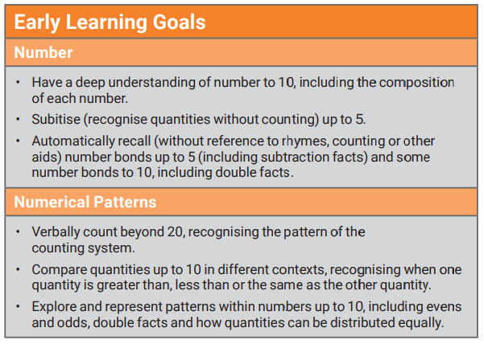

Slide 3
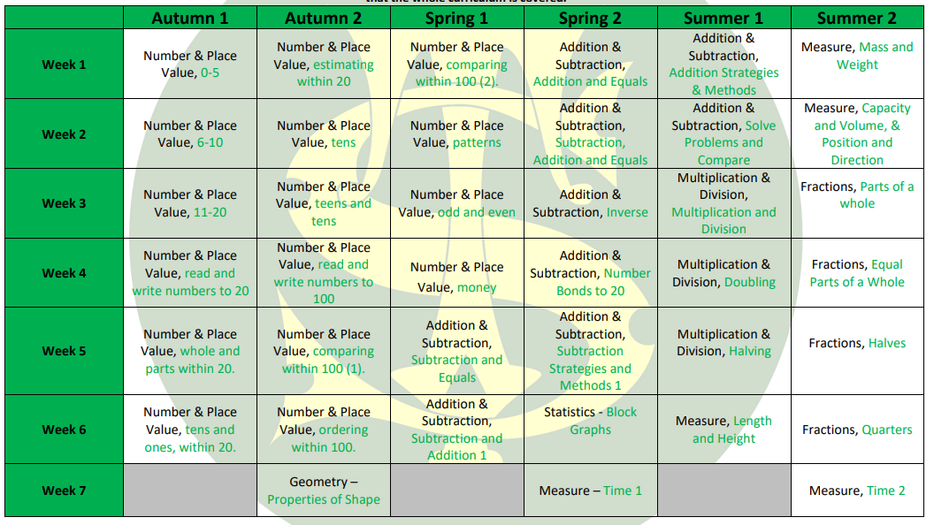

Slide 4
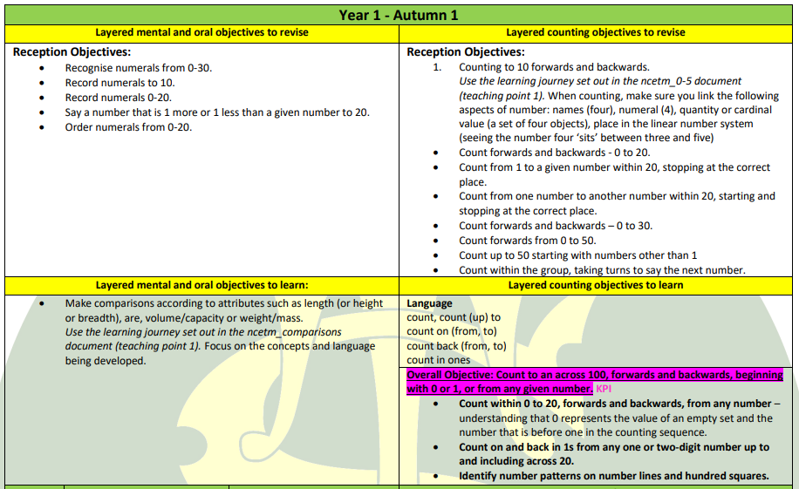

Slide 5
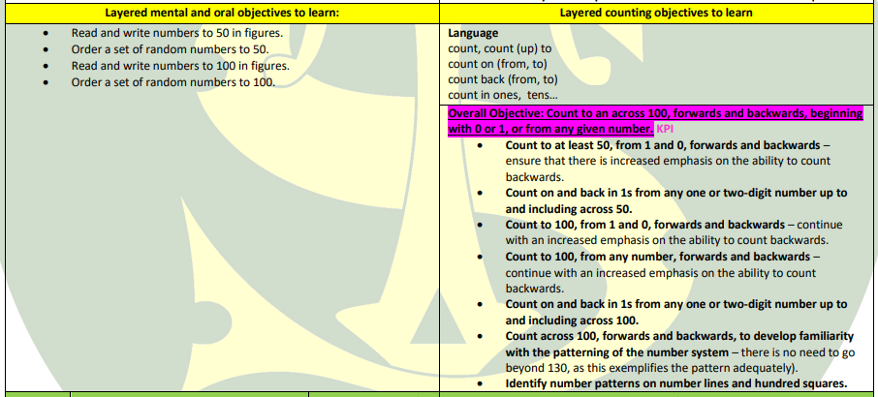

Slide 6
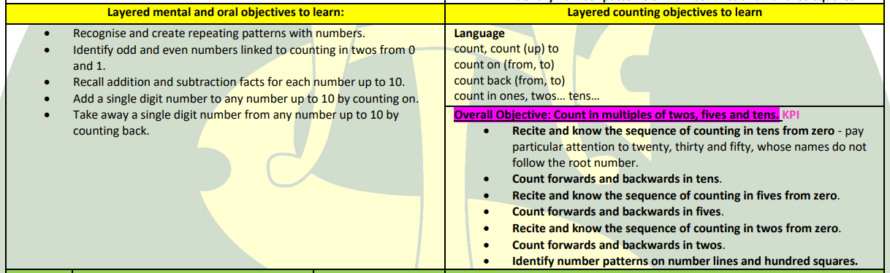

Slide 7
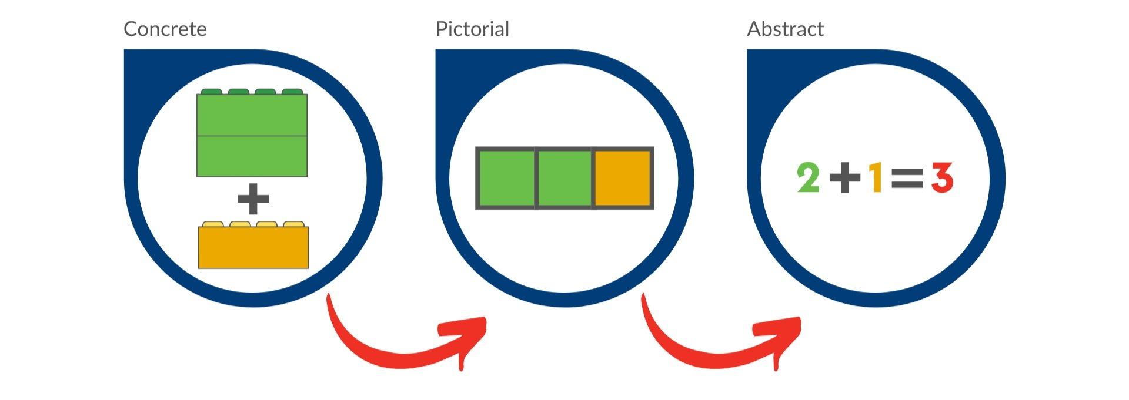
CONCRETE PICTORIAL ABSTRACT
Notes:
Share resources- Base 10, beadstrings, Numicon etc. Pictorial- number representations.

Slide 8
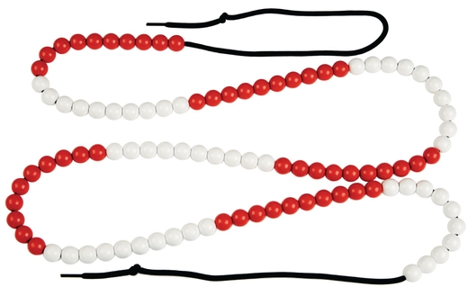
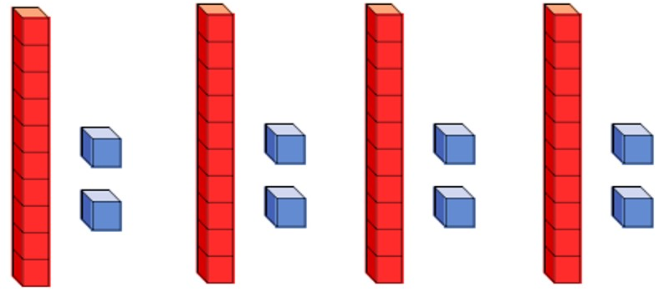
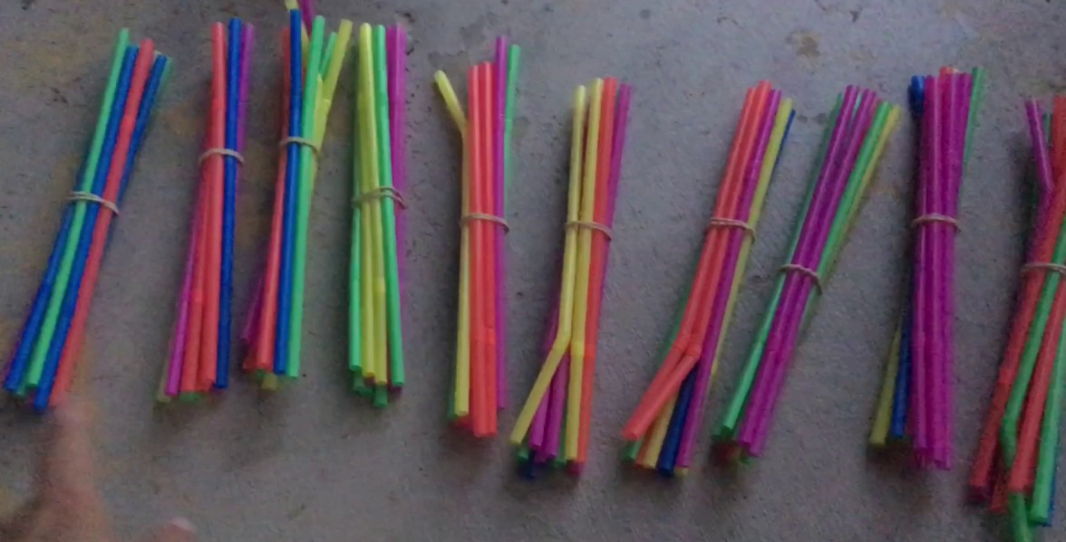
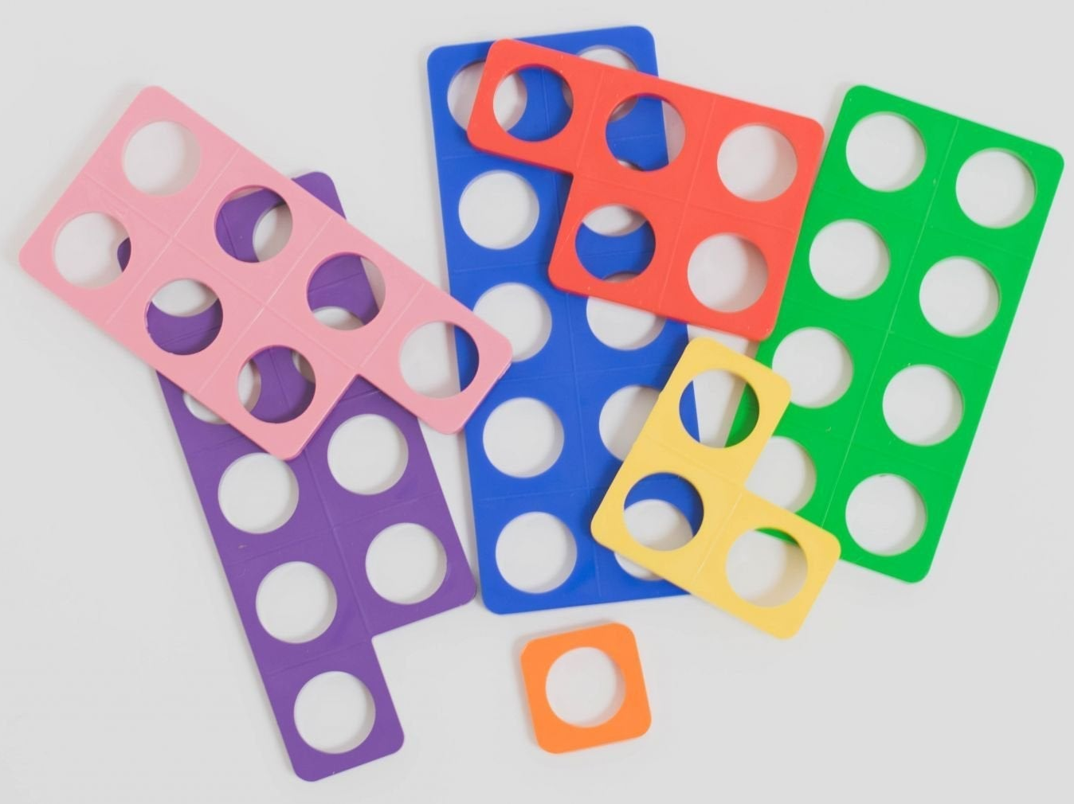
CONCRETE MATERIALS

Slide 9

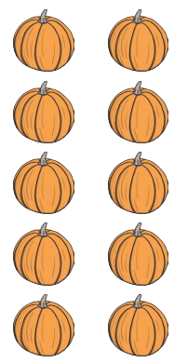

PICTORIAL

Slide 10
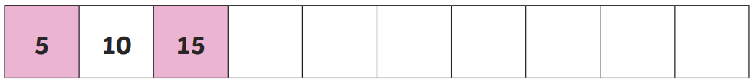
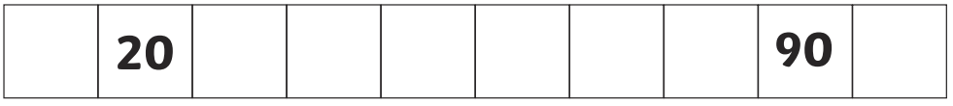


ABSTRACT

Slide 11
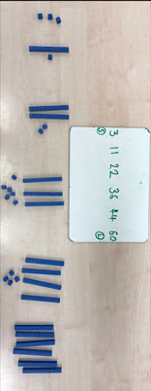
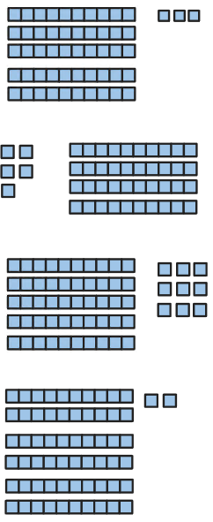


ORDERING NUMBERS
CONCRETE
ABSTRACT
PICTORIAL

Slide 12
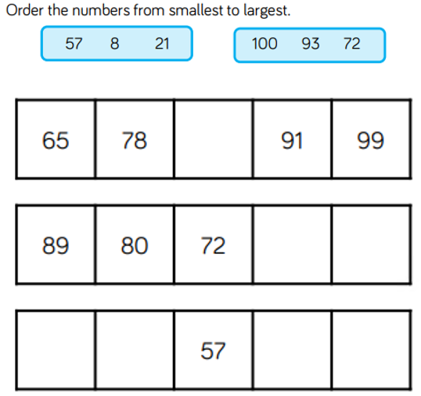
Fluency, Reasoning and Problem Solving
Fluency

Slide 13
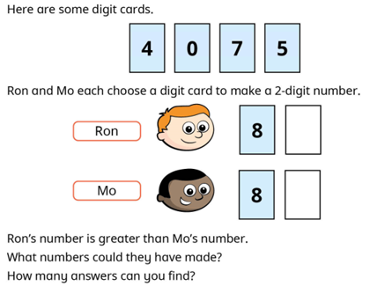
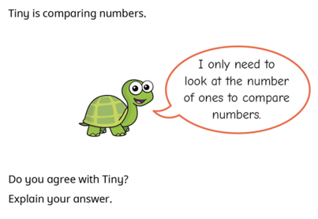
Reasoning and Problem Solving

Slide 14
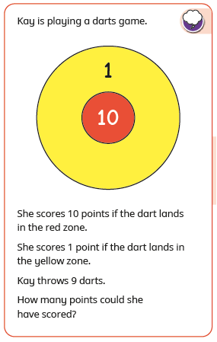
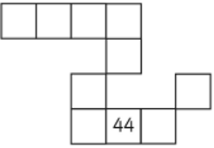
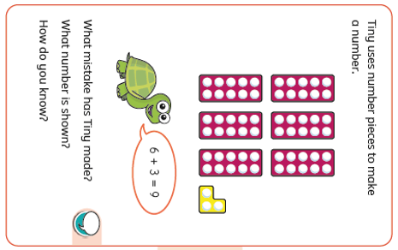
Reasoning and Problem Solving continued…

Slide 15
Maths at Home
Key skills to practise:
Counting forwards and backwards within 100
Writing number words to 20
Reading and writing numbers to 100 in numerals
1 more and 1 less – numbers up to 20
Ordering numbers to 100
Number bonds to 10
Number bonds to 20

Slide 16
Year 1
Any questions please do not hesitate to ask.
Best time to speak to teachers: 8.40am or 3.15pm

Slide 17
Thank you for coming!
Children will be released from classrooms, at home time, in the usual way.

