Slide 1

WELCOME TO YEAR 5
St Thomas of Canterbury RC Primary School
Notes:
Charlotte

Slide 2
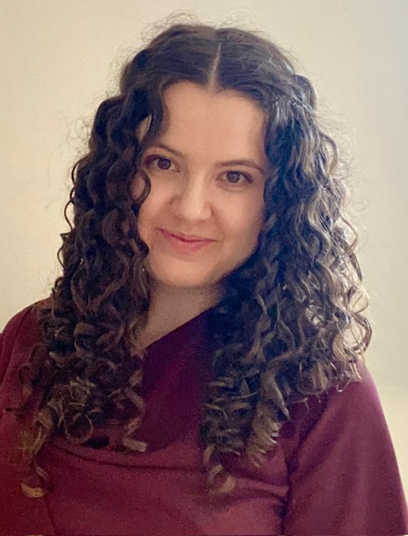
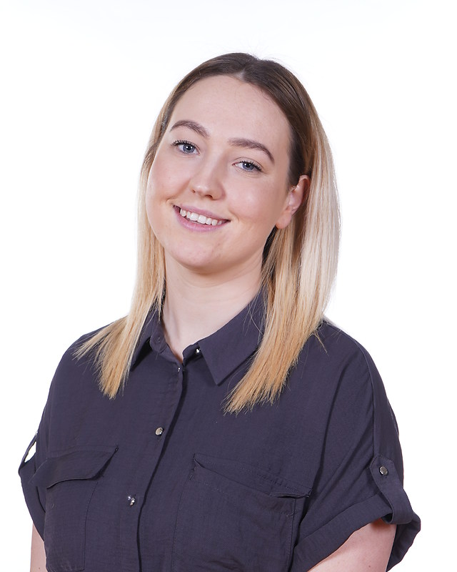
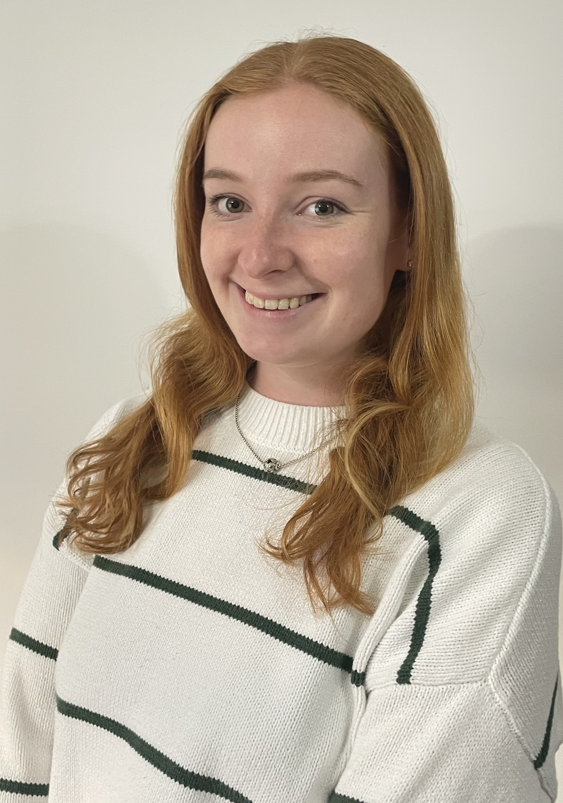
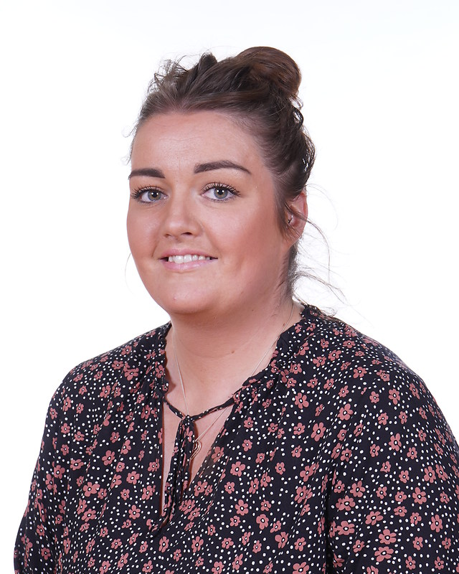
Year 5 team
Year 5C
Miss Connolly
Mrs Sutton
Year 5B
Miss Blackburn
Miss Dawson
Notes:
Issie - The whole team are committed to giving your child the highest quality education possible and we promise to help them in as many ways as we can. If you have any questions about anything, please come and talk to us.

Slide 3

Start times
We start school at 8:40
If the children are late (after 8:45am) they will be missing out on valuable learning time and will get a late mark.
If they children are on time every day, they will be in for a chance to win a prize each morning and entered into ‘Dine with Deane’ competition weekly.
School finishes at 3:15pm daily.

Slide 4
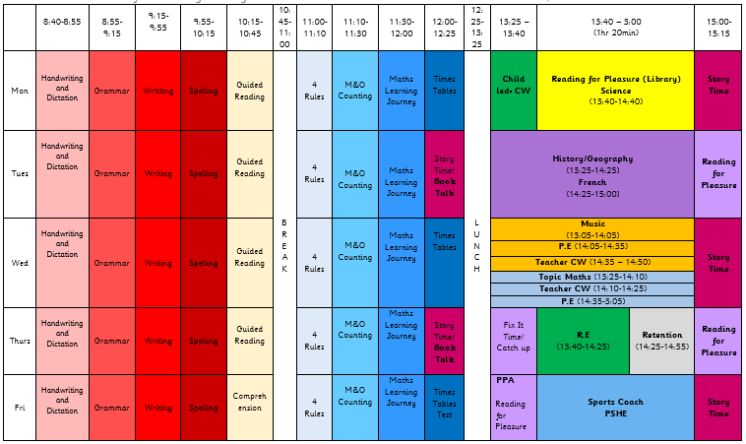
Notes:
Issie - Here is an overview of our timetable. There is some variation between the classes, e.g. Music instead of Art, but the hours dedicated to each subject are the same across the year group. DT and Computing blocks.

Slide 5

READING
Children will be expected to read every day and they have to sign their reading diaries 5 days a week. We expect them to do this independently for at least 10 minutes every evening.
We encourage the children to write a short summary of what they have read in the book. There are sentence starters at the back of their reading diary, to support if needed.
These will be checked by the adults daily.
Your child’s book will be changed, when they have finished it.
Notes:
Laura - Children may have the same book over a few weeks. Just ask them to write what page they are up to in the box. Children will read during break time if they haven’t read at home. Challenge books – 6 over the year to achieve silver badge.

Slide 6
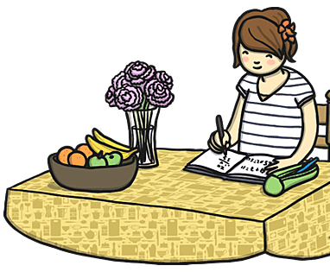
HOMEWORK
Each week we will send home a spelling sheet for the children to practise their weekly spellings.
This will be stuck in their red homework books. This will be checked by an adult every Monday.
We also ask that the children read each night and practise TTRS for 15min.
Notes:
Issie - TTRS log ins have been stuck in their reading diaries/homework books.

Slide 7
Multiplication and division facts
Every Friday, the children will complete a times tables test. The expectation for Year 5 to is to have completed 4 Gold by the end of the year. Children who have already passed this test will be complete more challenging tests.
TTRS is a brilliant way for children to learn their times tables. They all have their own log-ins.
Other useful websites – timestables.co.uk, top marks
Notes:
Laura

Slide 8
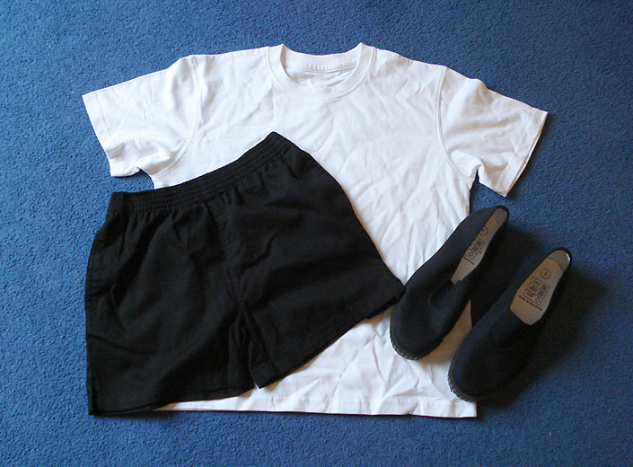
PE
PE is taught on Wednesday and Friday. We ask that the children wear their PE kits for school. This is a plain white T-shirt, black shorts, joggers or leggings and pumps or trainers. If it is cold, the children can wear tracksuit trousers and a sweatshirt over this kit.
We do gymnastics/dance on a Wednesday and games on Friday with a PE coach.
Notes:
Issie – uniform day to day has been great but remind about black shoes.

Slide 9
Walking home
In Year 5, the children, with parental permission, are able to walk home alone.
If you have decided it is too soon but change your mind later in the year, please send in signed note and then we will allow them to walk home alone.
These children are able to bring in a mobile phone, which will be locked in a cupboard all day, tuned off until home time. The children will not be allowed to use these to contact anyone during the school day. Please contact the office, if you need to pass a message on to your child.
Notes:
Laura - Reminder the children should be going home to somebody in the house.

Slide 10
Salford museum trip
As we are studying the Victorians this September, we have booked a trip to Salford Museum on the 23/9/24. This will immerse the children in Victorian history and provide them with a great head start to our topics in History and English.
We are asking for a contribution of £6 per child towards the museum workshop and coach travel. Please make sure you have paid your contribution.
The coach will leave Salford museum at 3pm and we hope to have arrived back at school by 3:15pm but it is likely, traffic dependent, that we will be a little late.
Children who are on school dinners will be provided with a packed lunch and a bottle of water from school. All children on pack lunches will need to bring their lunch as normal.
Notes:
Issie

Slide 11
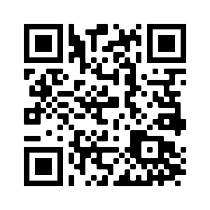

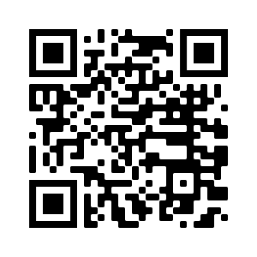


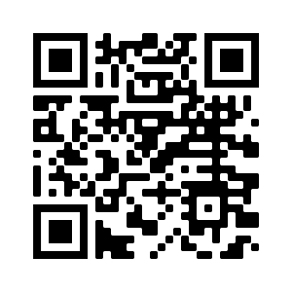
STOC Social media @stthomassalford
Notes:
Issie

Slide 12
FINAL REMARKS
Please keep us informed of any changes with regards to medication or dietary/allergy information.
We will send important information regarding trips etc through Parent Pay or in a letter.
Any questions, please ask.
Notes:
Laura

