Slide 1
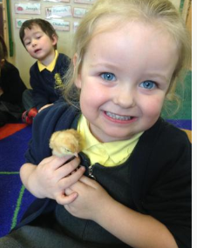
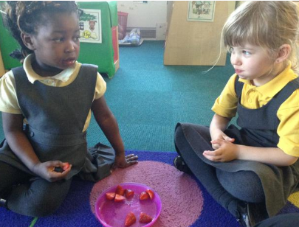
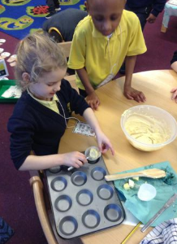
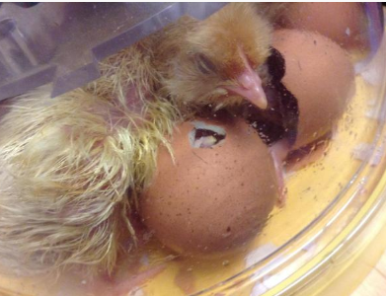
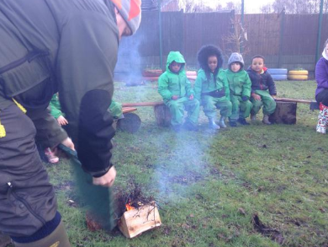
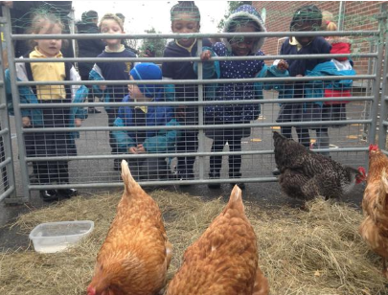
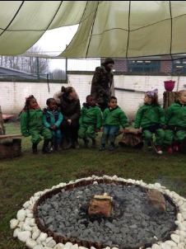
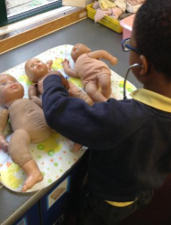
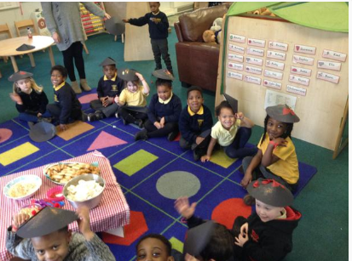
St Thomas of Canterbury
Reception Welcome Meeting

Slide 2

St Thomas of Canterbury
Key Reception Staff
Reception A – Mrs Arnold
Reception L – Mrs Leveridge-Johnson
With the support of:
HLTA – Mrs McGrath (Speech & Language)
HLTA – Miss Clarke- Covers Mrs Arnold on a Friday
TA3 – Mrs Donley
TA1 – Mrs Santos
TA1 – Miss MacDonald
EYFS Lead – Mrs McGuire

Slide 3
Transition into Reception
  Moving up to Reception is an important step in your child’s learning journey.
  It builds on the foundations of learning made in their Nursery year and prepares the children for their move into Key Stage 1 at the end of the year.
  Learning sessions become slightly longer and the pace of learning within sessions increases.
  Having an early night, restful sleep and healthy breakfast will help children be ready to show Fantastic Listening.

Slide 4
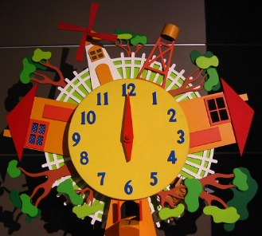
A Busy Day!
  Every day in Reception is a busy one! Please make sure your child arrives on time so they don’t miss any of their learning.
  A bell will ring to notify parents on the playground that the register will be taken at 8:45am.
  After the register we will spin a wheel - if it lands on a child’s name who is on time, they will win a treat. Your child must be on time to be in with a chance of winning!
  Our first lesson is Phonics which begins promptly at 8:55am. It is vital that your child does not miss this.
  Children who are late can often be unsettled and distracted during the morning as they have not started the day off with their normal school routine.

Slide 5


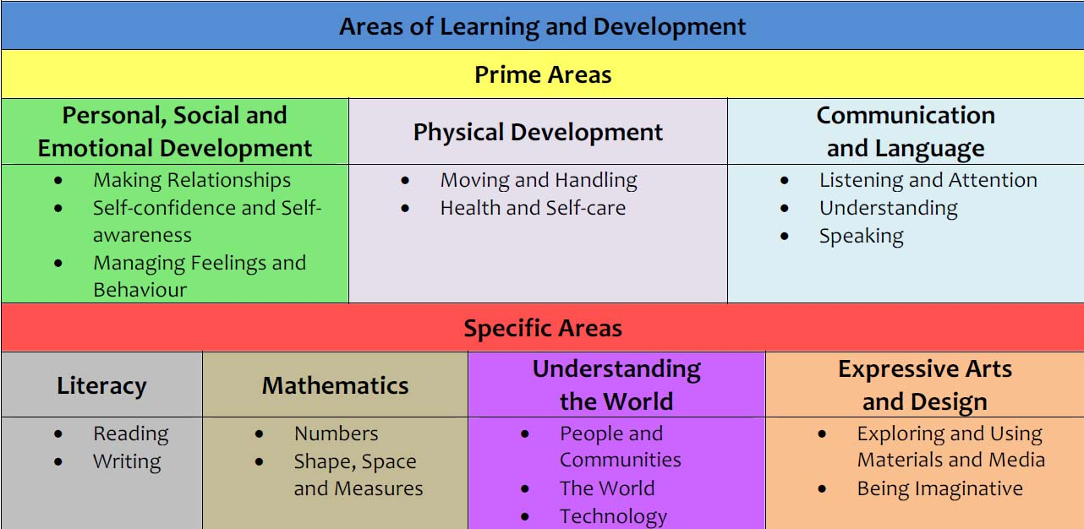
The curriculum

Slide 6
What your child will need for Reception
  Wellington Boots – names in please!
  PE Kits – PE kits are not required in Reception but will be worn from Year 1 onwards.
  Water bottles – we do provide cups for children to drink water, but a bottle from home is preferred.
  Children will not need a book bag whilst they are in Reception, all letters will be handed to children to give to parents at the door.
  NAMES IN EVERYTHING!
  If you do not have a marker for writing your child’s name, please let a member of staff know and we can write it in.

Slide 7
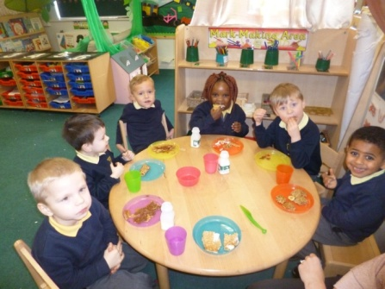
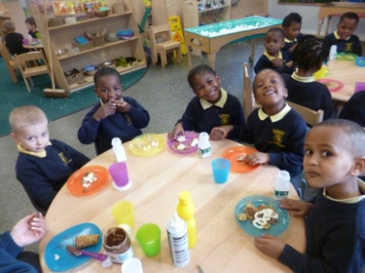
School Meals
Universal free school meals are provided for all children in Reception,
Y1 & Y2, regardless of income.
All children eat on the unit and are offered a hot meal with vegetarian options available. If there is a certain side that your child will not eat (e.g. beans) please let the class teacher know.
Reception children are also provided with a daily morning snack along with milk. All children are offered fruit at home time. A small charge of £1 per week is payable via ParentPay.

Slide 8
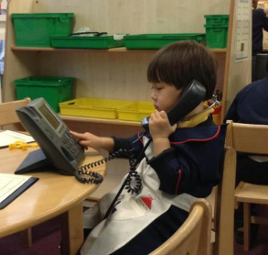
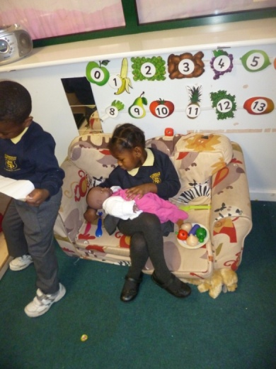
Speaking & Listening
  The most important skills to help your child succeed in their education are speaking and listening skills.
  It is vital that your child is able to speak to others using vocabulary appropriate to their development. It is equally important that they listen to others and can process what is being said to them.
  You can help your child by:
  Playing simple games like guess who, eye spy
  Reading stories together
  Modelling correct language at all times (and encourage
  eye contact)

Slide 9
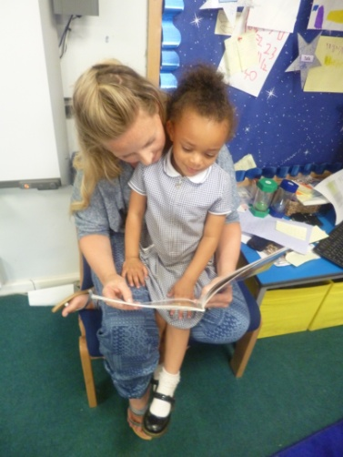
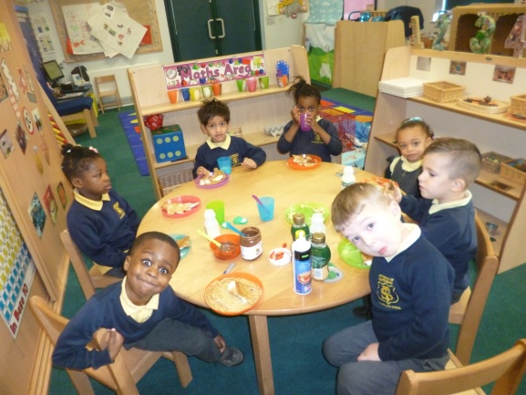
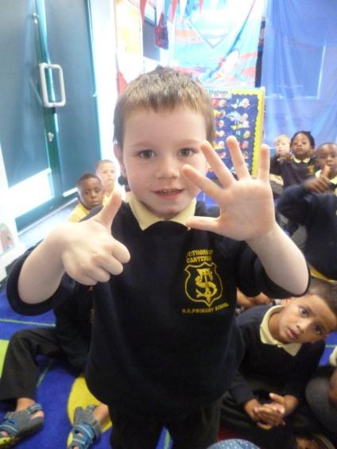
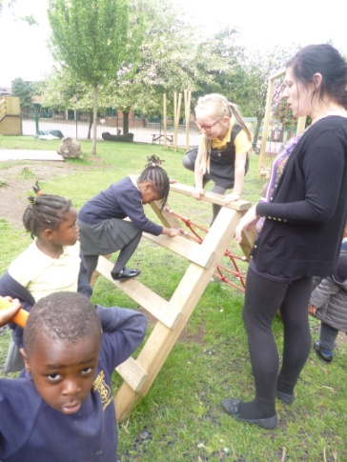
Key skills to support your child
  Getting dressed and undressed on their own.
  Encourage responsibility for own belongings.
  Feeding themselves with a knife and fork.
  Washing their hands properly before meals and after using the toilet or blowing their nose.
  Counting objects by touching or moving them.
  Recognising, naming and matching colours.
  Using pencils and scissors with increasing control.
  Riding a bike if possible.

Slide 10
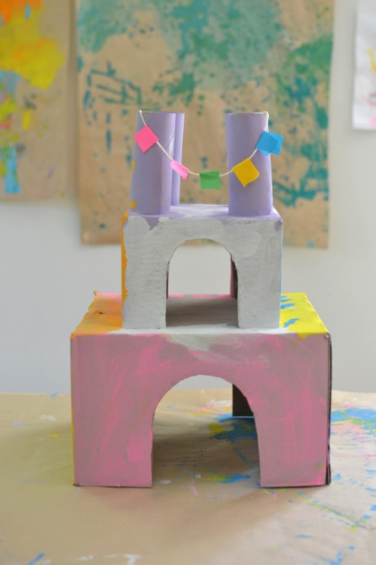
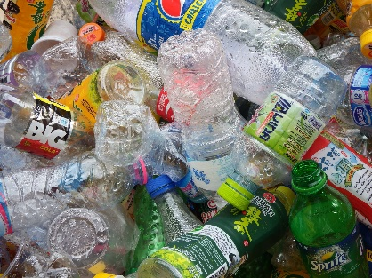
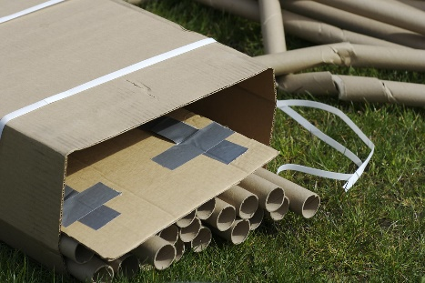
Parent Partnership
Recycling & Junk Modelling
We are continuously saving recycling items to support us with our Expressive Arts & Design curriculum. The children can choose to use these items for junk modelling in our creative areas.
Please donate any recycling items as and when you have them. We accept:
Cardboard boxes (large and small!)
Cardboard tubes (no toilet roll tubes)
Plastic bottles and lids
Plastic tubs / pots and lids (rinsed)

Slide 11
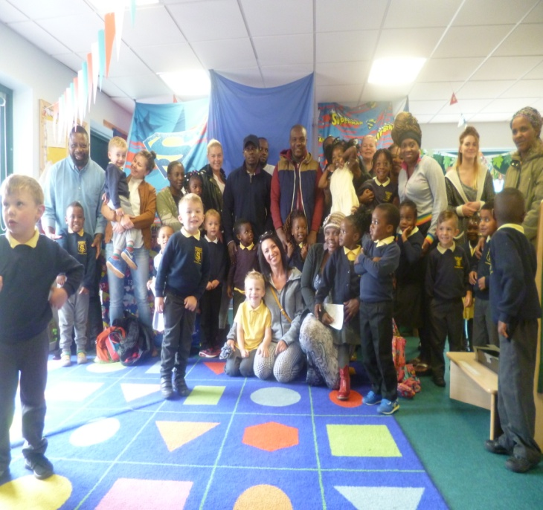

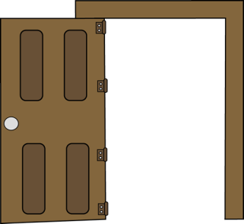
Parent Partnership
Monday / Friday Morning Read
From Autumn 2 we will be inviting parents to come into the classroom during morning drop-off to listen to their child read aloud.
We will provide phonics books related to your child’s reading ability so that they feel successful sharing their reading skills with you. Copies will also be online (eCollins).
This will run from 8:40am and finish promptly in time for the start of register at 8:50am.

Slide 12
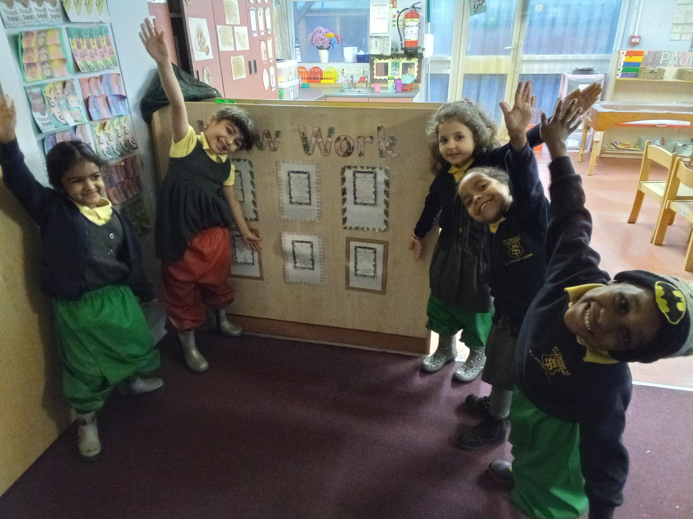
Parent Partnership
Homework & Wow Slips
Please ensure that you invest time in the weekly homework. We do not always expect homework to be physically returned to school, but we do encourage you to take some time to complete the activities with your child.
Going forward, we will be attaching a 'Wow Slip' to every Friday homework. Please look for opportunities where your child is demonstrating new learning, trying new things or showing helpfulness that you can include on a Wow Slip. We will then discuss and celebrate this in class.

Slide 13

Birthdays
We love to celebrate your child’s birthday with the class!
You are under no obligation to bring any gifts in for the class when it is your child’s birthday. However, if you choose to do so we please ask the following:
Nothing edible due to children who have allergies
No balloons
A lovely suggestion is to contribute a book to the classroom library instead of party bags.

Slide 14

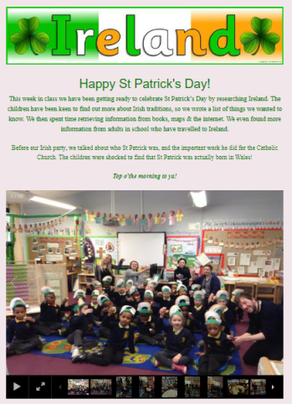
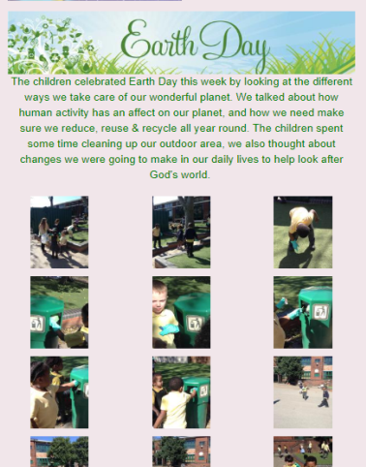
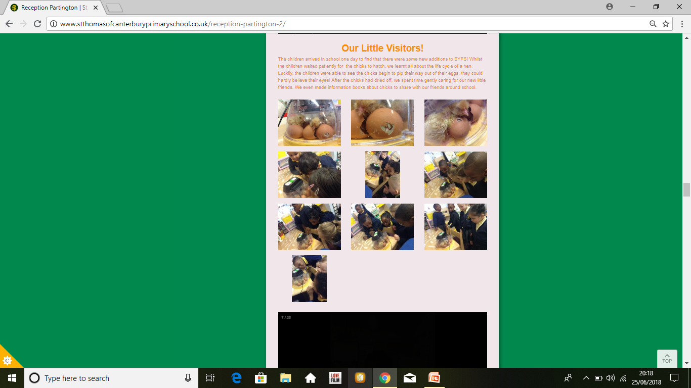
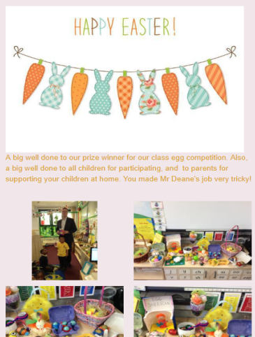
School Website
Our school website is a valuable tool for parents, pupils and teachers.
It gives up to date information about all that us happening in school and has the ParentPay link.
We have helpful information about what the children have been learning in school as well as lots of pictures of what they have been up to.
http://www.stthomasofcanterburyprimaryschool.co.uk

Slide 15
Thank you for your time
Any questions?
Our next meeting will be the Phonics Meeting.
When the date has been confirmed, we will send a letter on ParentHub.
http://www.stthomasofcanterburyprimaryschool.co.uk

