Slide 1

WELCOME TO YEAR 5
St Thomas of Canterbury RC Primary School
Notes:
Rosie

Slide 2
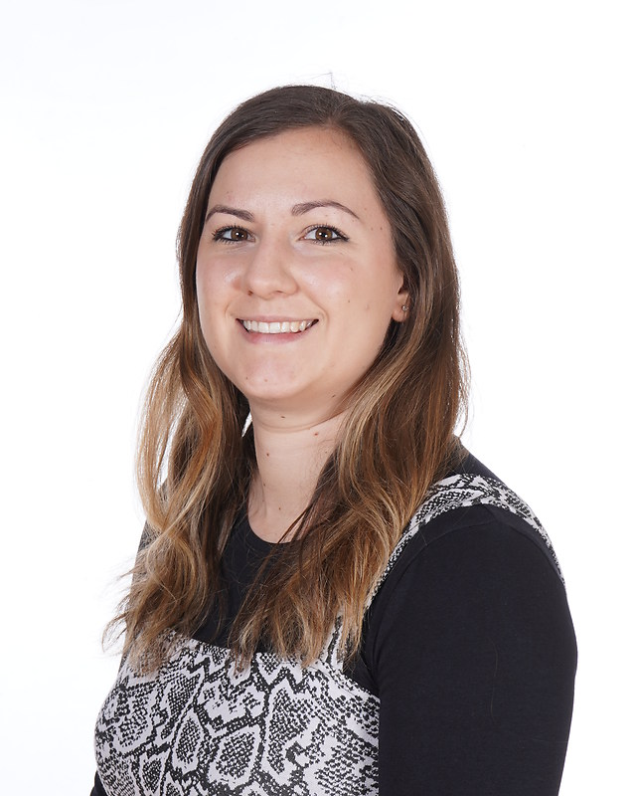
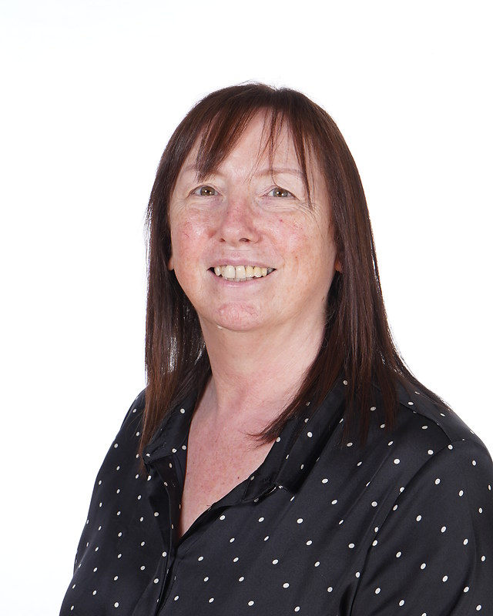
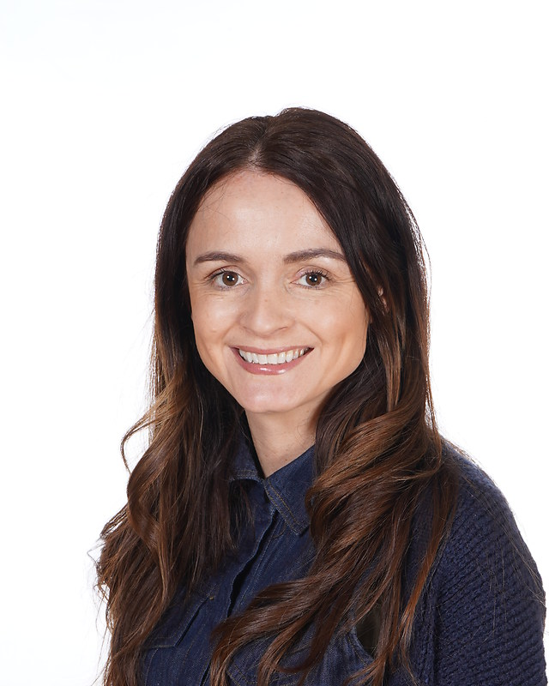
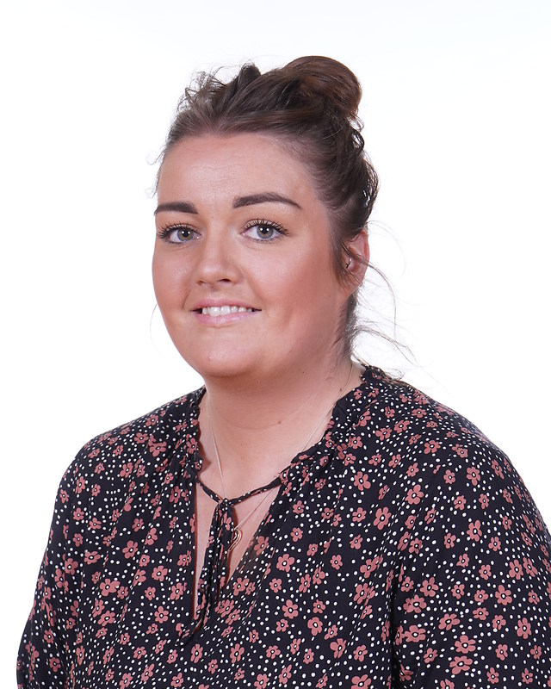
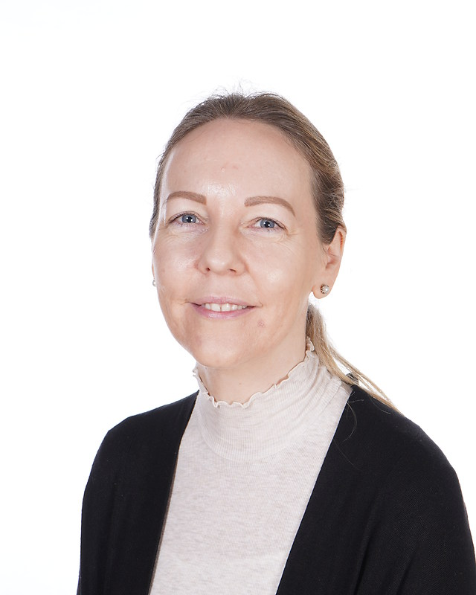
Year 5 team
Year 5C
Miss Chronnell
Miss Dawson
Miss Carter
Year 5H
Mrs Hawkins
Mrs Hallen
Notes:
Rosie - The whole team are committed to giving your child the highest quality education possible and we promise to help them in as many ways as we can. If you have any questions about anything, please come and talk to us.

Slide 3

Start times
School starts at 8:55am. However, children are invited to come into school from 8:45am.
If the children are late (after 8:55am) they will be missing out on valuable learning time. If they children are on time every day, then they are entered into out 'Dine with Deane' competition on a Friday.
School finishes at 3:15pm daily.
Notes:
Nia - Children may have the same book over a few weeks. Just ask them to write what page they are up to in the box. Children will read during break time if they haven’t read at home.

Slide 4
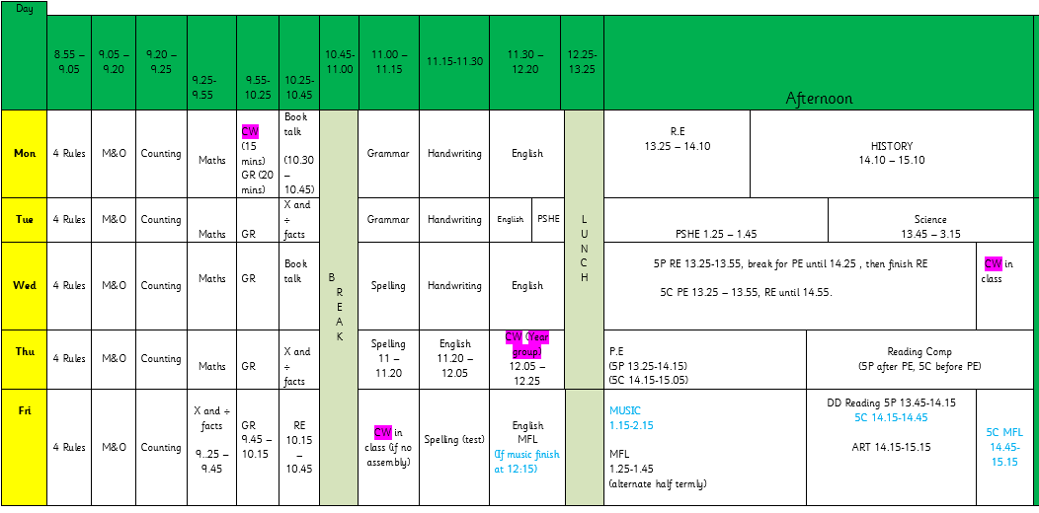
TIMETABLE
Notes:
Rosie - Here is an overview of our timetable. There is some variation between the classes, e.g. Music instead of Art, but the hours dedicated to each subject are the same across the year group. DT and Computing blocks.

Slide 5

READING
Children will be expected to read every day and sign their reading diaries 5 days a week. We expect them to do this independently for at least 10 minutes every evening.
We encourage the children to write a short summary of what they have read in the book. These will be checked by the adults daily.
Your child’s book will be changed, when they have finished it.
Notes:
Nia - Children may have the same book over a few weeks. Just ask them to write what page they are up to in the box. Children will read during break time if they haven’t read at home.

Slide 6
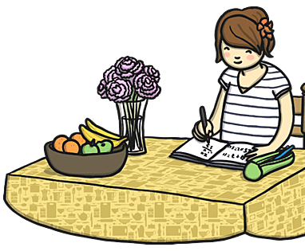
HOMEWORK
Homework will either be uploaded to Google Classroom every Friday or children will be given a paper copy. This must be completed by the following Monday, giving children the weekend to complete the work.
If children do not do the homework over the weekend, they will complete it during break time.
Notes:
Rosie - If you require a paper copy, just ask. We would prefer to reduce our paper usage so we are trying to move everything onto google classroom.

Slide 7
Spellings
Spelling tests will be handed out each Monday, based on what children will be learning in their spelling lessons that week.
The spelling tests will take place on Friday.
Notes:
Rosie

Slide 8
Multiplication and division facts
Every Friday, the children will complete a times tables test. The expectation for Year 5 to is to have completed 5 Gold by the end of the year. Children who have already passed this test will be complete more challenging tests.
TTRS is a brilliant way for children to learn their times tables. All have their own log-ins.
Other useful websites – timestables.co.uk, top marks
Notes:
Nia - As you may already know, Year 4 children across the country will be doing the statutory government MTC. The purpose of the MTC is to determine whether pupils can recall their times tables fluently, which is essential for future success in mathematics. It will help schools to identify pupils who have not yet mastered their times tables, so that additional support can be provided.

Slide 9
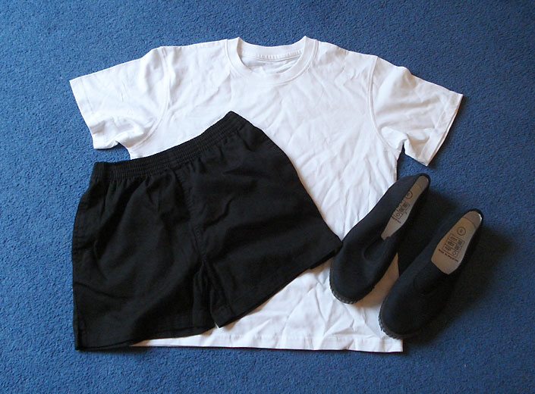
PE
PE is taught on Wednesdays and Thuursdays. We ask that the children wear their PE kits for school. This is a plain white T-shirt, black shorts, joggers or leggings and pumps or trainers. If it is cold, the children can wear tracksuit trousers and a sweatshirt over this kit. We do gymnastics/dance on a Wednesday and games on Thursday.
Notes:
Rosie

Slide 10
FINAL REMARKS
Please keep us informed of any changes with regards to medication or dietary/allergy information.
We will send important information regarding trips etc through Parent Pay or in a letter.
Any questions, please let us know.
Notes:
Rosie

