Slide 1
WELCOME TO YEAR 5
St Thomas of Canterbury RC Primary School
Notes:
Charlotte

Slide 2
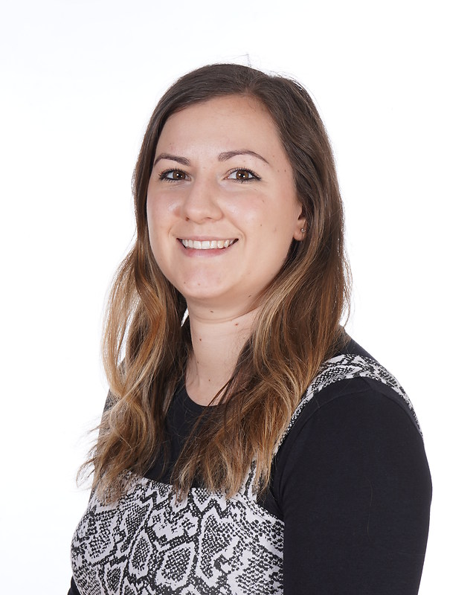
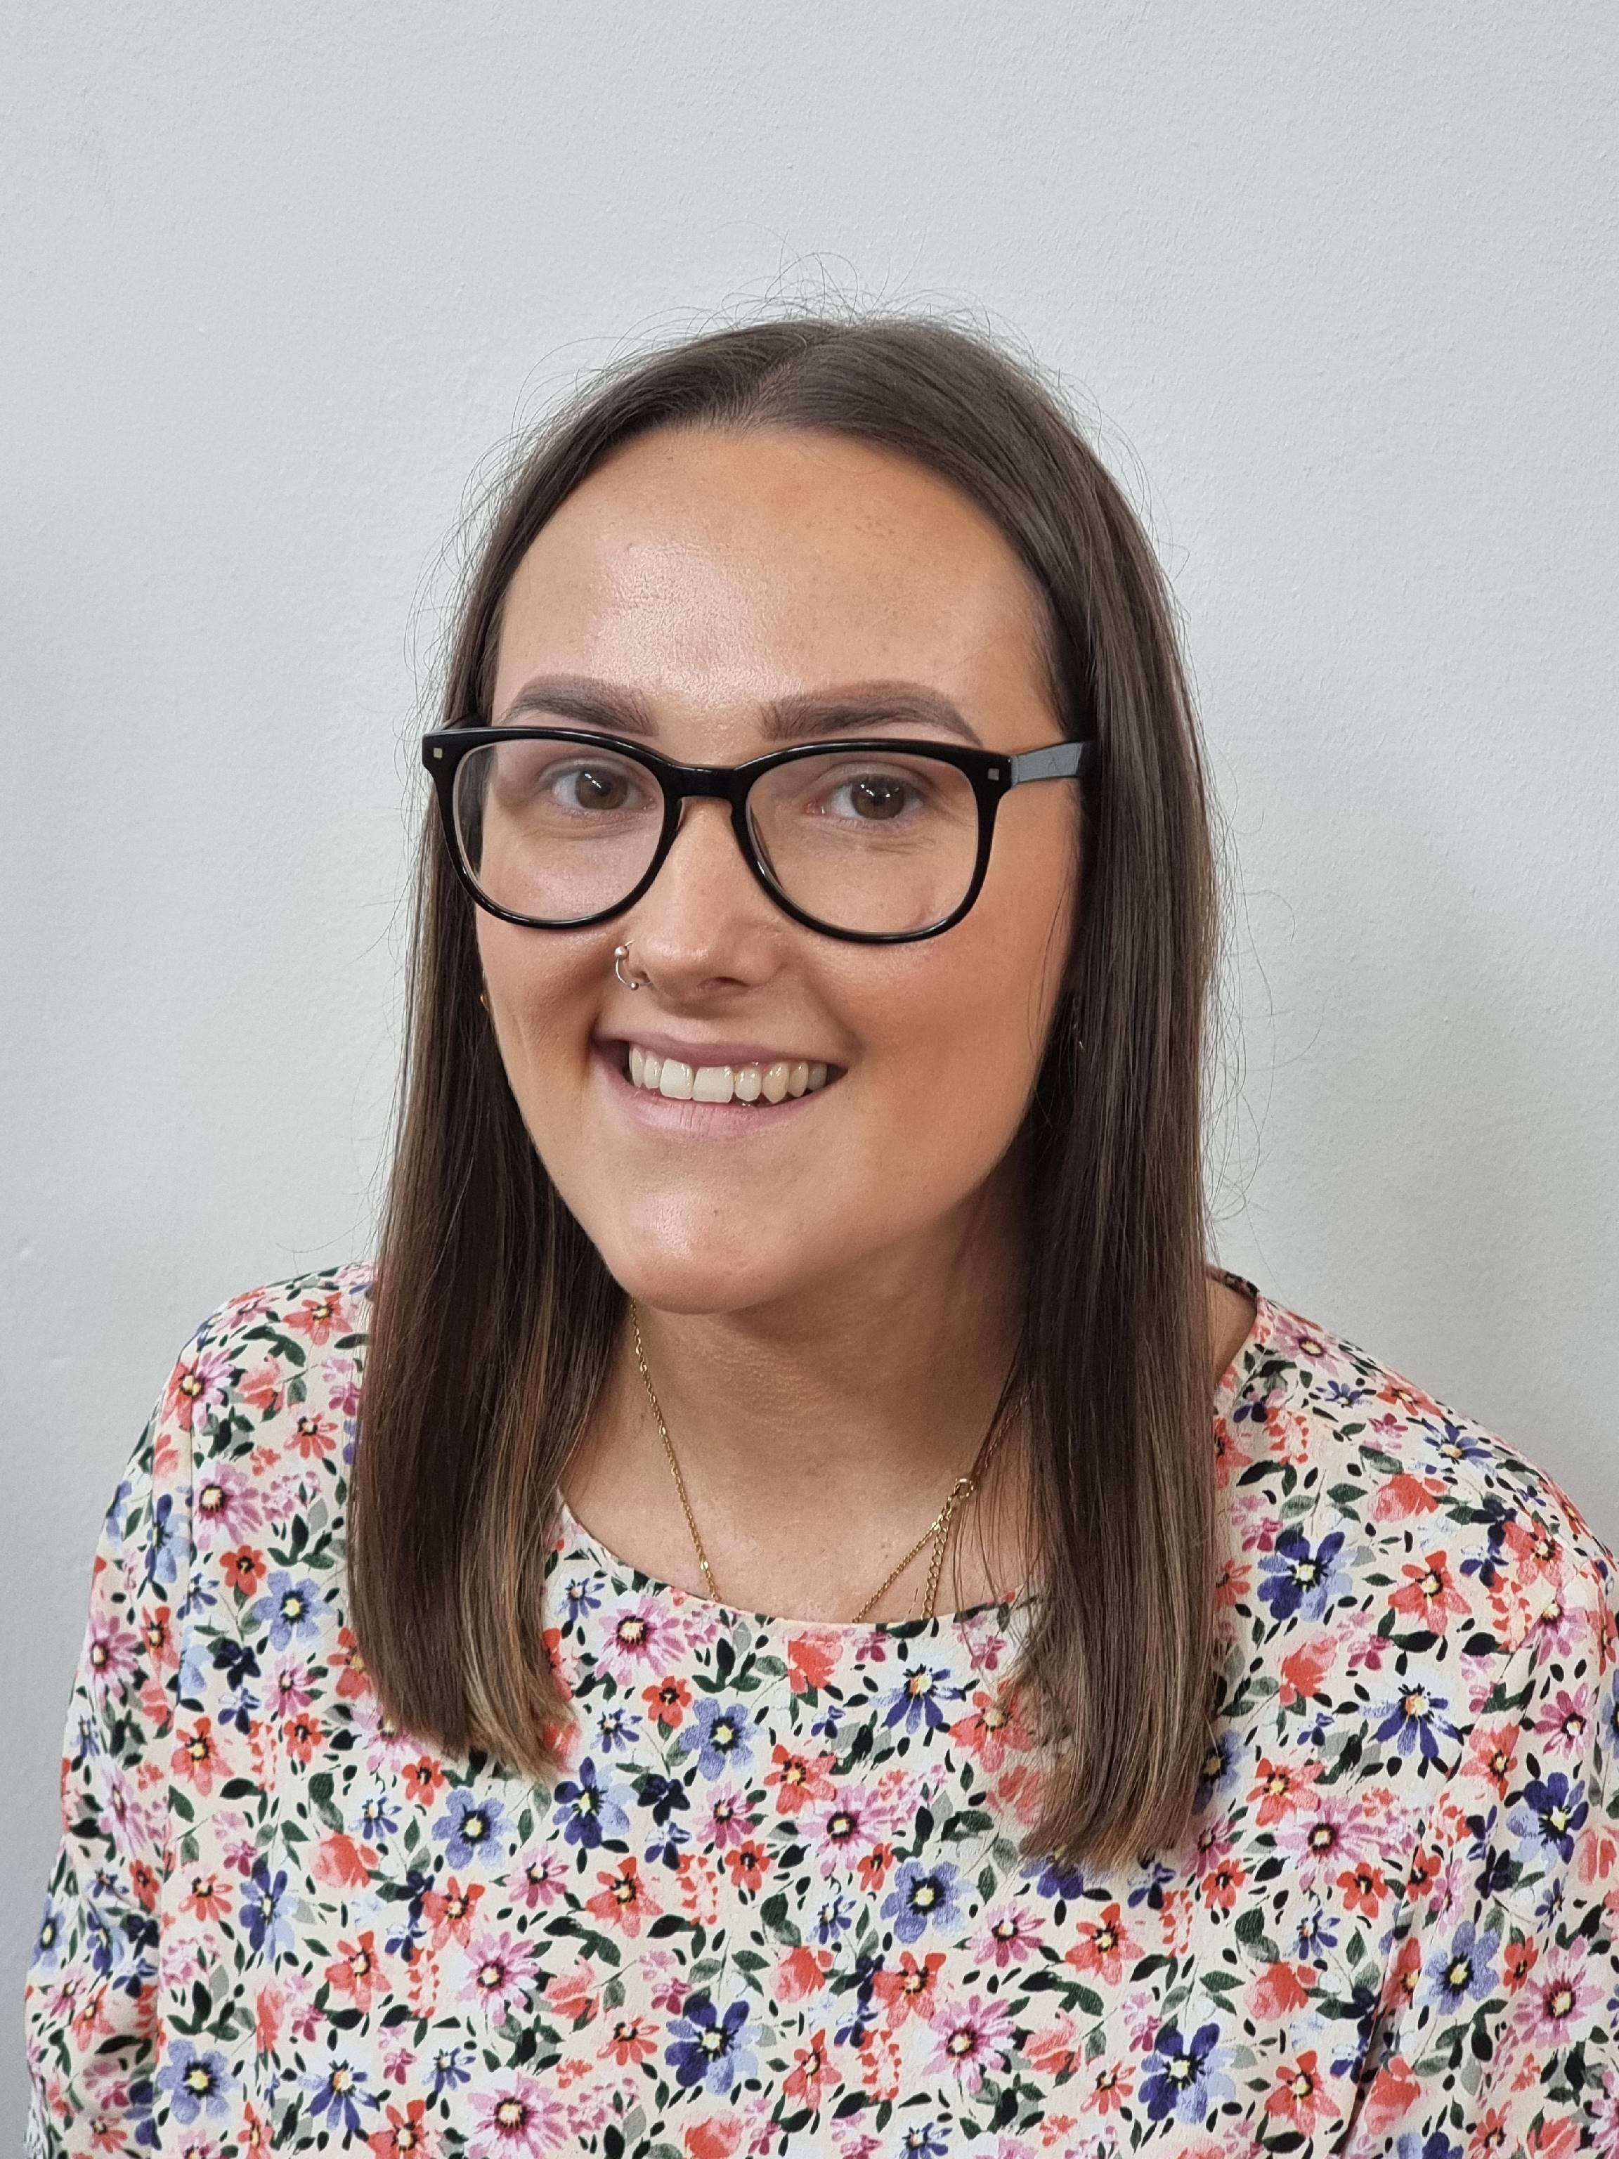
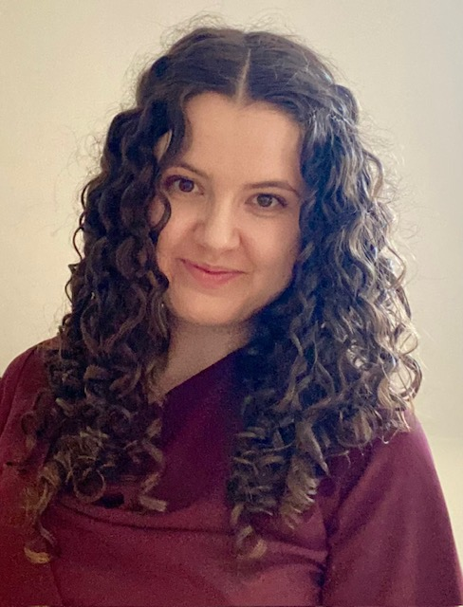
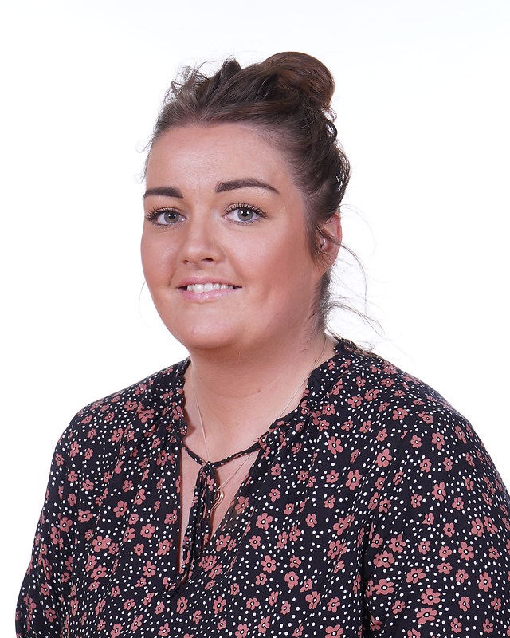
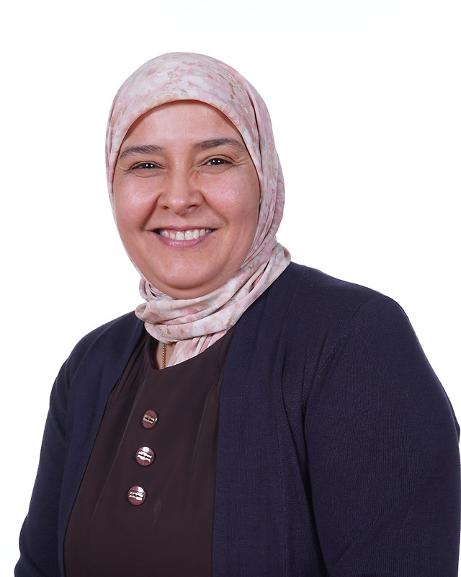
Year 5 team
Year 5C
Miss Connolly
Miss Dawson
Mrs Bouster
Year 5H
Mrs Hawkins
Miss Piggott
Notes:
Charlotte introduce - The whole team are committed to giving your child the highest quality education possible and we promise to help them in as many ways as we can. If you have any questions about anything, please come and talk to us.

Slide 3
Start times
School starts at 8:55am. However, children are invited to come into school from 8:45am.
If the children are late (after 8:55am) they will be missing out on valuable learning time. If they children are on time every day, they will be in for a chance to win a prize each morning.
School finishes at 3:15pm daily.
Notes:
Issie

Slide 4
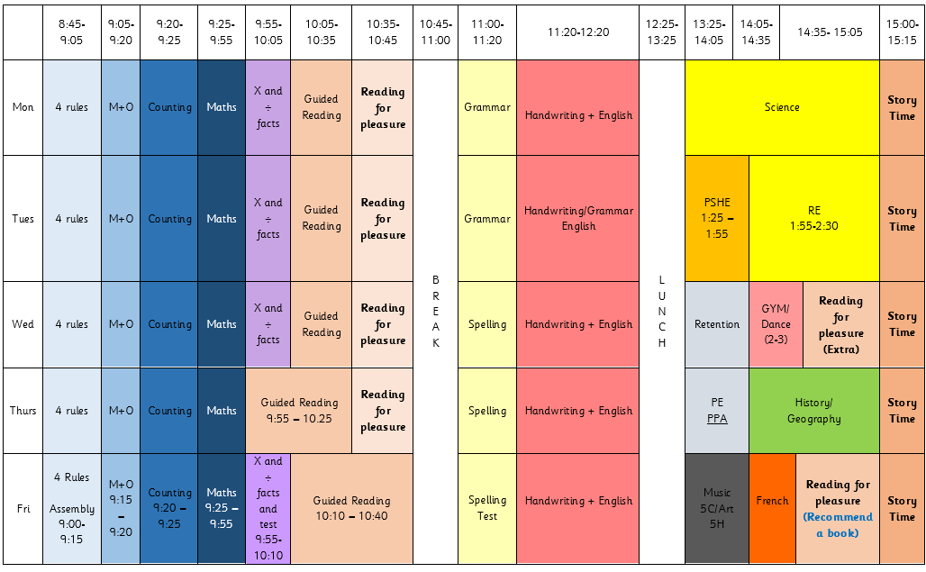
TIMETABLE
Notes:
Charlotte - Here is an overview of our timetable. There is some variation between the classes, e.g. Music instead of Art, but the hours dedicated to each subject are the same across the year group. DT and Computing blocks.

Slide 5
READING
Children will be expected to read every day and sign their reading diaries 5 days a week. We expect them to do this independently for at least 10 minutes every evening.
We encourage the children to write a short summary of what they have read in the book. These will be checked by the adults daily.
Your child’s book will be changed, when they have finished it.
Notes:
Issie - Children may have the same book over a few weeks. Just ask them to write what page they are up to in the box. Children will read during break time if they haven’t read at home. Challenge books – 6 over the year to achieve silver badge.

Slide 6
HOMEWORK
Homework will either be uploaded to Google Classroom every Friday or children will be given a paper copy. This must be completed by the following Monday, giving children the weekend to complete the work.
If children do not do the homework over the weekend, they will complete it during break time.
Notes:
Charlotte - If you require a paper copy, just ask. We would prefer to reduce our paper usage so we are trying to move everything onto google classroom.

Slide 7
Spellings
Spelling tests will be handed out each Monday, based on what children will be learning in their spelling lessons that week.
The spelling tests will take place on Friday.
Notes:
Issie

Slide 8
Multiplication and division facts
Every Friday, the children will complete a times tables test. The expectation for Year 5 to is to have completed 4 Gold by the end of the year. Children who have already passed this test will be complete more challenging tests.
TTRS is a brilliant way for children to learn their times tables. All have their own log-ins.
Other useful websites – timestables.co.uk, top marks
Notes:
Issie

Slide 9
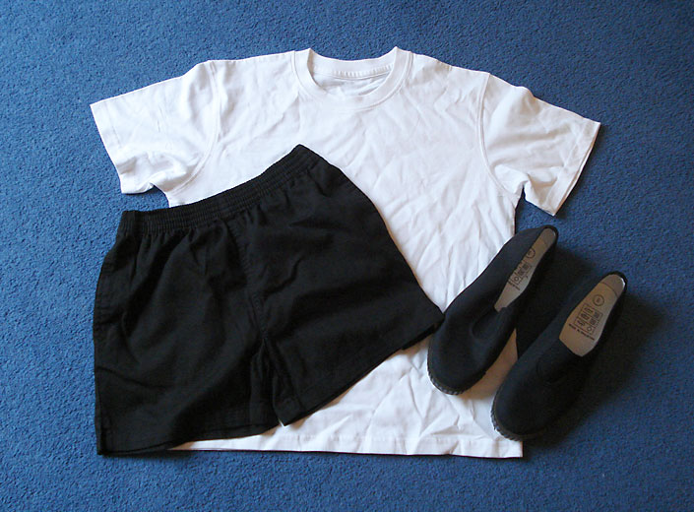
PE
PE is taught on Wednesday and Thursday. We ask that the children wear their PE kits for school. This is a plain white T-shirt, black shorts, joggers or leggings and pumps or trainers. If it is cold, the children can wear tracksuit trousers and a sweatshirt over this kit.
We do gymnastics/dance on a Wednesday and games on Thursday with a PE coach.
Notes:
Charlotte – uniform day to day has been great but remind about black shoes.

Slide 10
Walking home
In Year 5, the children, with parental permission, are able to walk home alone.
If you have decided it is too soon but change your mind later in the year, please send in signed note and then we will allow them to walk home alone.
These children are able to bring in a mobile phone, which will be locked in a cupboard all day, tuned off until home time. The children will not be allowed to use these to contact anyone during the school day. Please contact the office, if you need to pass a message on to your child.
Notes:
Issie - Reminder the children should be going home to somebody in the house.

Slide 11
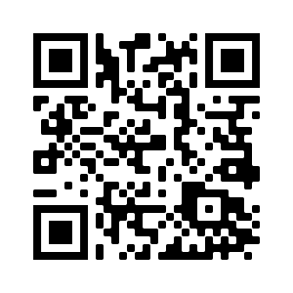
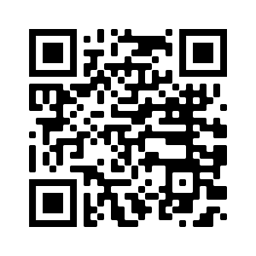
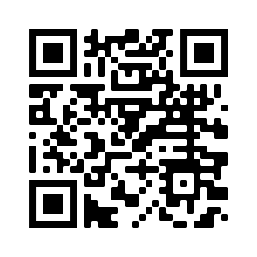
STOC Social media @stthomassalford
Notes:
Charlotte

Slide 12
FINAL REMARKS
Please keep us informed of any changes with regards to medication or dietary/allergy information.
We will send important information regarding trips etc through Parent Pay or in a letter.
Any questions, please ask.
Notes:
Issie

