Slide 1

WELCOME TO YEAR 4
St Thomas of Canterbury RC Primary School

Slide 2
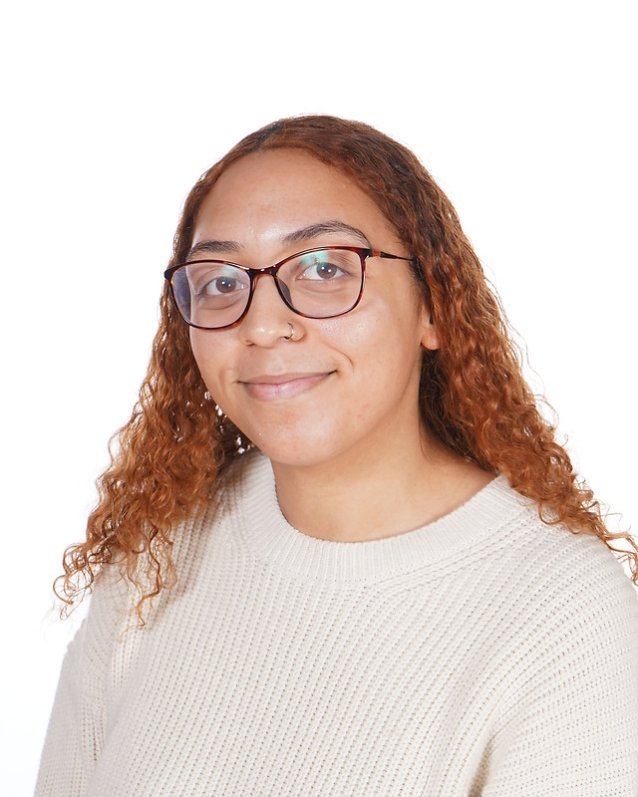
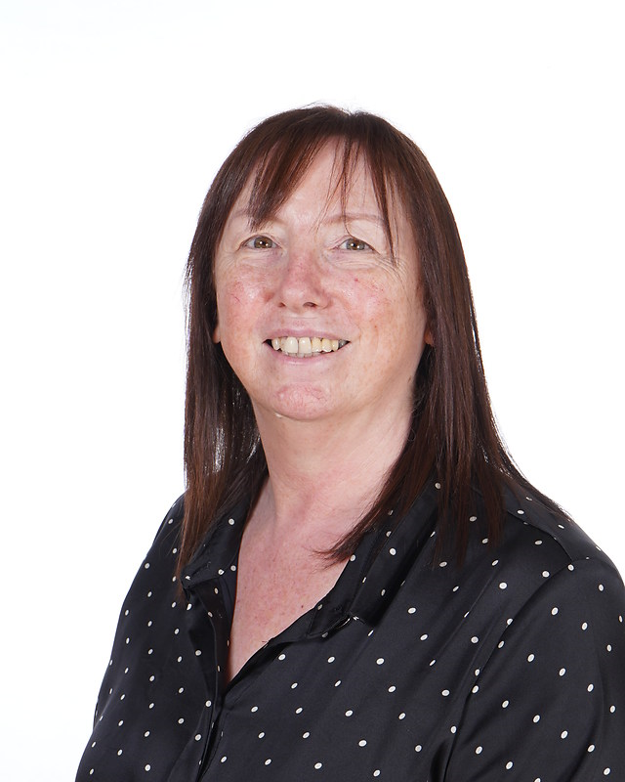
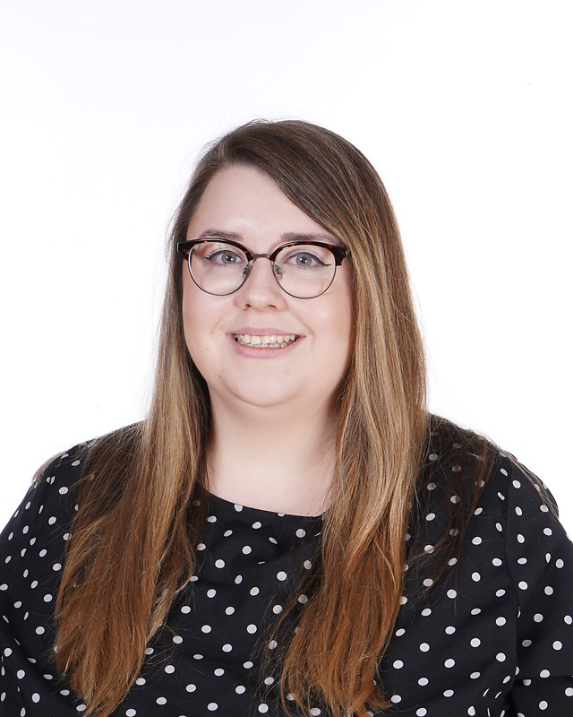
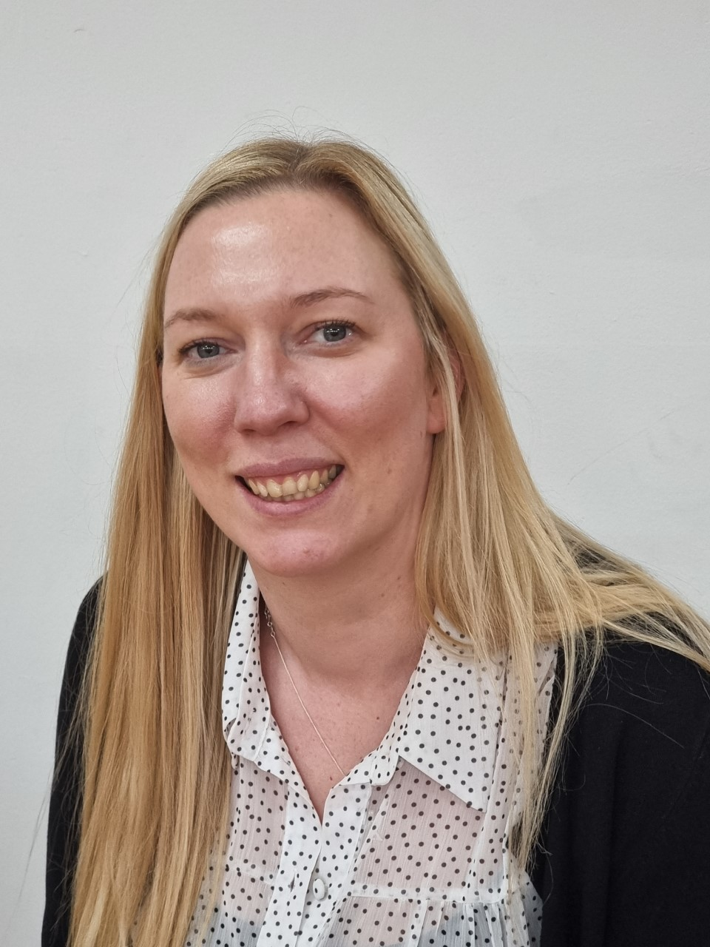
Year 4 team
Year 4L
Miss Lyimo
Mrs Hallen (to be replaced)
Year 4S
Miss Sale
Mrs Kaluza

Slide 3
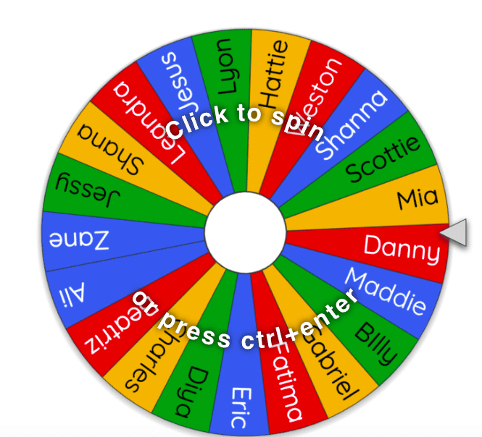

DROP OFF AND PICK UP
The school day begins at 8:45am
Classroom doors open at 8:40am
Collect your child promptly at 3:15pm
We politely ask all parents to remain on the playground at home time.
Notify class teacher if someone new is collecting your child.

Slide 4
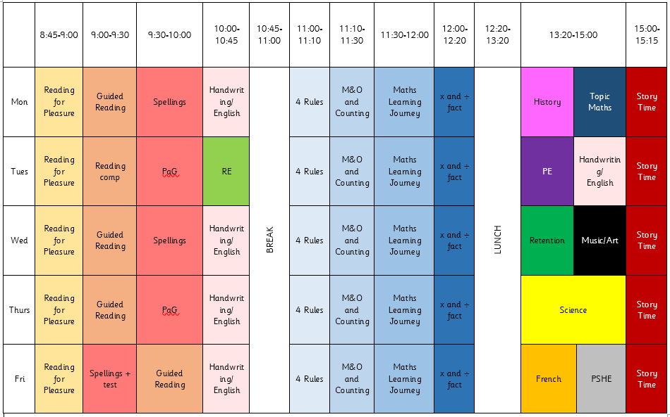
TIMETABLE

Slide 5

READING
Children will be expected to read every day and sign their reading diaries 5 days a week. We expect them to do this by themselves.
We encourage the children to write a short summary of what they have read in the book. These will be checked by the adults.
Your child’s book will be changed every Tuesday and Friday.

Slide 6
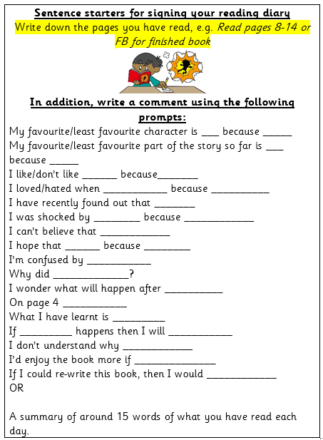
READING

Slide 7

HOMEWORK
Homework will be uploaded to Google Classroom every Friday (starting this Friday) . This must be completed by the following Monday, giving children the weekend to complete the work.
If children do not do the homework over the weekend, they will complete it during break time.

Slide 8
Spellings
Spellings will be given out Friday of each week, based on what children have learnt in their spelling lessons the previous week.
The spelling tests will take place on a Friday so the children have one week to practise.

Slide 9
Multiplication tables check (MTC)
All year 4 children will take the multiplication tables check, required by the government. It comprises 25 questions and the children have 6 seconds to answer.
TTRS is a brilliant way for children to learn their times tables.
Other useful websites – timestables.co.uk, top marks

Slide 10
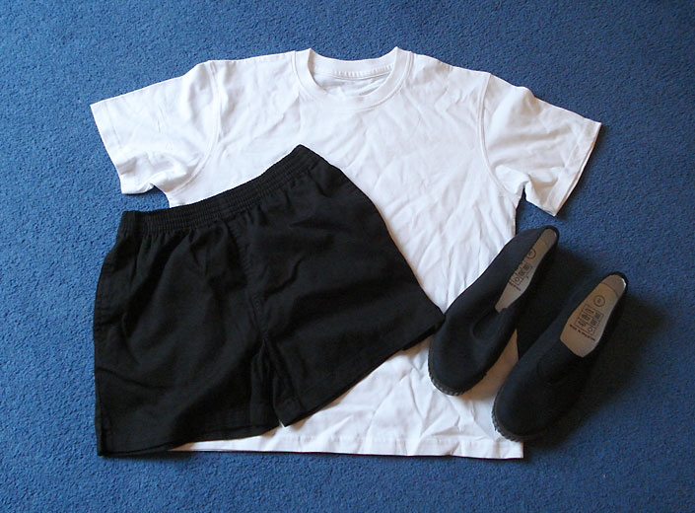
PE
PE is taught on Tuesdays. We ask that the children wear their PE kits for school. This is a plain white T-shirt, black shorts or leggings and pumps or trainers. If it is cold, the children can wear tracksuit trousers and a sweatshirt over this kit. We do gymnastics/dance on a Tuesday as well as games. The children need to have shorts and leggings for this as tracksuit trousers can catch on the equipment.

Slide 11
FINAL REMARKS
Please keep us informed of any changes with regards to medication or dietary/allergy information.
We will send important information regarding trips etc through Parent Pay or in a letter.
Any questions, come let us know.

