Slide 1
WELCOME TO YEAR 3
St Thomas of Canterbury RC Primary School

Slide 2
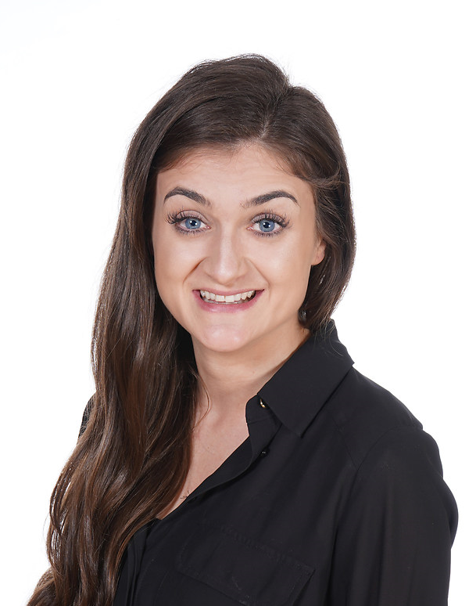
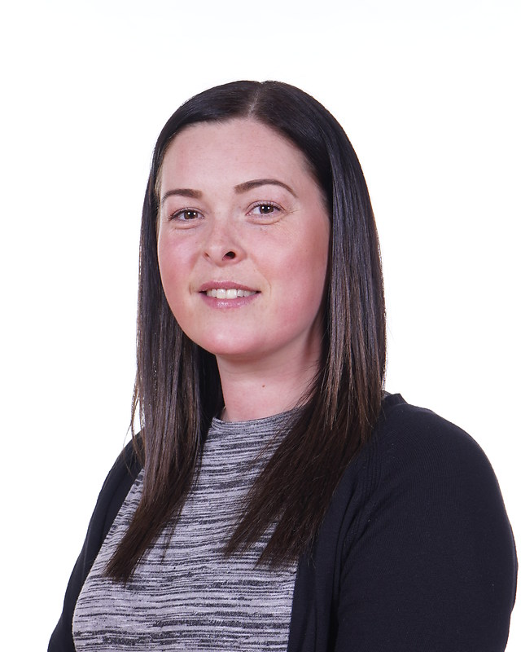
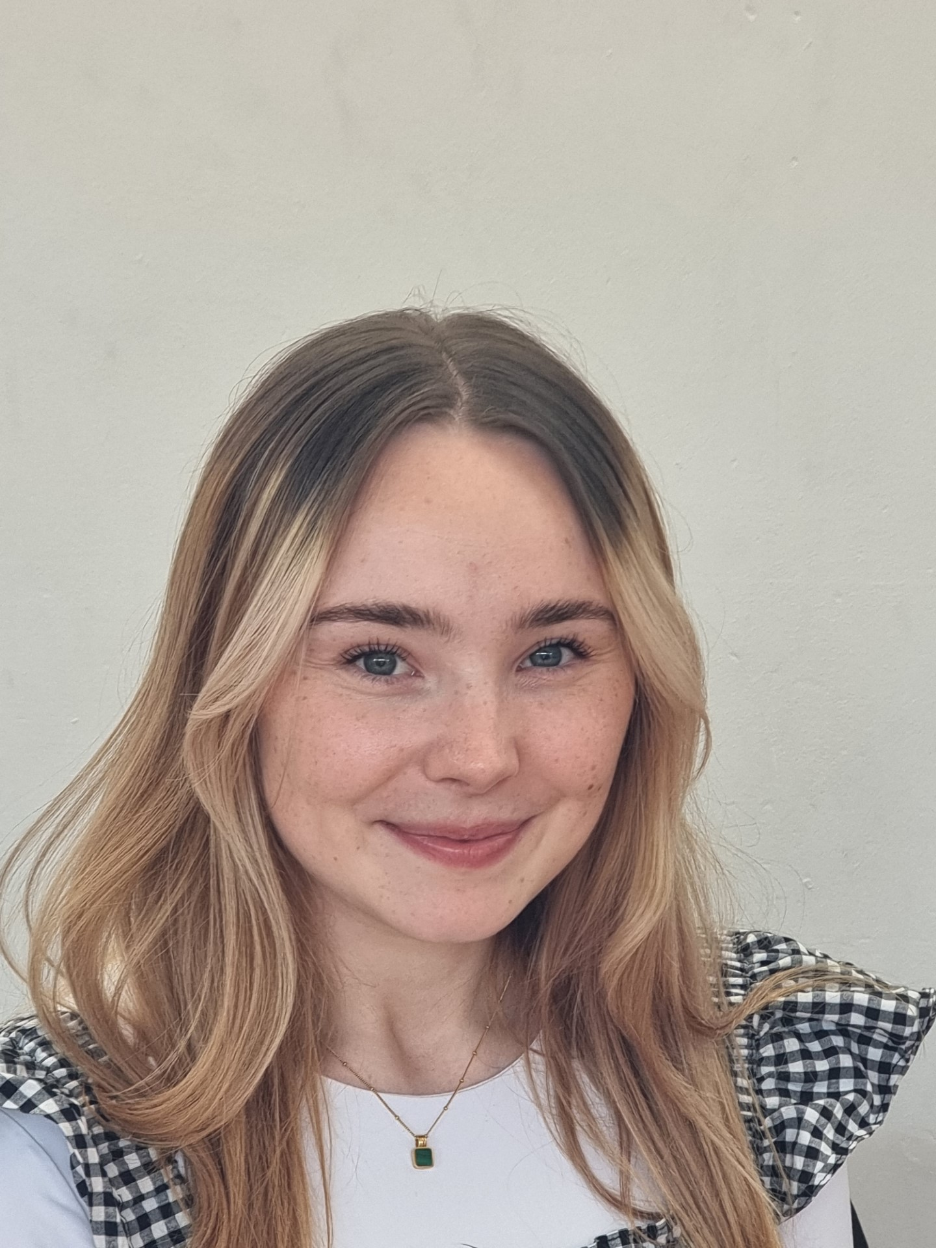
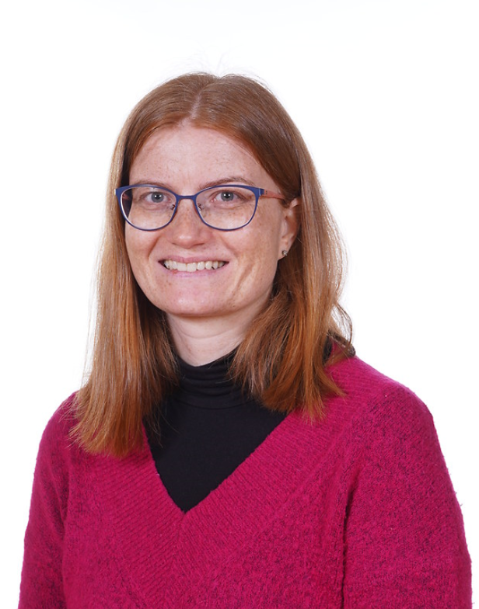
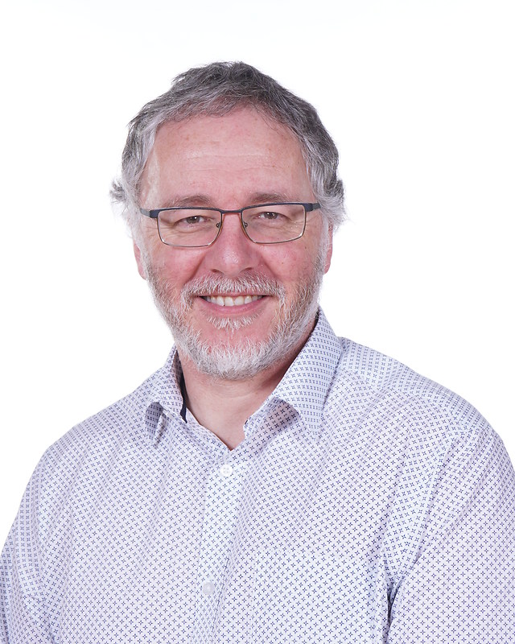
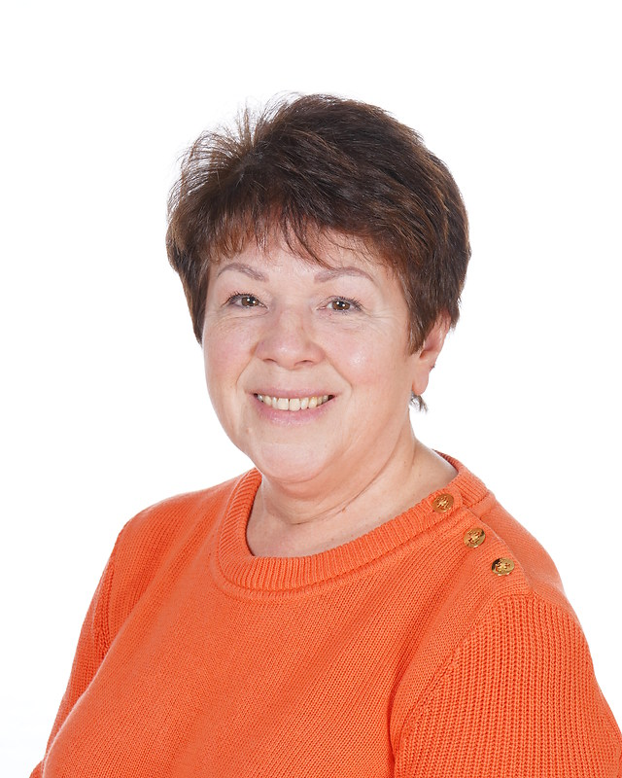
Year 3 team
Year 3C
Miss Camilleri Miss Fay
Year 3D
Miss Daly Miss Janiak
Mr Stenton
Miss Lanagahan
Miss Harrison

Slide 3
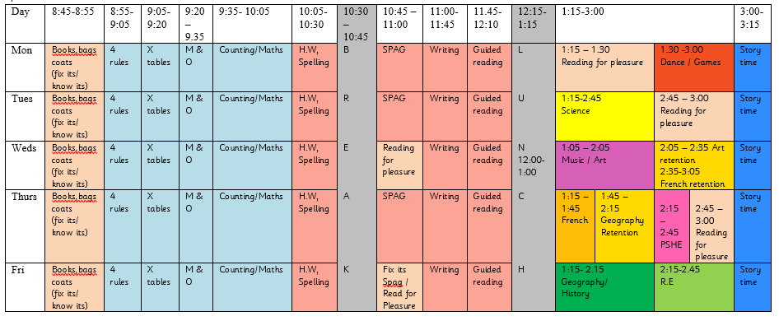
TIMETABLE
When your child’s class is swimming (Friday morning), the timetable will be adjusted to accommodate their lessons.
Notes:
- Here is an overview of our timetable. There is some variation between the classes, e.g. Music instead of Art, but the hours dedicated to each subject are the same across the year group. DT and Computing blocks.
Year 3M swimming until Feb – timetable slightly adjusted
When art is being taught, please bring an old t-shirt that you don’t mind getting dirty.

Slide 4
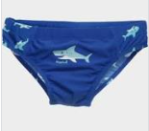
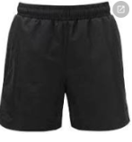
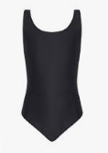
SWIMMING
Swimming takes place on Fridays.
3D – September until February half term
3C – after the February half term until the end of the school year
Full swimming kit is required. This consists of swimming cap, swimming trunks or shorts (not too long below the knee) or a swimming costume. Bikinis must not be worn. Earrings and jewellery must not be worn on these days. Towels are needed in their swimming bags.

Slide 5
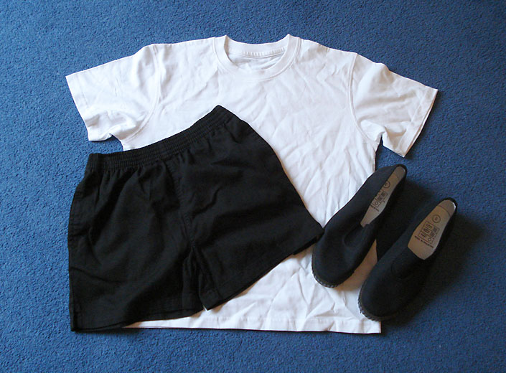
PE
PE is taught on Mondays. We ask that the children wear their PE kits for school. This is a plain white T-shirt, black shorts or leggings and pumps or trainers. If it is cold, the children can wear black tracksuit trousers and a school jumper over this kit.
Notes:
Jess

Slide 6
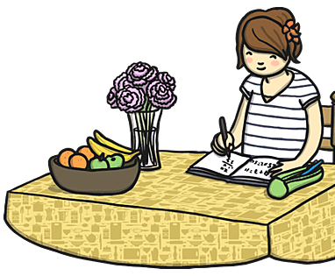
HOMEWORK
Homework will be uploaded to Google Classroom every Friday.
This must be completed by the following Thursday, giving children the weekend and the following week to complete the work.
Notes:
Username and passwords will be stuck in the front of their reading diaries.

Slide 7
Spellings
Spellings will be uploaded to Google Classroom each week, based on what children have been learning in their spelling lessons.
The spelling tests will take place on a Friday and the new test will be uploaded with the homework on Friday so the children have one week to practise.
Please support your children to learn these at home.

Slide 8
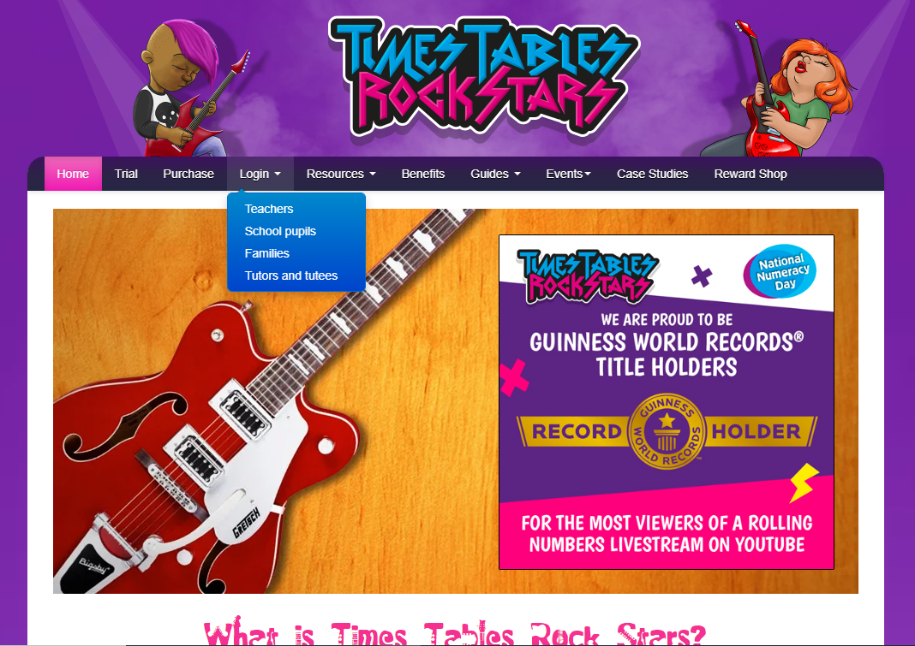
TTRS
TTRS practice should be daily to prepare the children to sit their multiplication check in Year 4.
There will be a weekly competition between both classes, with a termly prize of extra playtime.

Slide 9
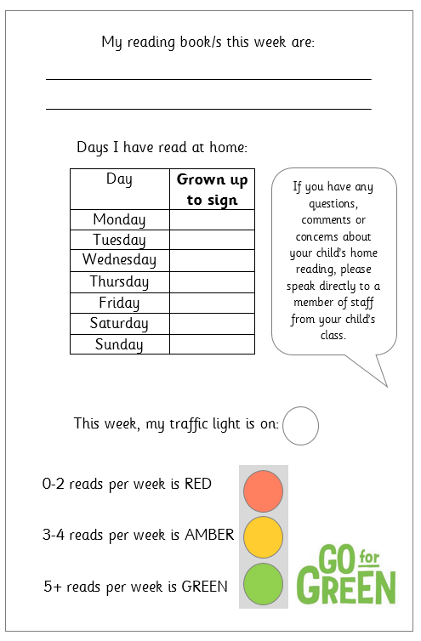
READING
Children will be expected to read every day an adult at home will sign their reading diaries 7 days a week.
The books will be checked by the adults in school daily.
Your child’s book will be changed every Monday and Thursday.

Slide 10
FINAL REMARKS
Please keep us informed of any changes with regards to medication or dietary/allergy information.
We will send important information regarding trips etc through Parent Pay or in a letter.
Any questions, come let us know.

