Slide 1
Welcome to the Year 2 Maths workshop
Aims of the session:
To explain the key aims of the maths curriculum in KS1
To outline the way we teach maths at STOC.
The 3 main aims of the maths curriculum are fluency, reasoning and problem solving.

Slide 2
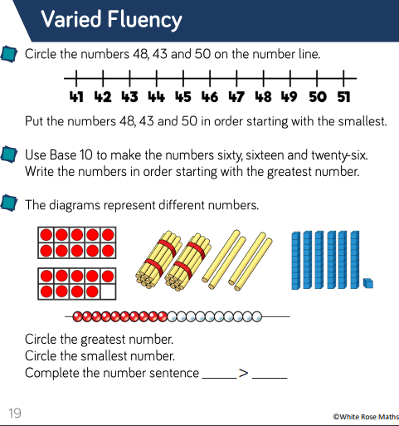
STOC Scheme of Learning for Mathematics
Fluency- the ability to recall and apply number knowledge rapidly and accurately e.g. times tables facts, number facts e.g. 3+7=10

Slide 3
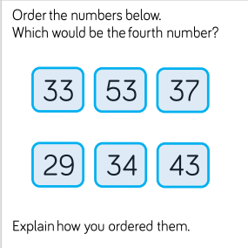
STOC Scheme of Learning for Mathematics
Reasoning- and developing an argument, justification or proof using mathematical language they must explain how they got the answer and why they are correct e.g. If I know that 3+7=10 I know that 13+7 must be equal to 20.

Slide 4
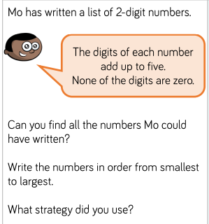
STOC Scheme of Learning for Mathematics
Problem Solving- applying their skills to real life contexts. breaking down problems into a series of simpler steps and persevering in seeking solutions.

Slide 5
What does a typical Year 2 maths lesson look like?
15 minutes: Mastering number
Recapping Year 1 objectives and teaching Year 2 objectives.
30 minutes: Mental and Oral
15 minutes revisiting learnt skills from Year 1 and 2.
10 minutes counting in 1’s, 10’s, 2’s and 5’s.
5 minutes recapping multiplication and division facts.
25 minutes: Maths lesson
Focusing on new Y2 objectives.

Slide 6
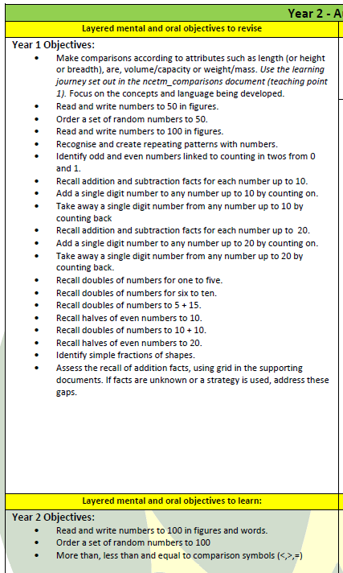
Mental and Oral Starters
How?
IMPLEMENTATION
15 Minutes Everyday
Practise grasped concepts, skills and facts through a layered approach
Master a new concept, skill or fact in any remaining time

Slide 7
Subtraction
We teach children the following methods. Initially, subtraction is taught with concrete materials, we then move to pictorial- drawing number lines etc and at the final abstract stage we would expect the children to be able to answer these questions mentally.
Looking for what I already know/notice. E.g. 12-6= 20-15=
Subtracting tens with no ones. 23-10, 65-30, 85-20 etc
Subtracting tens and ones, with out crossing a barrier (breaking into a new ten) 37-22, 55-31, 86-25
The hardest- Subtraction two, two digit number crossing a ten.
In addition to this, all children will be exposed to more mental methods, as shown at the bottom of your handout.

Slide 8
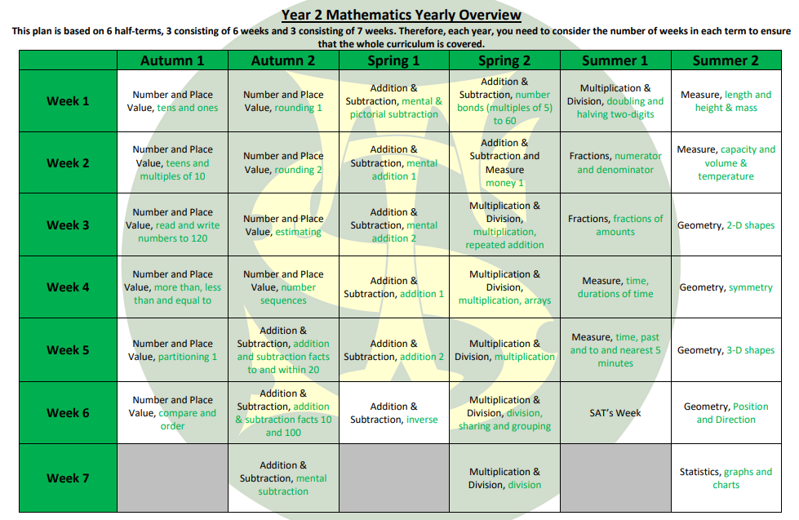
STOC Scheme of Learning for Mathematics

Slide 9
Y2 Maths Objectives

Slide 10
How to support your child at home
Practise key skills as often as possible e.g. counting- steps, household items, mental maths in supermarkets, measuring in cooking- any opportunity to practise maths in the real world.
Useful websites:
https://www.topmarks.co.uk/
https://www.bbc.co.uk/bitesize/subjects/zqpqfdm
https://ttrockstars.com/
https://www.thenational.academy/

Slide 11
Any questions?
Thank you for joining us today!

Slide 12
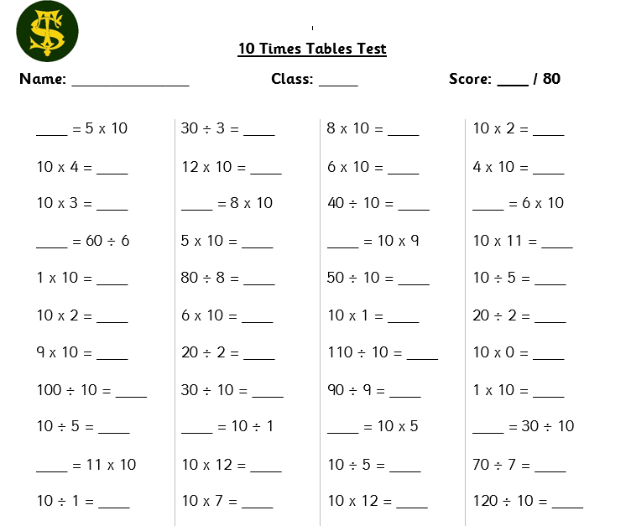
Example of Challenge 2
The children are expected to know all the fact families for each multiplication.
E.g. 4x 10 = 40, 10 x 4 = 40, 40 $÷4=10 40 ÷10=4$

