Slide 1
Year 2 Parents Meeting
Mrs Arnold & Miss Rosato

Slide 2
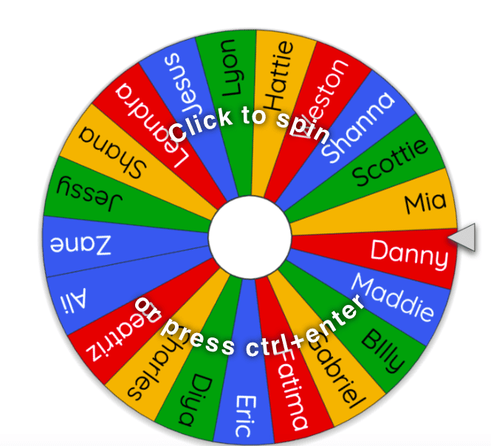
Drop off & Pick up
The school day now begins promptly at 8:45.
Classroom doors open at 8:40am
We politely ask all parents remain at the bottom of the grass/ramp at home time.
If you have any questions or concerns, the best time of the day to speak to your child’s teacher is in the morning.

Slide 3
A typical Year 2 day
Morning
Grammar, Handwriting, Phonics, writing lesson, Mastering number
PLAYTIME (15 mins)
Mastering number, Mental Oral and Counting (Maths), Times tables practise, Maths lesson
LUNCHTIME (1 hour)
Afternoon
Reading groups, Topic (PE, Music, Geography, History, Art, Science, RE)

Slide 4
Reading in Year 2
Your child will be assigned one e-book every two weeks-read half one week. Finish the second half the next week. This is the book they have read in school that week, which they should read fluently, or with very little support. E-book log ins are stuck in on the inside cover of your child’s diary.
Your child will also bring home two reading books each Monday. Please can you ensure these books are returned on a Monday, ready to be changed. Please listen to your child read aloud every night and sign their reading diary, to show they have read.
Terrific Texts will be sent out every Monday. These books are to be enjoyed together, read by an adult as they will be above your child’s reading ability.
Reading daily will not only develop your child’s fluency and confidence develop, but they will be able to take part in the reading rewards in their class- Traffic Light Treat Winner! ☺

Slide 5
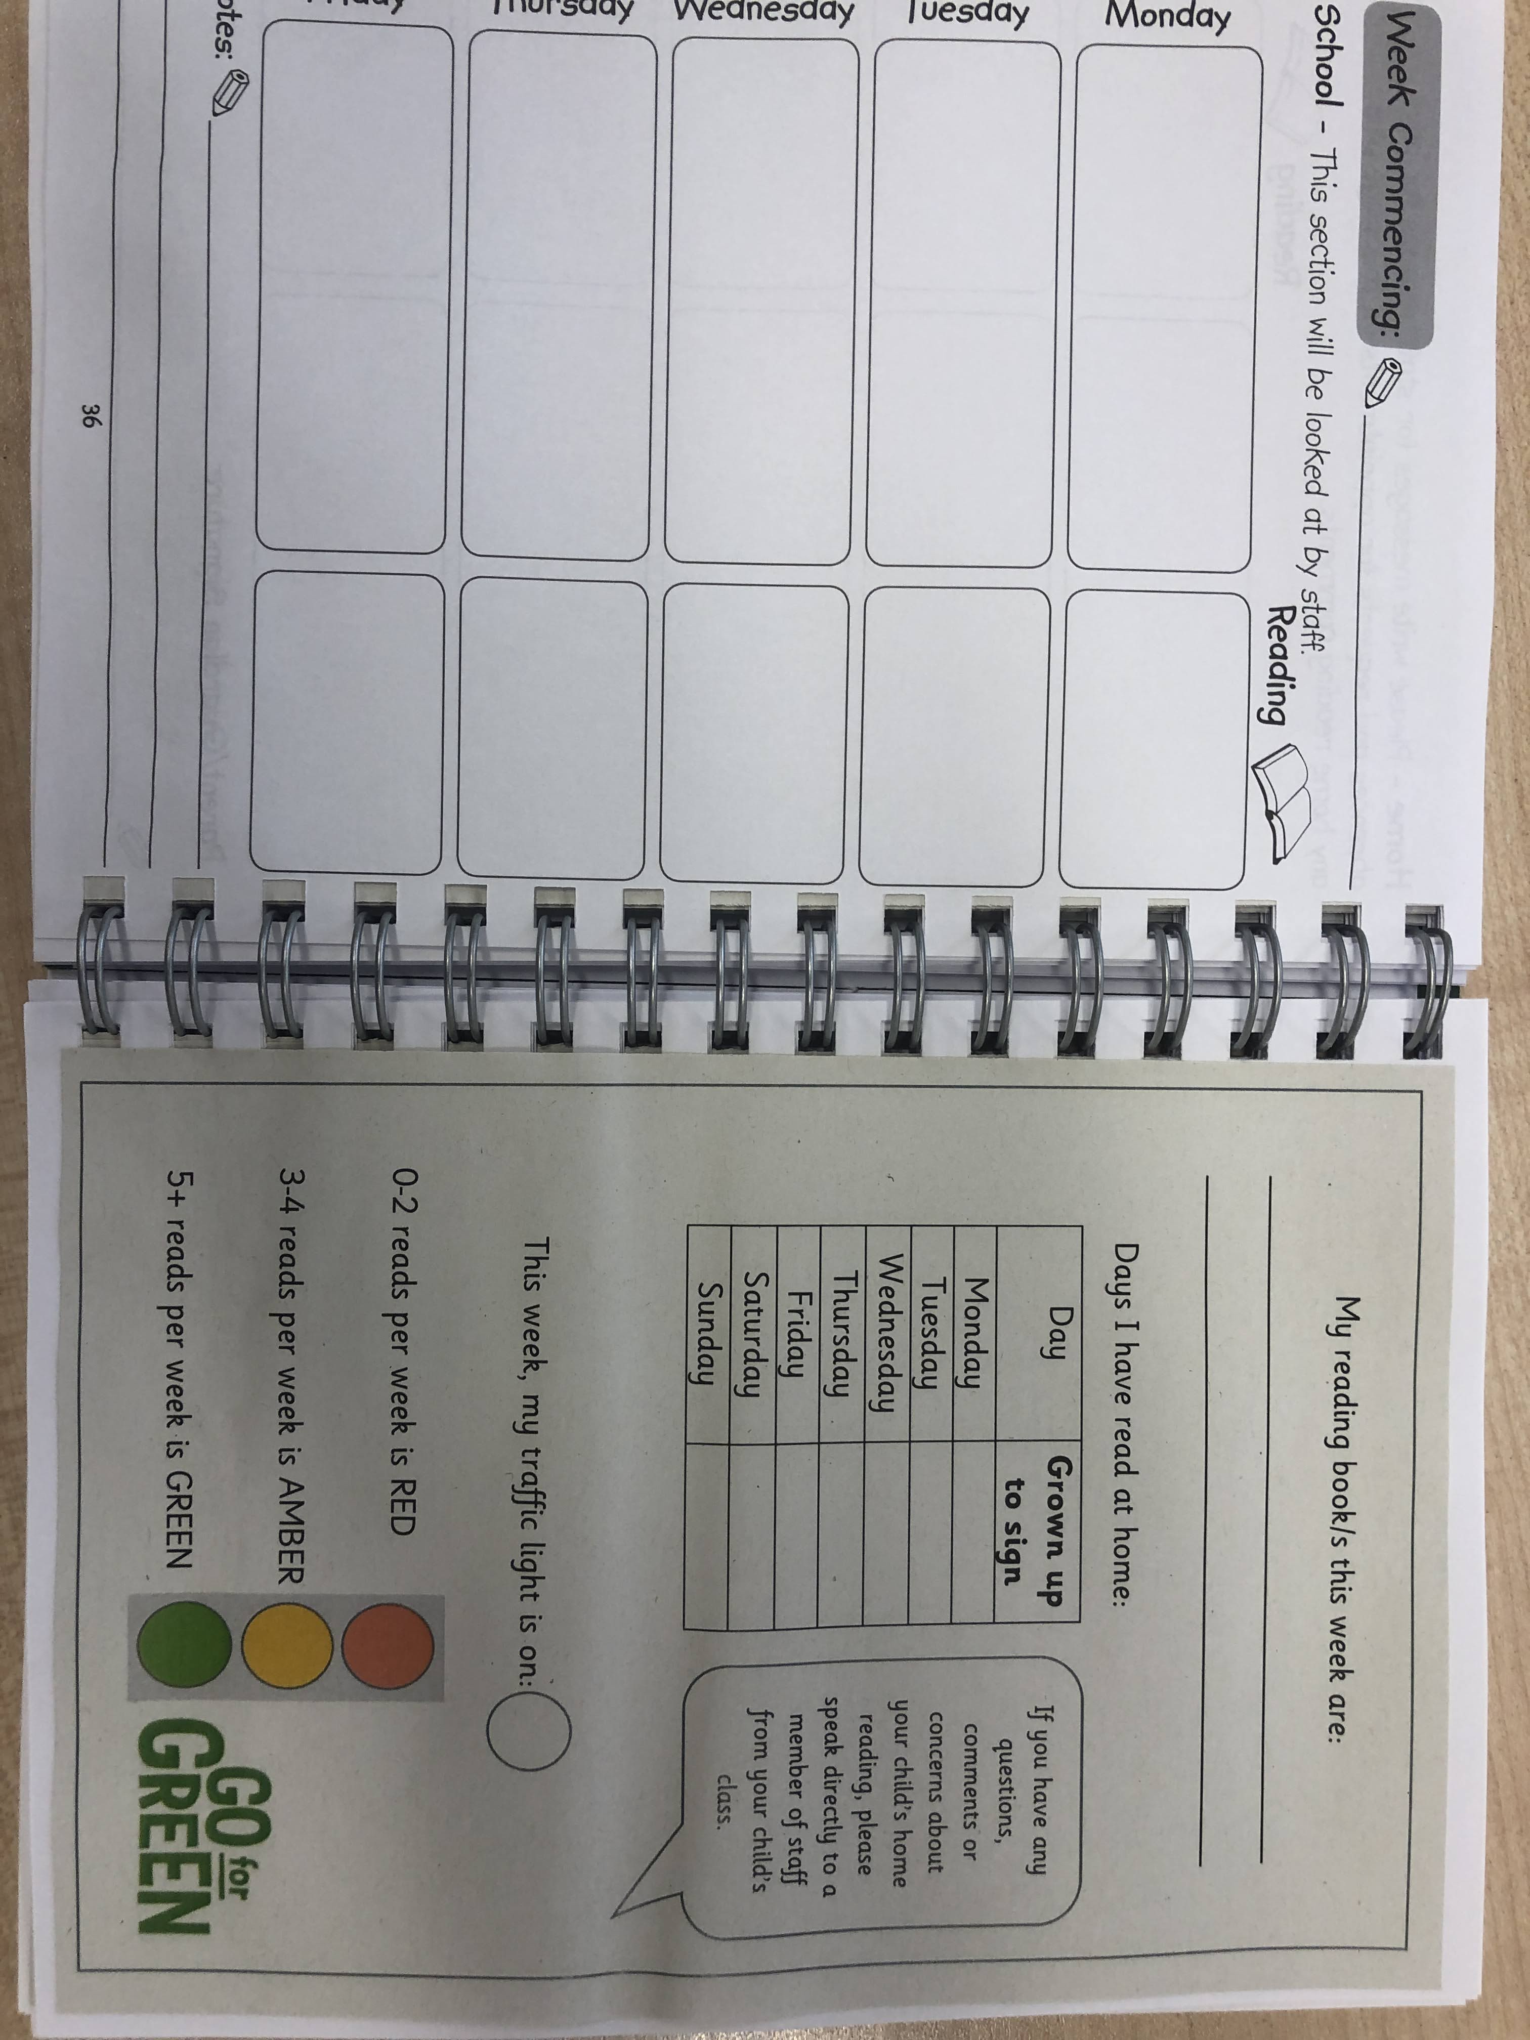
Reading

Slide 6
Spellings
As part of their homework each week, your child will bring home a new word list, to practise spelling at home, in preparation for a spelling quiz in school.
The words will be in line with their current phonics stage.
Your child will have seen all of the words during phonics during the week in their sessions.
Please support your child to learn these at home.
Say it, segment it, write it. ‘Sheep’ ‘sh-ee-p’ sheep
Year 2 common exception words – read first then spell

Slide 8
Additional Homework
1 page in Maths book and 1 page in Grammar book. The date and page number will always be written on the inside of the book, letting you know which page has been set for homework that week.
Reading comprehension and spelling.
Children are also expected to learn their 10, 5 and 2 times tables and division facts too. Times tables rocks stars log ins are stuck on the inside front page of your child's diary.

Slide 9
Times tables test
The children will sit a times tables test every week. 2R- Thursdays 2A- Wednesday
They are expected to complete 5 different challenges by the end of Year 2. Each challenge must be completed in 4 minutes.
Challenge 1 – 10 times tables test - 40 questions
Challenge 2 – Multiplying and dividing by 10 - 80 questions
Challenge 3 – Multiplying and dividing by 5 ( with some 10’s facts) - 80 questions
Challenge 4 - Multiplying and dividing by 2 (with some 10’s and 5’s facts) - 80 questions
Challenge 5 – Equal amount of all 10’s, 5’s and 2’s facts

Slide 10
Example of Challenge 2
The children are expected to know all the fact families for each multiplication.
E.g. 4x 10 = 40, 10 x 4 = 40, 40 $÷4=10 40 ÷10=4$

Slide 11
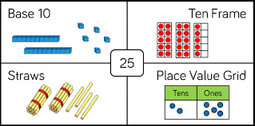
Maths
Key skills to practise:
Counting forwards and backwards within 100, in 10’s, 5’s 2’s and 3’s.
Reading and writing numbers to 100
Writing number words to 100
Ordering numbers to 100
Representing numbers in different ways (see example above)
Number bonds to 10, 20 and 100.

Slide 12
PE
Two PE lessons a week:
2A: Wednesday & Thursday.
2R: Monday & Thursday
Children should come to school wearing their PE kit.
PE kit should consist of black shorts/jogging bottoms and a white t-shirt with trainers.

Slide 13
Snack & Water
A piece of fruit is provided at break time.
Your child may bring in a healthy snack from home if they wish.
Children can also bring a (named) water bottle into school each day.
Children who are entitled to milk will receive it before break.

Slide 14
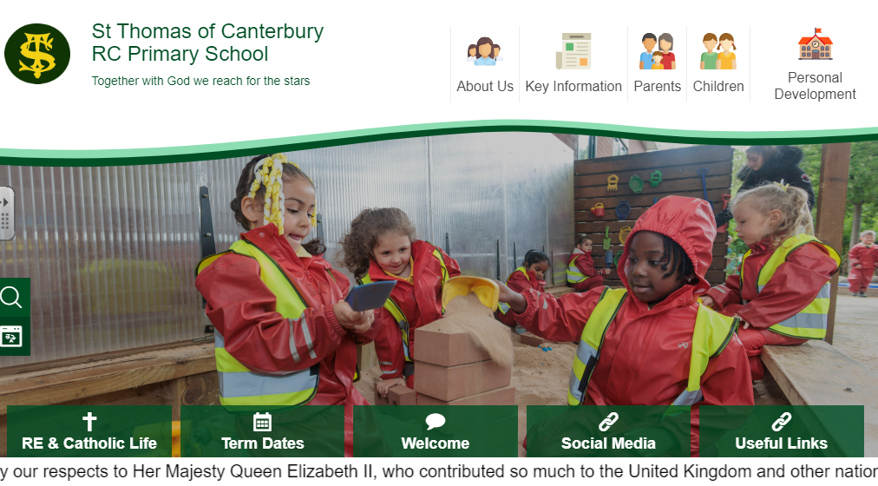
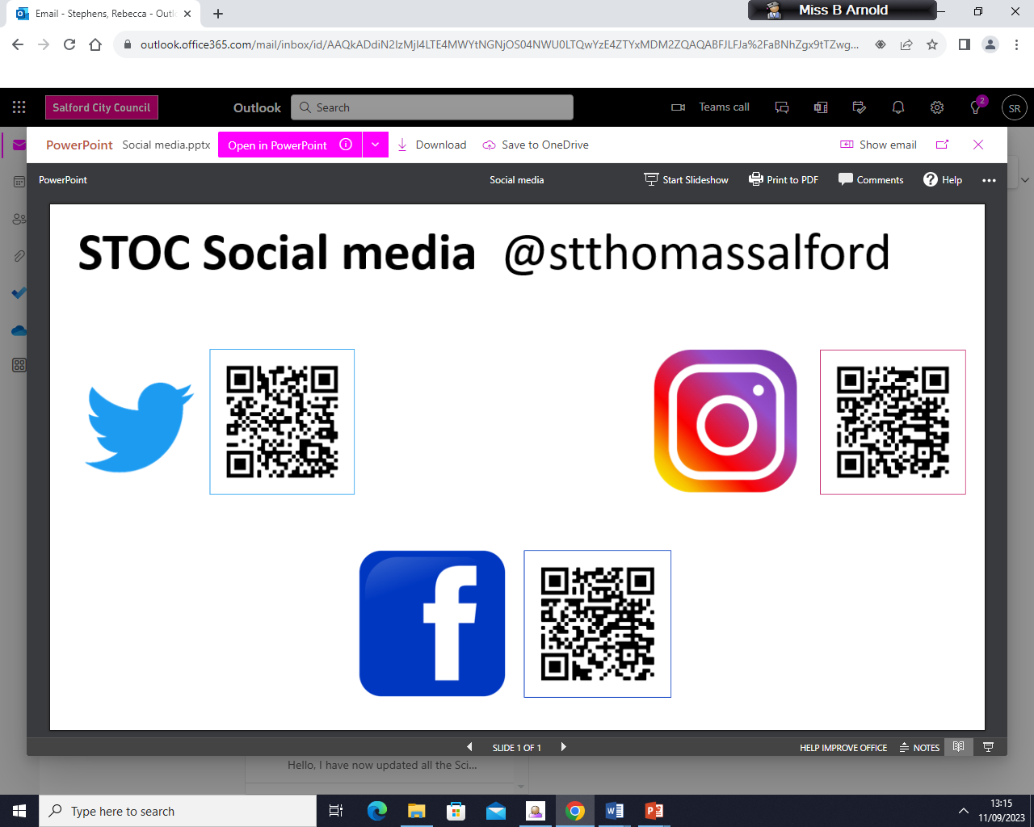
Social Media

Slide 15
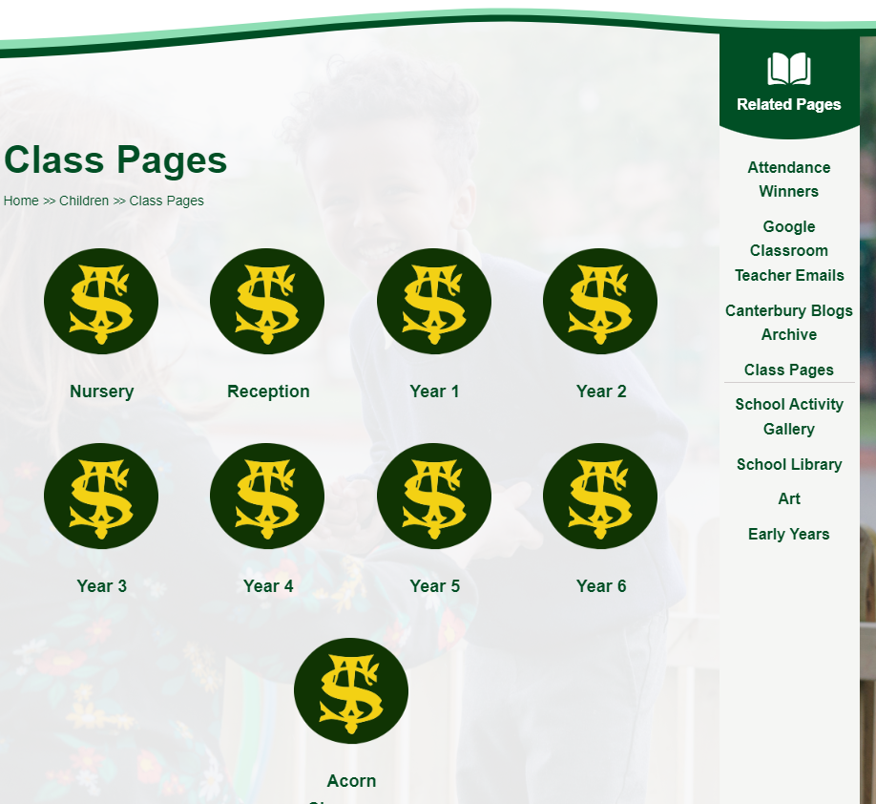
Class Page

Slide 16
Thank you for coming!
Children will be released from classrooms, in the usual way.

