Slide 1
Year 1 Parents Meeting
Mrs Clifford & Miss Power

Slide 2
A typical Year 1 day
Morning
Phonics, Handwriting, writing lesson
PLAYTIME (15 mins)
Mental Oral and Counting (Maths), Maths lesson
LUNCHTIME (1 hour)
Afternoon
Phonics, Reading groups, Topic (PE, Music, Geography, History, Art, Science, RE)
Choosing time
7pm bedtime

Slide 3

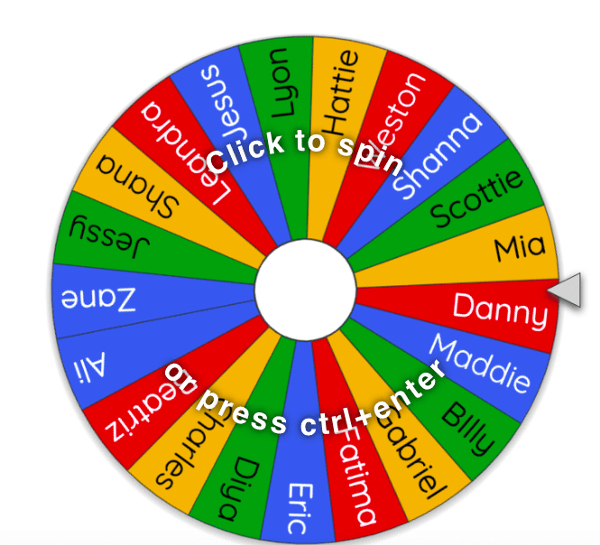
Drop off & Pick up
The school day begins at 8:45am
Classroom doors open at 8:40am
We politely ask all parents to remain on the playground at home time.
Notify class teacher if someone new is collecting your child.

Slide 4
Reading in Year 1
Your child will be assigned one e-book each week on a Friday. This is the book they have read in school that week, which they should read fluently, or with very little support. *E-book logins*
Your child will also bring home two phonics books each Monday. Please can you ensure these books are returned on a Monday, ready to be changed. Please listen to your child read aloud every night and sign their reading diary, to show they have read.
*Bring books/diaries into school daily*
Terrific Texts coming soon!
Reading daily will not only will your child’s fluency and confidence develop, but they will be able to take part in the reading rewards in their class- Traffic Light Treat Winner! ☺

Slide 5
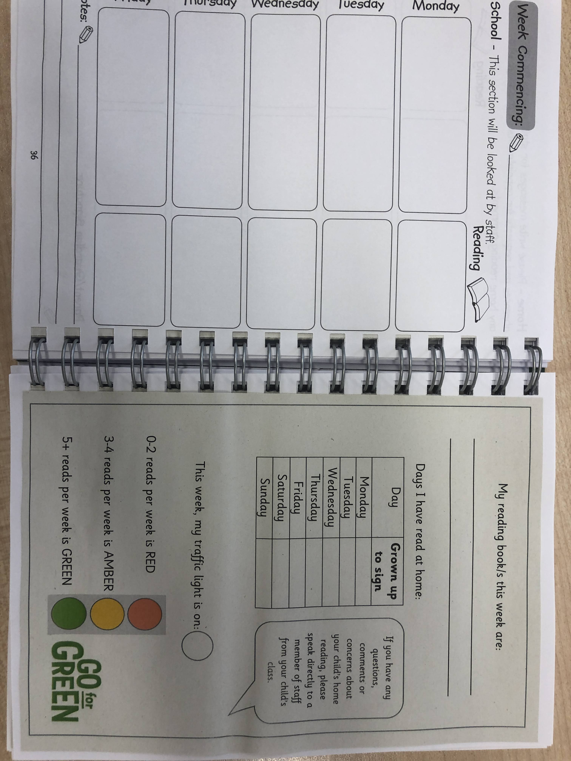
Reading

Slide 6
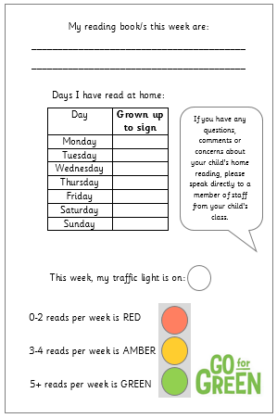

Slide 7
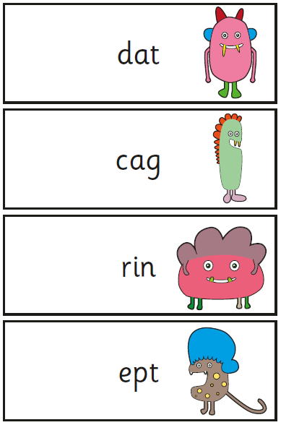
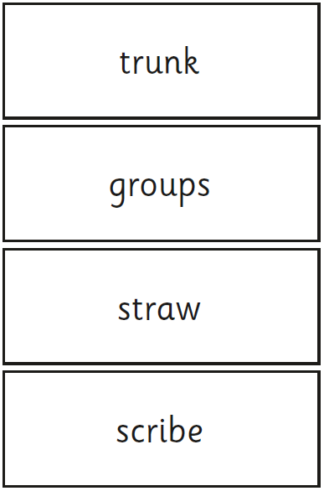
Phonics Screening Check
w/c Monday 9th June
20 real words
20 alien words

Slide 8
Spellings
As part of their homework each week, your child will bring home a new word list, to practise spelling at home, in preparation for a spelling quiz in school.
The words will be in line with their current phonics stage.
Your child will have seen all of the words during phonics during the week in their sessions.
Please support your child to learn these at home.
Say it, segment it, write it. ‘Sheep’ ‘sh-ee-p’ sheep
Year 1 Common Exception Words – read first then spell

Slide 10
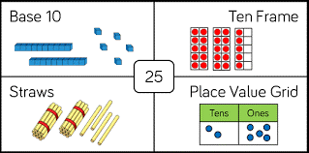
Maths
Key skills to practise:
Counting forwards and backwards within 100
Reading and writing numbers to 20
Writing number words to 20
Reading and writing numbers to 100 in numerals
1 more and 1 less– numbers up to 20 and then 100
Ordering numbers to 100
Representing numbers in different ways (see example above)
Number bonds to 10 and 20

Slide 11
PE
Two PE lessons a week, both on a Friday, until October half term.
Children should come to school wearing their PE kit.
PE kit should consist of black shorts/jogging bottoms/leggings and a white t-shirt with trainers.

Slide 12
Snack & Water
Children should also bring a (named) water bottle into school each day.
Children who have milk will receive it in the morning.
A piece of fruit is provided at break time.
Your child may bring in a piece of fruit/healthy snack from home if they wish.

Slide 13
Healthy Snacks
Fruit
Cereal bar (no nuts or chocolate)
Yogurt pouch
Bread sticks

Slide 14
Year 1
Names in any items of clothing brought to school.
Any questions please do not hesitate to ask.
Best time to speak to teachers: 8.40am.

Slide 15
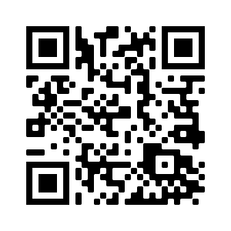

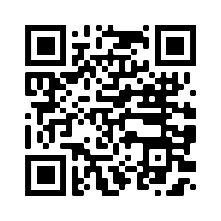


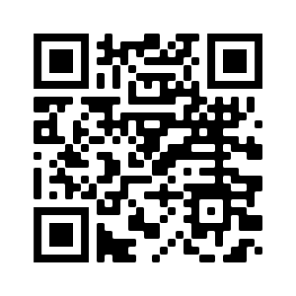
STOC Social media @stthomassalford

Slide 16
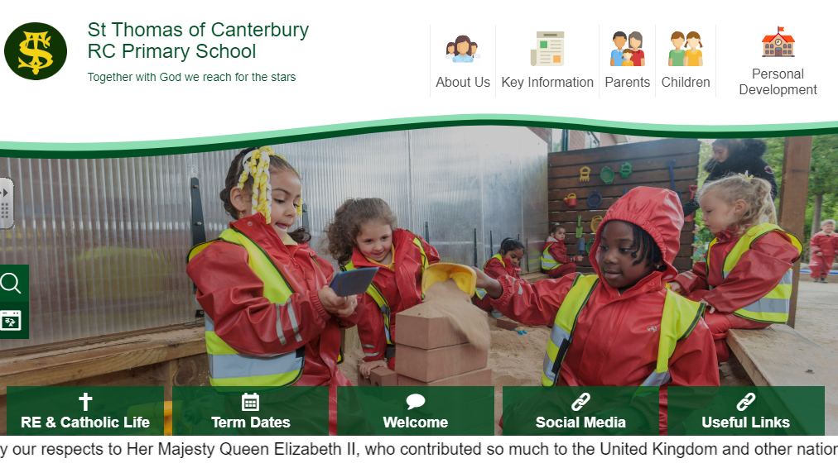
Social Media

Slide 17

Class Page

Slide 18
Thank you for coming!
Children will be released from classrooms, in the usual way.

