Slide 1
Year 1 Parents Meeting
Mrs Clifford & Miss Cotton

Slide 2
A typical Year 1 day
Mornings
Phonics, Handwriting, Writing
Break
Mental Oral and Counting (Maths), Maths lesson
Afternoon
Phonics, Reading groups, Topic (Geography, History, Art, Science, RE)
7pm bedtime

Slide 3
Drop off & Pick up
The school day begins at 8:55
Classroom doors will open at 8:45
We politely ask all parents remain at the bottom of the ramp at home time.
Please return your child’s collection form if you have not done so already.

Slide 4
Reading Books
Your child will be assigned one e-book each week on a Friday. This is the book they have read in school that week, which they should read fluently, or with very little support.
Your child will also bring home two phonics books each Monday. Please can you ensure these books are returned on a Monday, ready to be changed. Please listen to your child read aloud every night and sign their reading diary, to show they have read.
Reading for pleasure
Reading daily will not only will your child’s fluency and confidence develop, but they will be able to take part in the reading rewards in their class! ☺

Slide 5
Reading
Read every night with your child and sign their reading diaries everyday to show they have read.
Reading diaries can also be used for e-books.
A signature is required everyday
E-book logins will remain the same as Reception. Usernames and passwords will be sent out Friday as a reminder.
Phonics screening check in June 2023

Slide 6
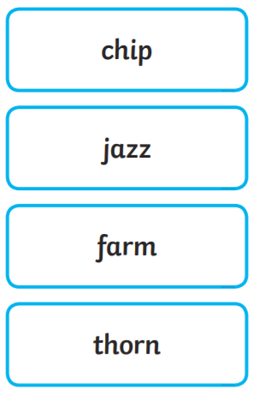

Slide 7
Spellings
Your child will bring home a new word list each week, to practice spelling at home, in preparation for a quiz in school.
The words will be in line with their current phonics stage.
Your child will have read all of the words during phonics during the week in their sessions.
Please support your child to learn these at home.
Say it, segment it, write it. ‘Sheep’ ‘sh-ee-p’ sheep
Year 1 common exception words – read first then spell

Slide 9
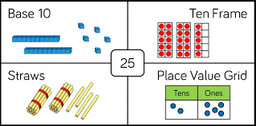
Maths
Key skills to practice
Counting forwards and backwards within 100
Reading and writing numbers to 20
Writing number words to 20
Reading and writing numbers to 100 in numerals
1 more and 1 less – numbers up to 20
Ordering numbers to 100
Representing numbers in different ways (see example above)
Number bonds to 10

Slide 10
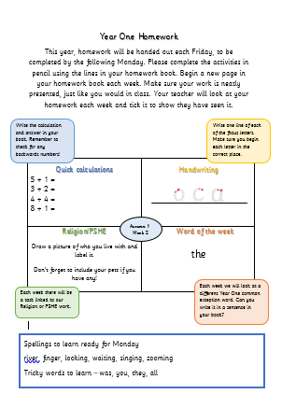
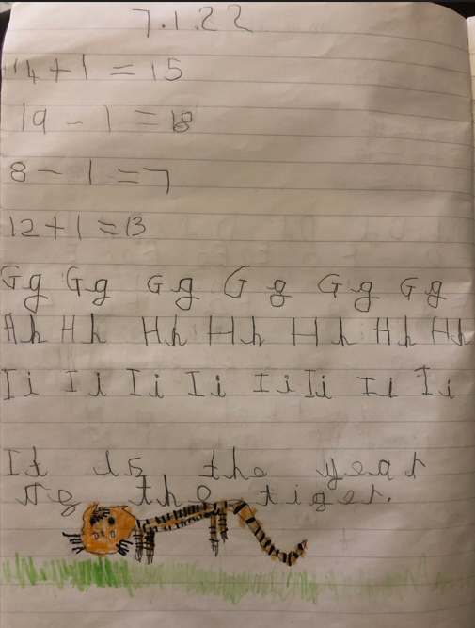

Slide 11
PE
Your child will take part in two PE lessons a week.
They should arrive at school wearing their PE kit.
PE kit should consist of black shorts/jogging bottoms and a white t-shirt with pumps/trainers.
Mrs Clifford’s PE days | Miss Cotton’s PE days
Friday | Friday

Slide 12
Snack & Water
A piece of fruit is provided at break time. Feel free to also send in a piece of fruit from home.
Children should also bring a water bottle into school each day.
Children who are entitled to milk will receive it after break.

Slide 13
Class Page

Slide 14
Social Media

Slide 15
Collection
Miss Cotton’s class to be released from Main Office.
Mrs Clifford’s class to be released from hall.
Any questions please do not hesitate at drop off/pick up times.

