Slide 1
This pencil is big.
This pencil is small.
This pencil is even smaller.
This pencil is the smallest.

Slide 2
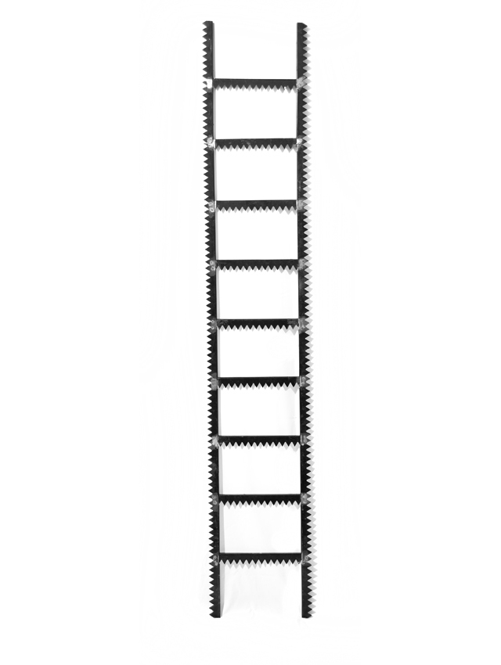
This ladder is big.
This ladder is small.
This ladder is even smaller.
This ladder is the smallest.

Slide 3
This crayon is big.
This crayon is small.
This crayon is even smaller.
This crayon is the smallest.

Slide 4
These scissors are big.
These scissors are small.
These scissors are even smaller.
These scissors are the smallest.

Slide 5
This bag is big.
This bag is small.
This bag is even smaller.
This bag is the smallest.

Slide 6
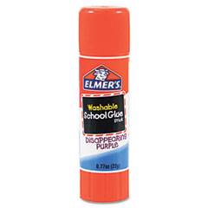
This glue is big.
This glue is small.
This glue is even smaller.
This glue is the smallest.

