Slide 1
This pencil is short.
This pencil is long.
This pencil is even longer.
This pencil is the longest.

Slide 2
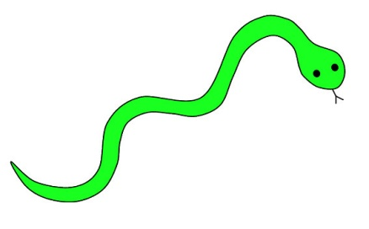
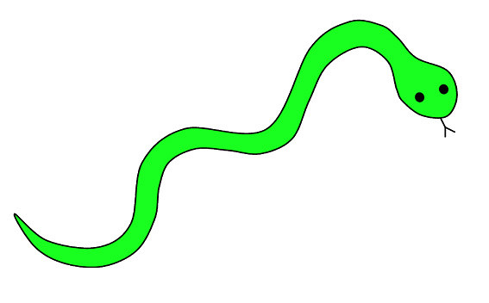
This snake is short.
This snake is long.
This snake is even longer.
This snake is the longest.

Slide 3
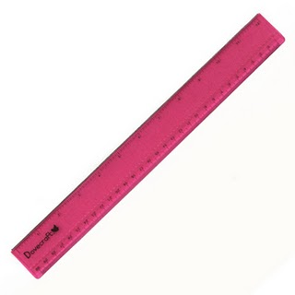
This ruler is short.
This ruler is long.
This ruler is even longer.
This ruler is the longest.

Slide 4
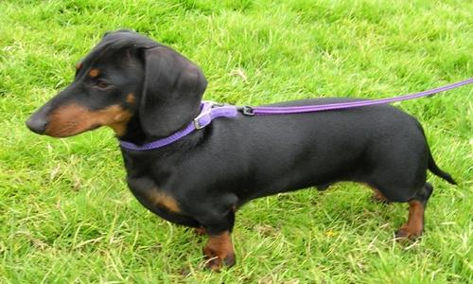
This dog is short.
This dog is long.
This dog is even longer.
This dog is the longest.

Slide 5
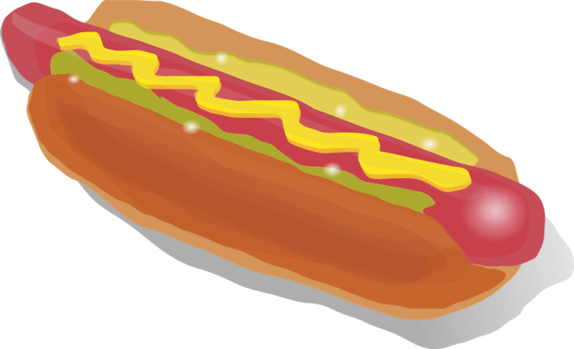
This hotdog is short.
This hotdog is long.
This hotdog is even longer.
This hotdog is the longest.

Slide 6
This bone is short.
This bone is long.
This bone is even longer.
This bone is the longest.

