Slide 1
This pencil is the biggest.
This pencil is bigger.
This pencil is big.
This pencil is small.

Slide 2
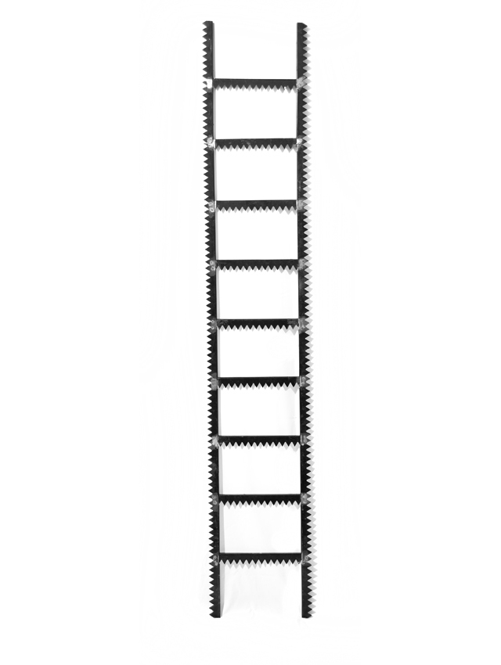
This ladder is the biggest.
This ladder is bigger.
This ladder is big.
This ladder is small.

Slide 3
This crayon is the biggest.
This crayon is bigger.
This crayon is big.
This crayon is small.

Slide 4
These scissors are the biggest.
These scissors are bigger.
These scissors are big.
These scissors are small.

Slide 5
This bag is the biggest.
This bag is bigger.
This bag is big.
This bag is small.

Slide 6
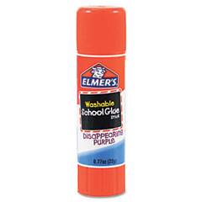
This glue is the biggest.
This glue is bigger.
This glue is big.
This glue is small.

