Slide 1
This pencil is even....
This pencil is big.
This pencil is small.

Slide 2
This pencil is short.
This pencil is long.
This pencil is even ....

Slide 3
This pencil is big.
This pencil is small.
This pencil is even .....

Slide 4
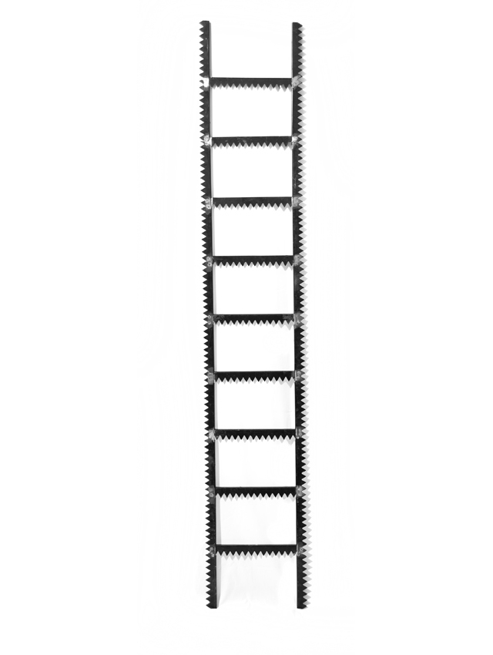
This ladder is even .....
This ladder is big.
This ladder is small.

Slide 5
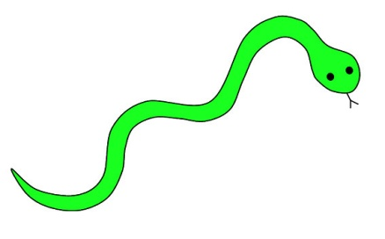
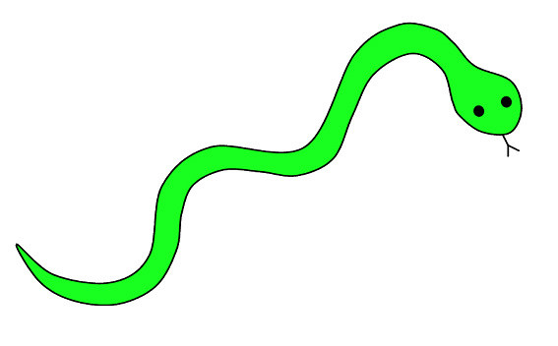
This snake is short.
This snake is long.
This snake is even .....

Slide 6
This ladder is big.
This ladder is small.
This ladder is even .....

Slide 7
This crayon is even ....
This crayon is big.
This crayon is small.

Slide 8
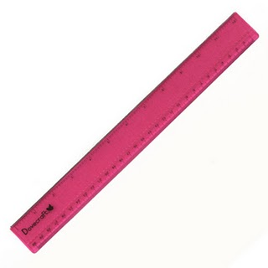
This ruler is short.
This ruler is long.
This ruler is even .....

Slide 9
This crayon is big.
This crayon is small.
This crayon is even .....

Slide 10
These scissors are even .....
These scissors are big.
These scissors are small.

Slide 11
These scissors are big.
These scissors are small.
These scissors are even ......

Slide 12
This bag is even ......
This bag is big.
This bag is small.

Slide 13
This bag is big.
This bag is small.
This bag is even ......

Slide 14
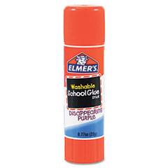
This glue is even ......
This glue is big.
This glue is small.

Slide 15
This glue is big.
This glue is small.
This glue is even .....

