Slide 1
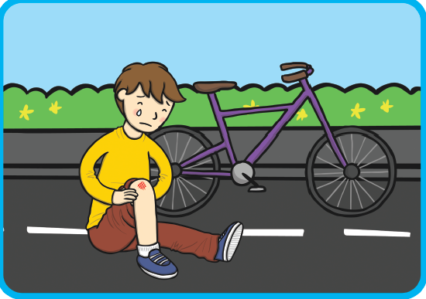
The boy is sad because he fell off his bike.

Slide 2
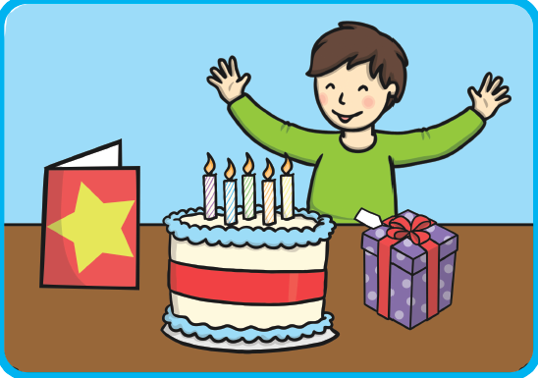
The boy is happy because it is his birthday.

Slide 3
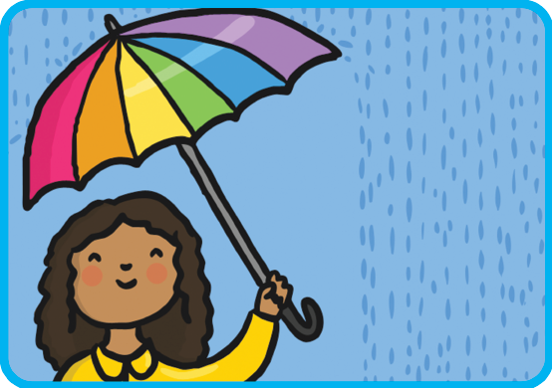
The girl is using an umbrella because it is raining.

Slide 4
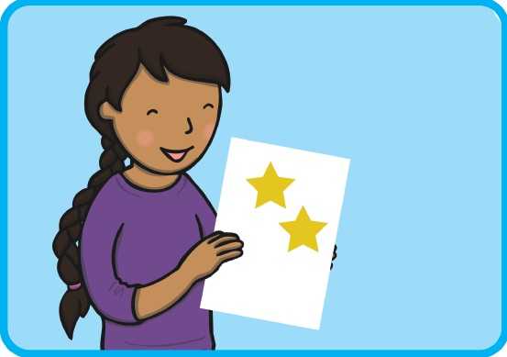
The girl is happy because she had stickers for good work.

Slide 5
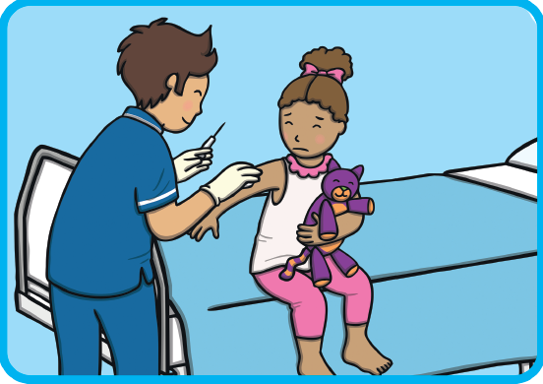
The girl is scared because she doesn’t like needles.

Slide 6
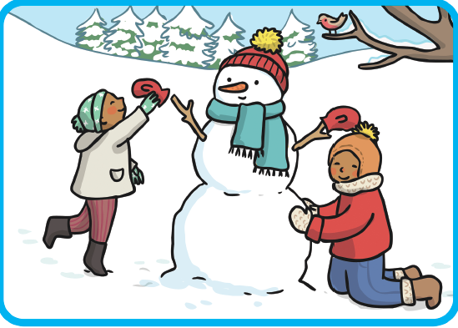
The children are wearing coats because it is cold.

Slide 7
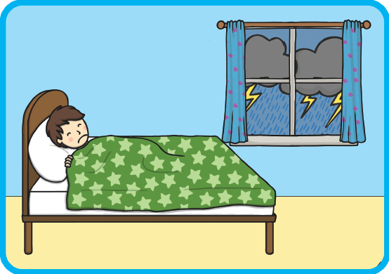
The boy is scared because there is a storm outside.

Slide 8
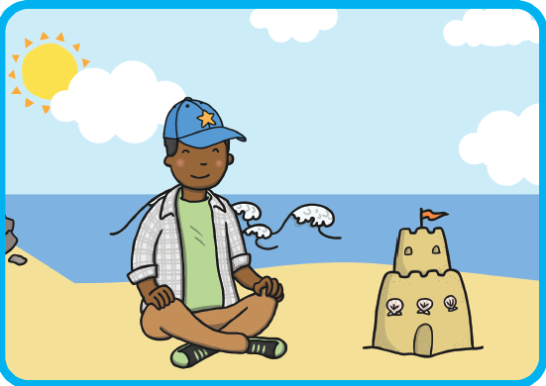
The boy is wearing a hat because it is sunny.

Slide 9
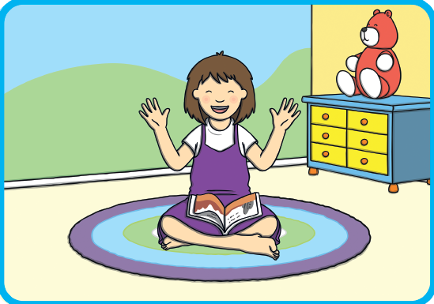
The girl is laughing because the story is funny.

Slide 10
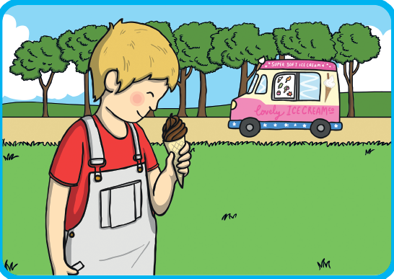
The boy is happy because he is eating ice-cream.

