Slide 1
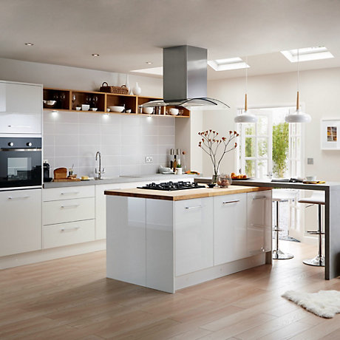
This is the Kitchen.
What do we do in the kitchen?

Slide 2
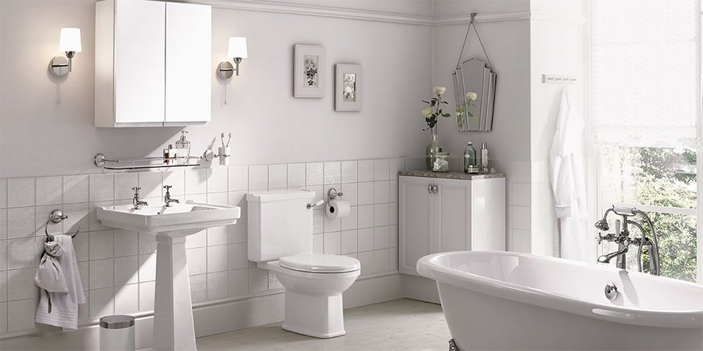
This is the bathroom.
What do we do in the bathroom?

Slide 3
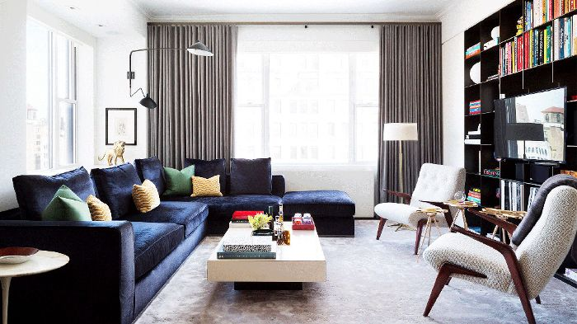
This is the living room.
What do we do in the living room?

Slide 4
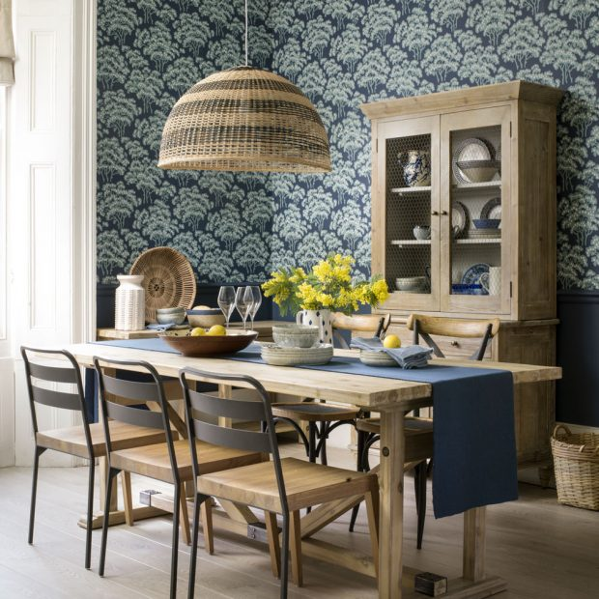
This is the dining room.
What do we do in the dining room?

Slide 5
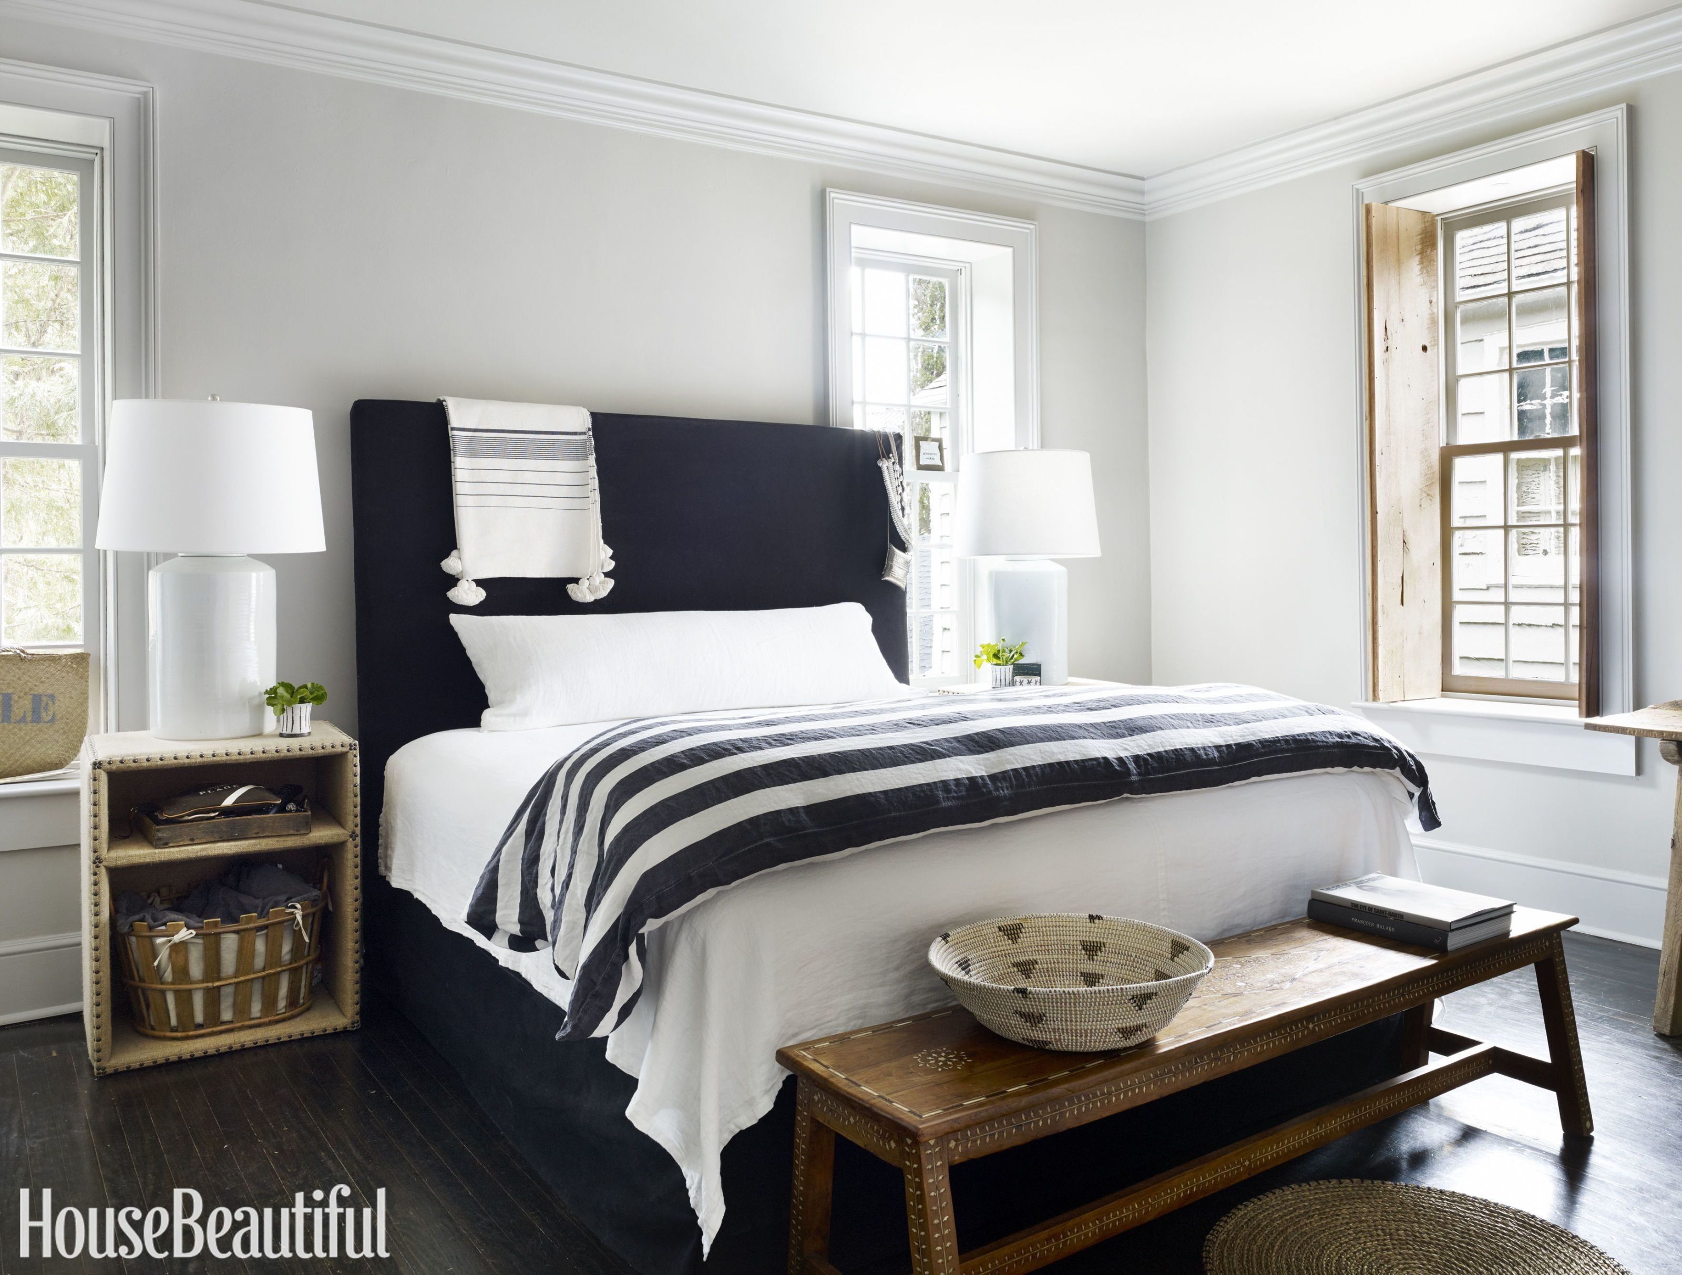
This is the bedroom.
What do we do in the bedroom?

Slide 6
Where do we have a bath?

Slide 7
Where do we cook dinner?

Slide 8
Where do we sleep?

Slide 9
Where do we brush our teeth?

Slide 10
Where do we watch television?

Slide 11
Where do we go to the toilet?

