Slide 1
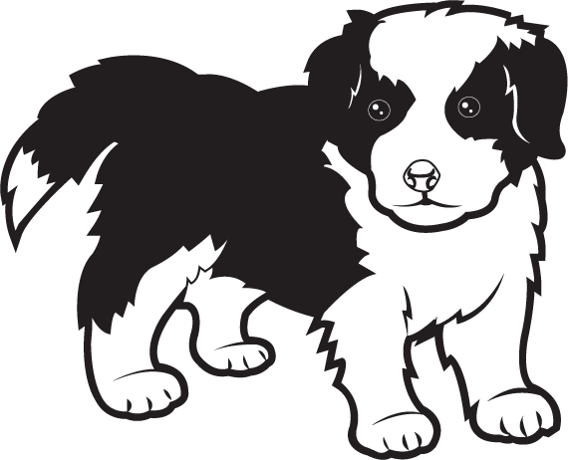
Where is the dog?
Can you find him?

Slide 2
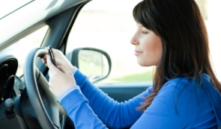
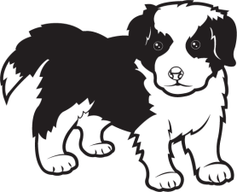
Where is the dog?

Slide 3
Dog is under the car.

Slide 4
Where is the dog?

Slide 5
Dog is under the box.

Slide 6
Where is the dog?

Slide 7
Dog is under the flower pot.

Slide 8
Where is the dog?

Slide 9
Dog is under the cup.

Slide 10
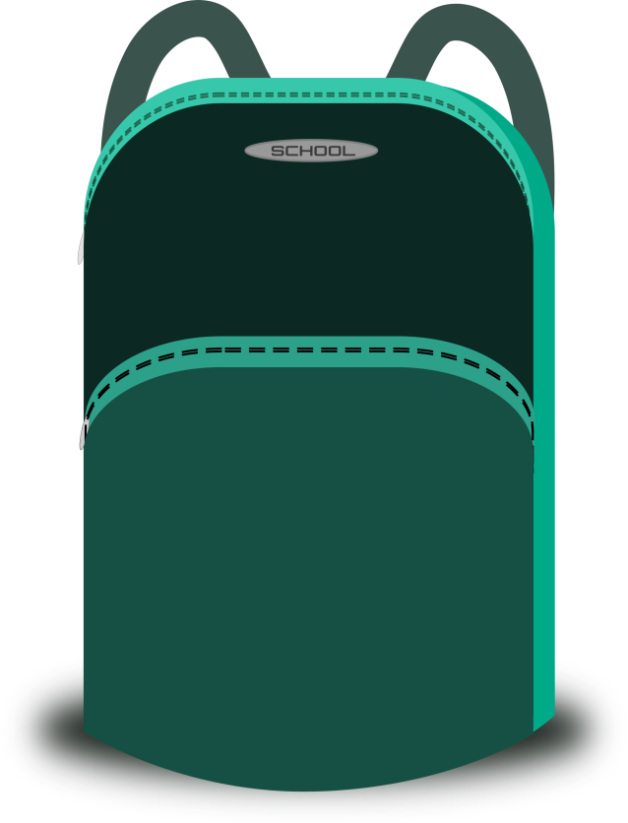
Where is the dog?

Slide 11
Dog is under the bag.

Slide 12
Well done

