Slide 1
Disclaimer/s
We hope you find the information on our website and resources useful.
Animations
This resource has been designed with animations to make it as fun and engaging as possible. To view the content in the correct formatting, please view the PowerPoint in ‘slide show mode’. This takes you from desktop to presentation mode. If you view the slides out of ‘slide show mode’, you may find that some of the text and images overlap each other and/or are difficult to read.
To enter slide show mode, go to the slide show menu tab and select either from beginning or from current slide.
You may wish to delete this slide before beginning the presentation.

Slide 3
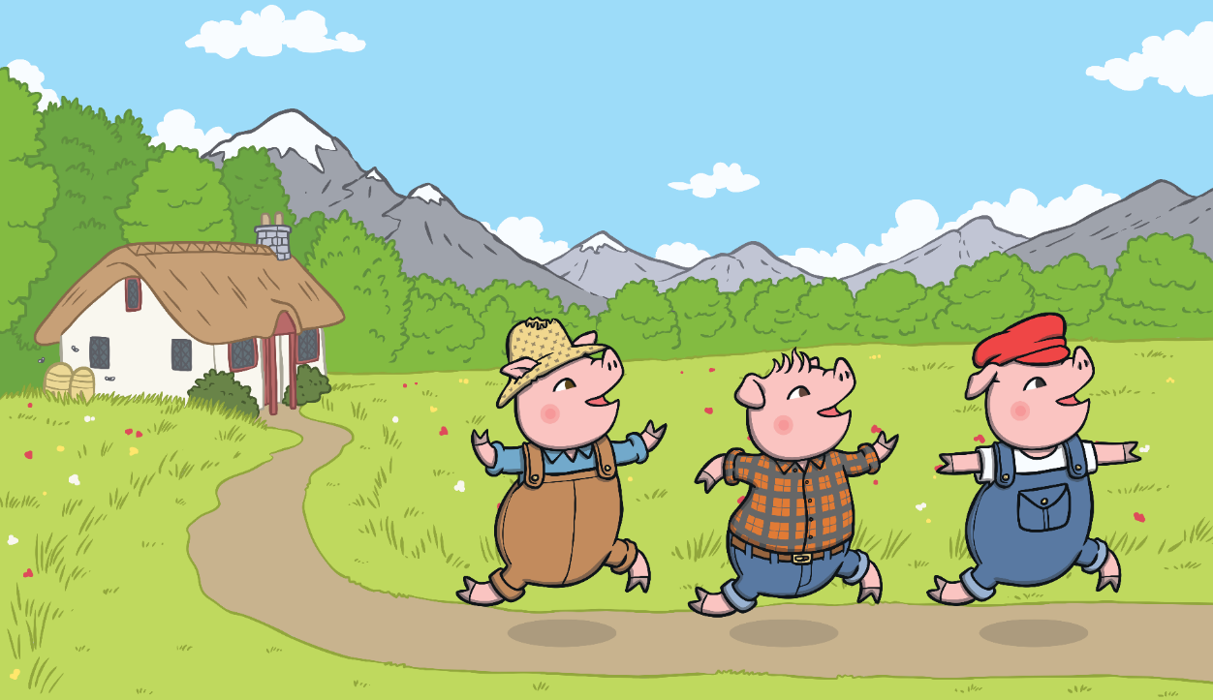
Once upon a time, there lived three little pigs.
One day, they decided to leave home and build houses of their own.

Slide 4
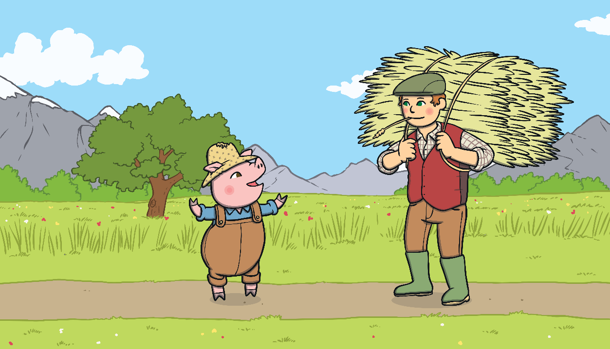
The first little pig thought that straw would make a good house.

Slide 5
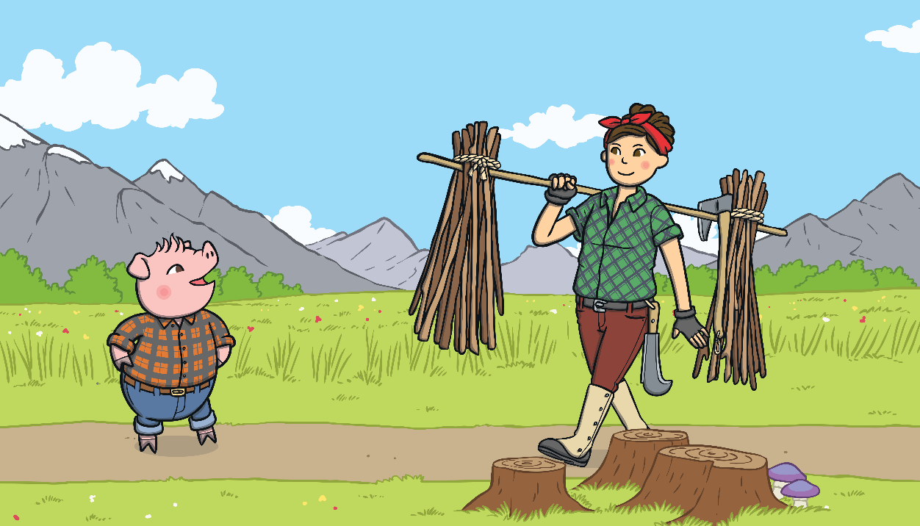
The second little pig thought that sticks would make a fine house.

Slide 6
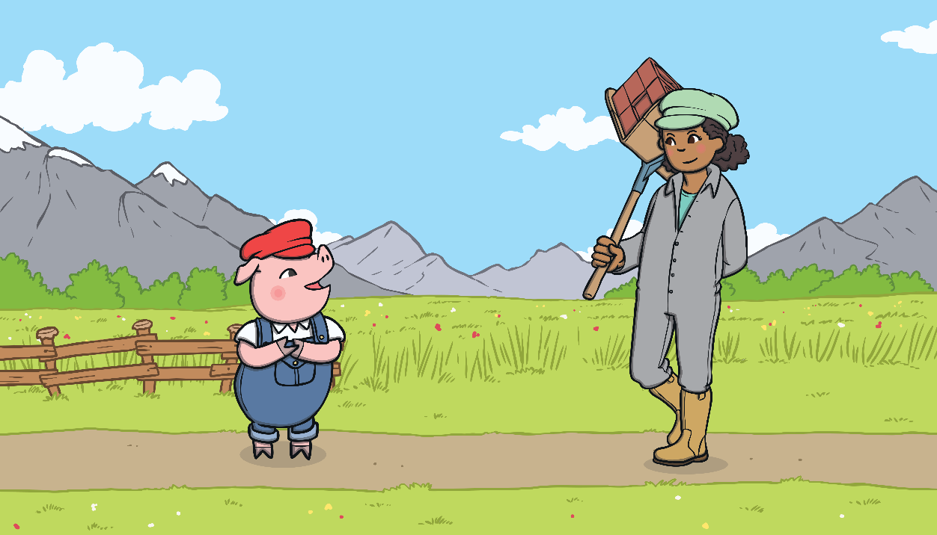
The third little pig thought that bricks would make a strong house.

Slide 7
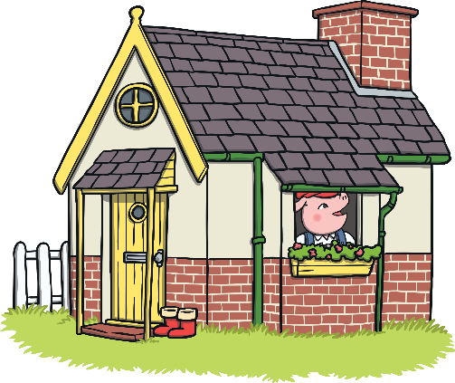
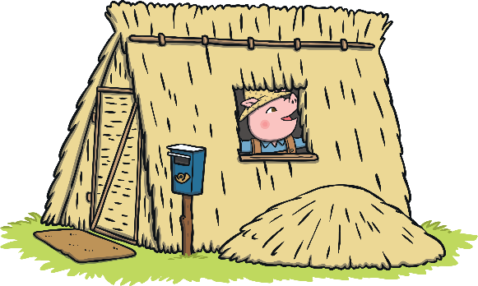
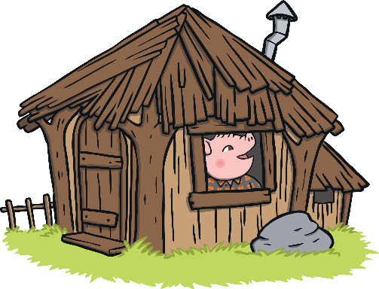
The first little pig built his house out of straw very quickly and he was very pleased with it.
It took the third little pig a long time to build his house out of bricks but he was very pleased with it.
The second little pig built his house out of sticks very quickly and he was also very pleased with it.

Slide 8
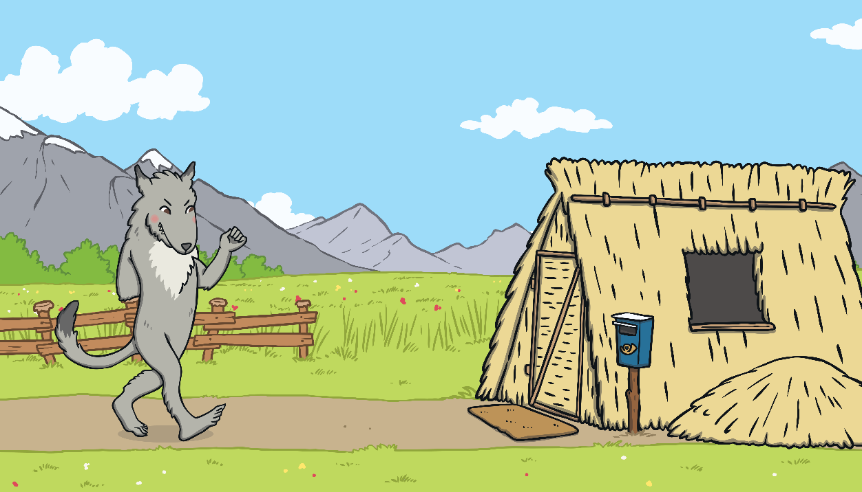
One day, a big bad wolf came along.
He saw the first little pig in his house of straw.

Slide 9
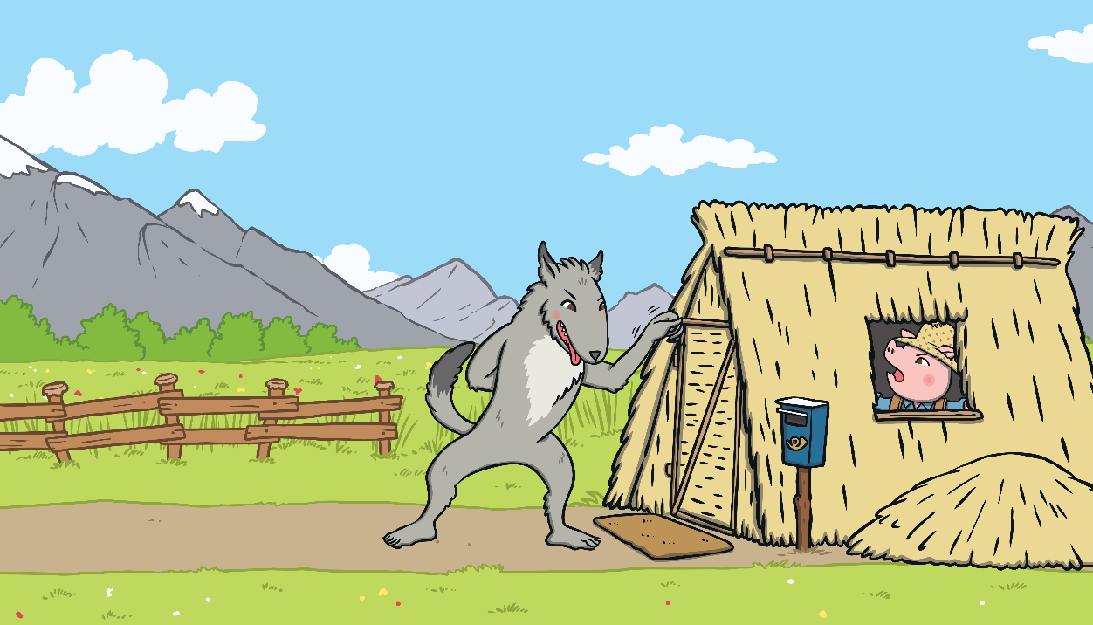
“Little pig, little pig, let me come in,” he snarled.
“Not by the hair on my chinny, chin, chin!” cried the first little pig.

Slide 10
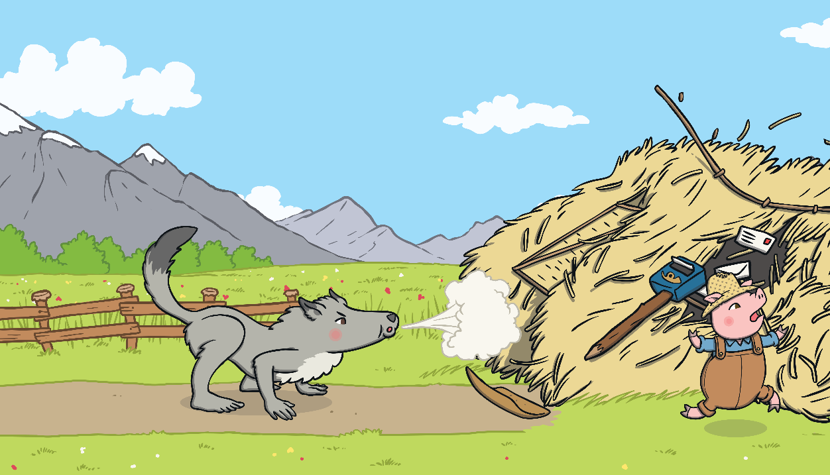
“Then I’ll huff and I’ll puff and I’ll blow your house down!” growled the big bad wolf.
So he huffed and he puffed and he blew the house down!
The first little pig escaped and ran to join his brother in the house made of sticks.

Slide 11
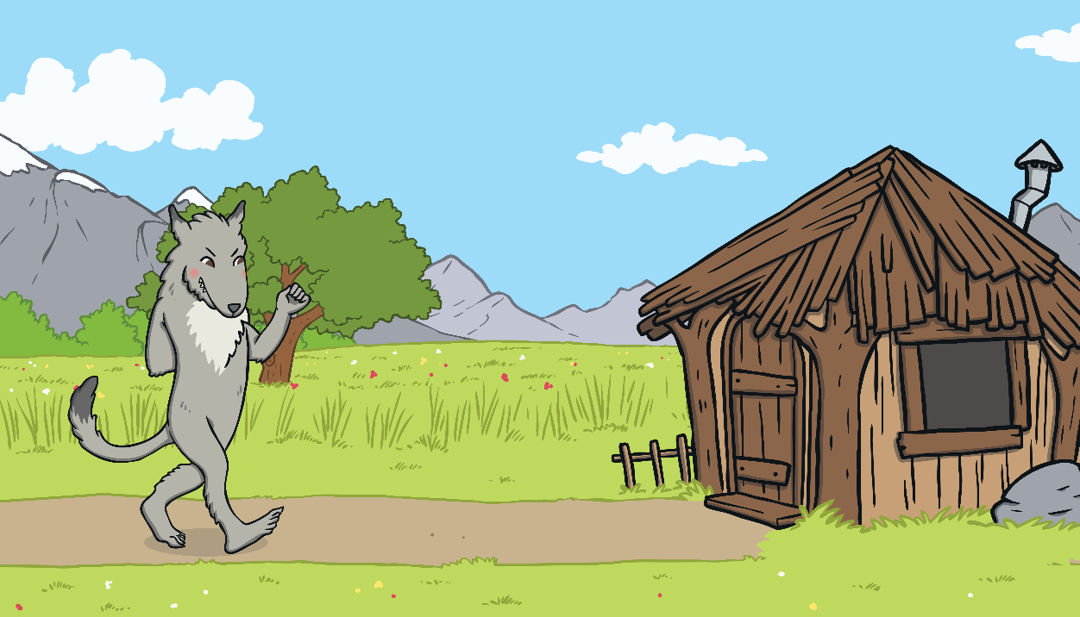
The big bad wolf followed the little pig to the house made of sticks.

Slide 12
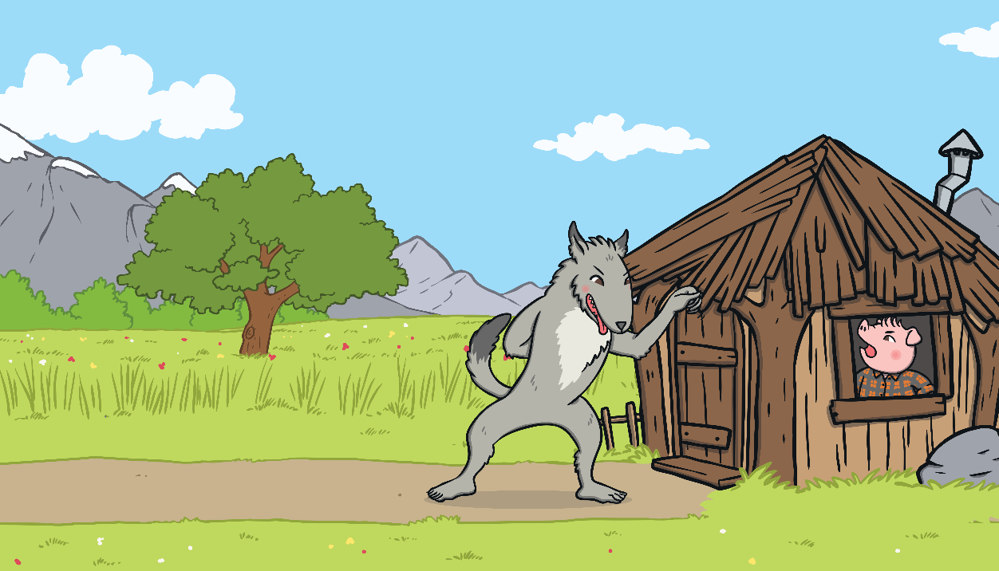
“Little pig, little pig, let me come in,” he snarled.
“Not by the hair on my chinny, chin, chin!” cried the second little pig.

Slide 13
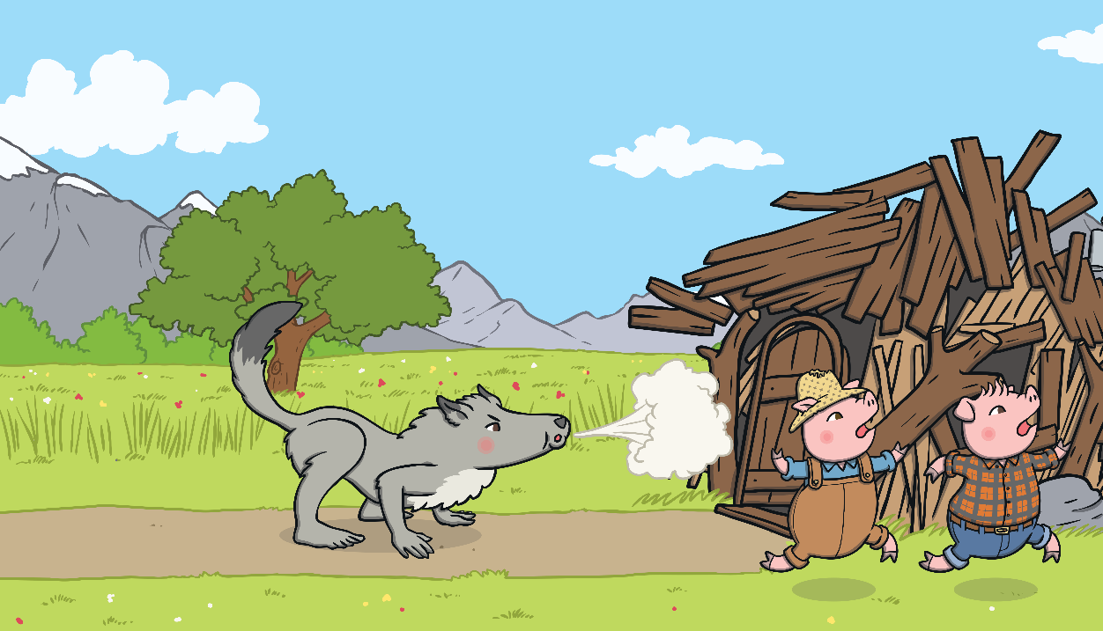
“Then I’ll huff and I’ll puff and I’ll blow your house down!” growled the big bad wolf.
So he huffed and he puffed and he blew the house down!
The two little pigs escaped and ran to join their brother in the house made of bricks.

Slide 14
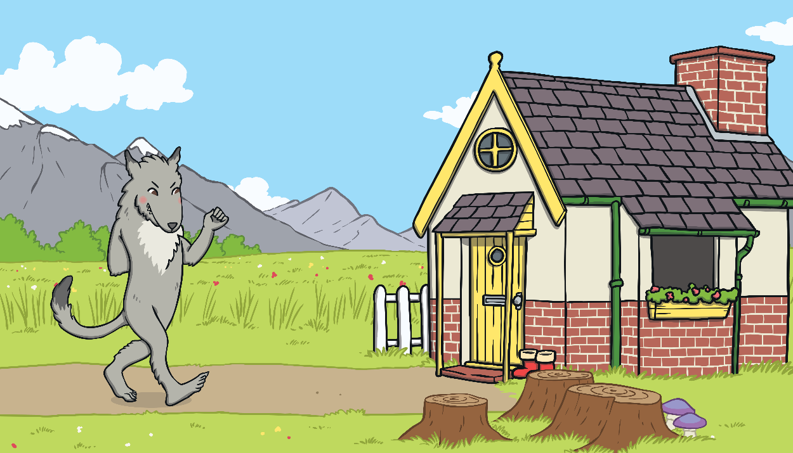
The big bad wolf followed the pigs to the house made of bricks.

Slide 15
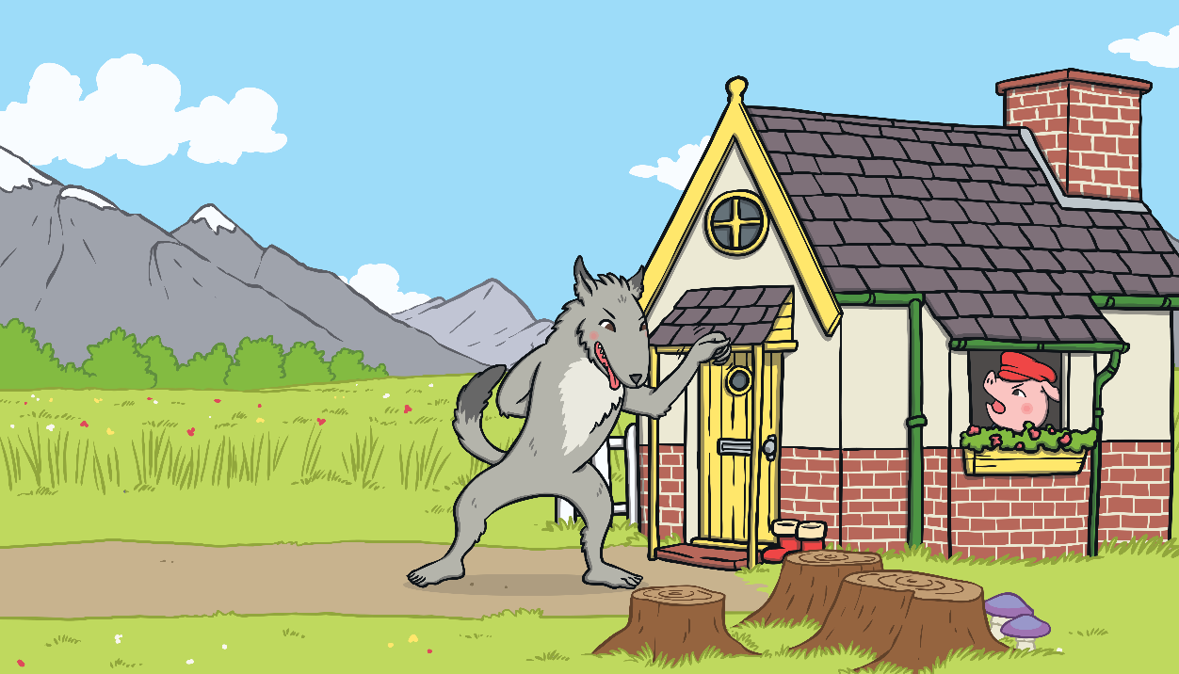
“Little pig, little pig, let me come in,” he snarled.
“Not by the hair on my chinny, chin, chin!” cried the third little pig.

Slide 16
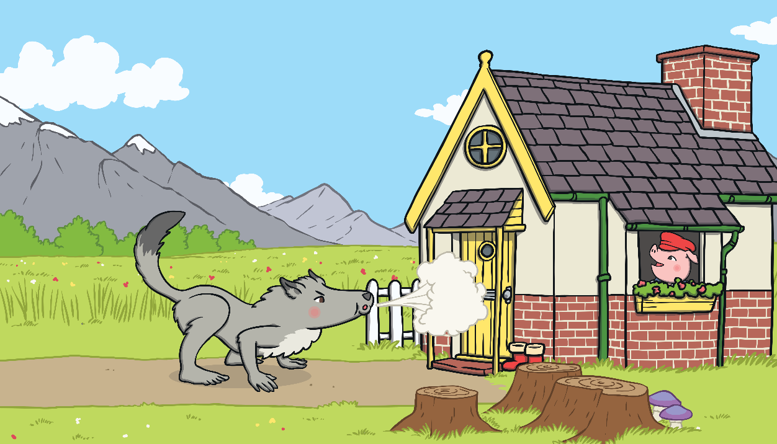
“Then I’ll huff and I’ll puff and I’ll blow your house down!” growled the big bad wolf.
He huffed and he puffed, but the house was too strong. He could not blow it down!

Slide 17
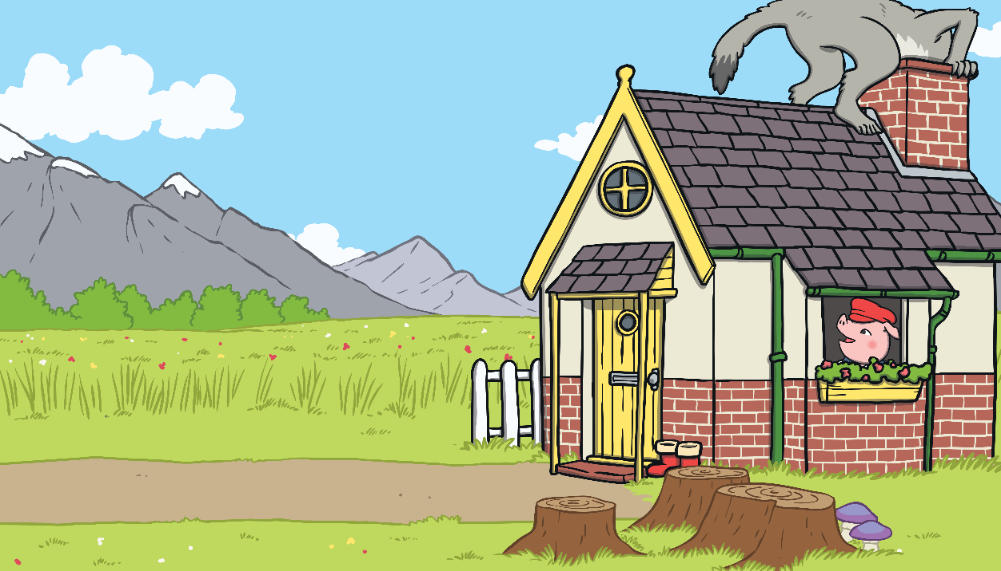
This made the big bad wolf very angry.
He climbed onto the roof of the house so he could crawl down the chimney.

Slide 18
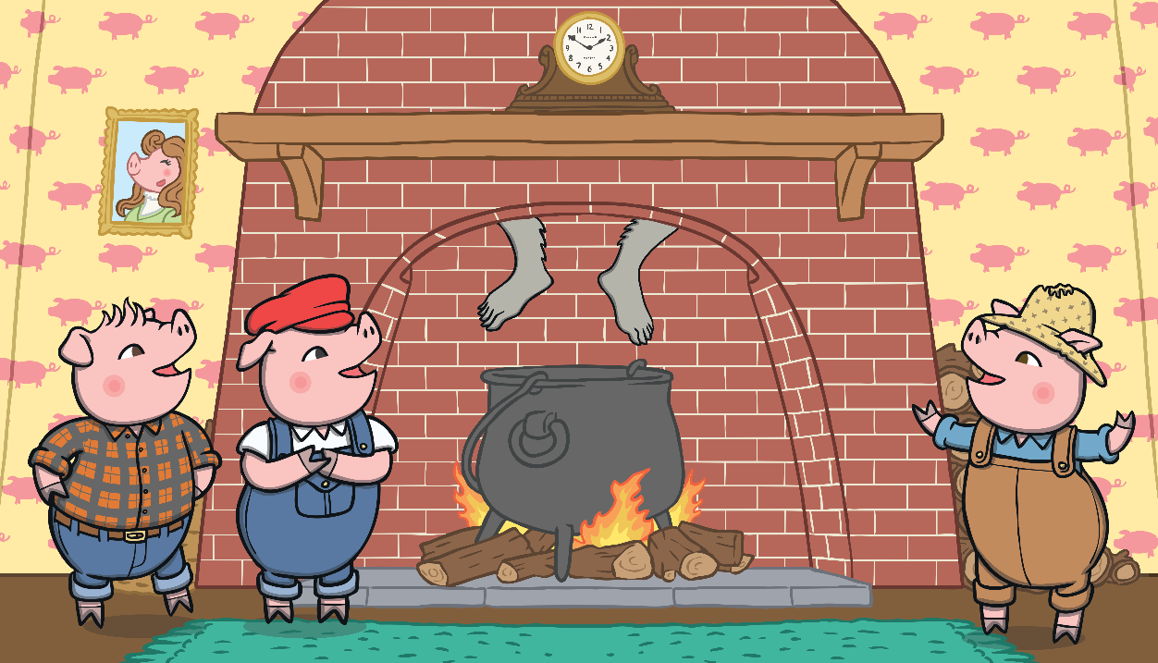
The big bad wolf was in for a big surprise!

Slide 19
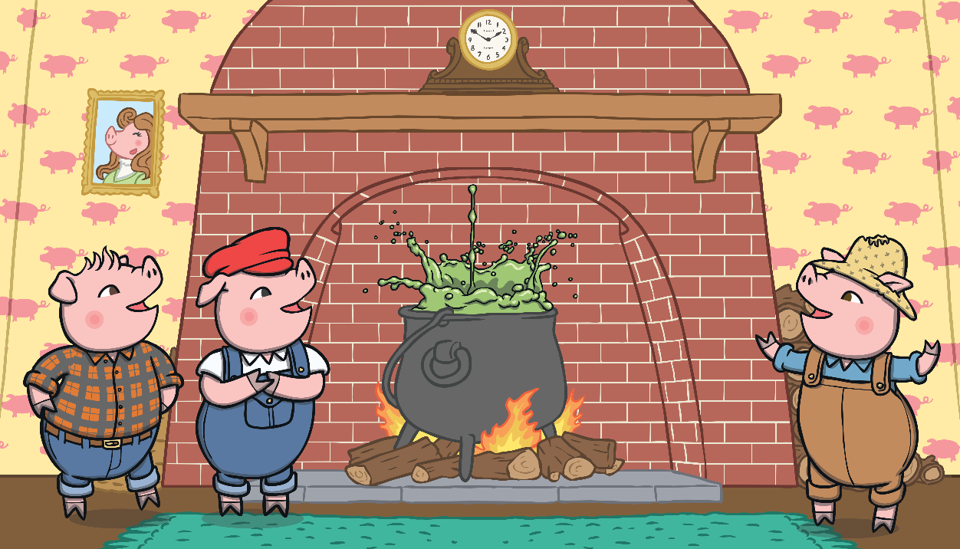
The third little pig had been cooking a big pot of stew and SPLASH!
The wolf fell right into the pot!

Slide 20
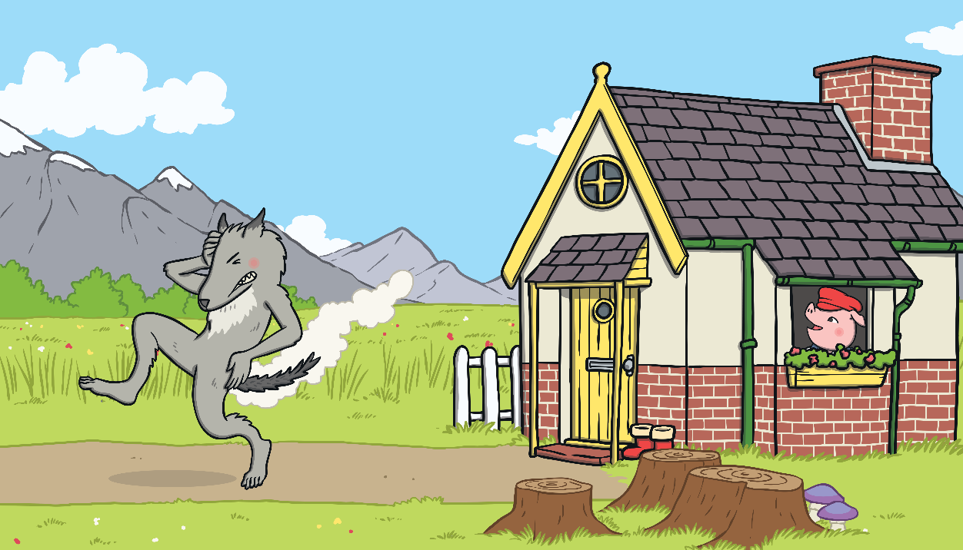
The wolf was very shocked. He jumped out of the pot and ran straight out of the house. He never came back again.

Slide 21
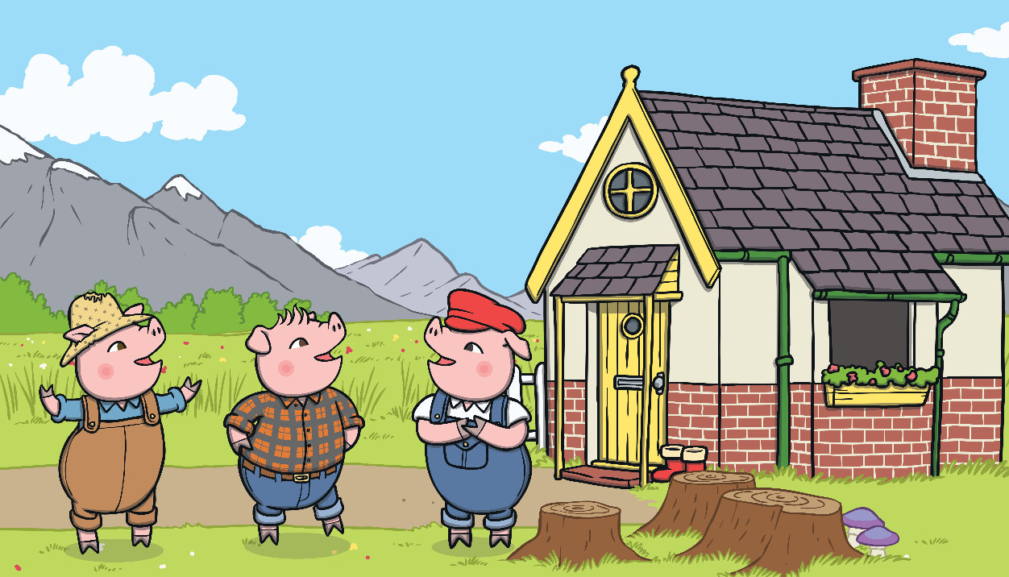
The little pigs lived happily ever after in the house made of bricks.

