Slide 2
Who Was Saint Patrick?
Saint Patrick is the patron saint of Ireland.
He is known for bringing Christianity to Ireland.

Slide 3
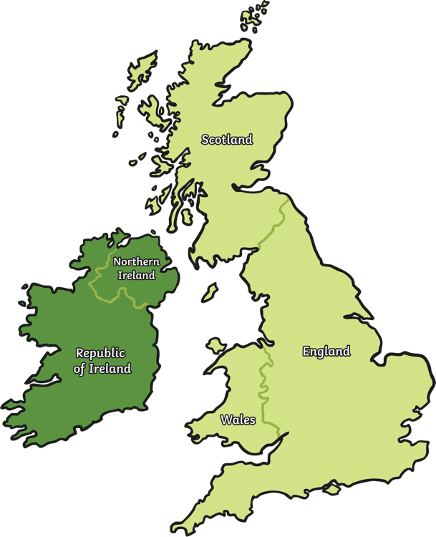
An Amazing Story
Saint Patrick was born a very long time ago
in around AD 390.
He grew up happily with his family.
He was captured by pirates when he was
16 years old and taken as a slave to Ireland.
He had to work there for 6 years before
he could escape.
Saint Patrick was a Christian and
decided to become a priest.
He decided he wanted to return to Ireland to teach
people about Jesus.

Slide 4
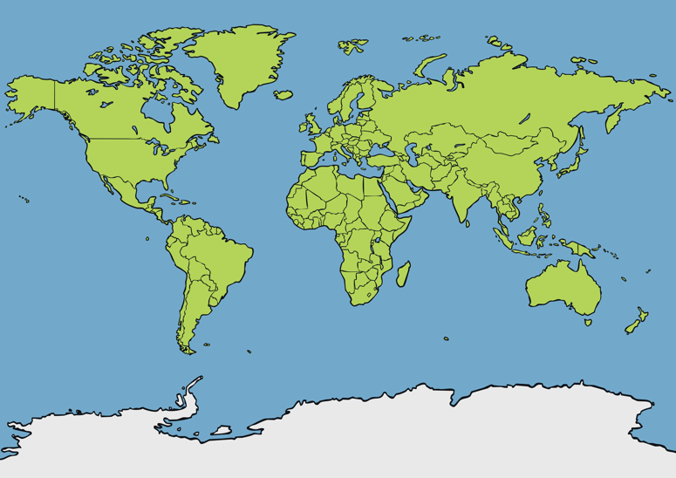
St. Patrick’s Day
St. Patrick’s Day is celebrated on 17th March.
Where in the world do you think it is celebrated?
St. Patrick’s Day is celebrated all over the world! Wherever Irish people live, they like to celebrate the special day of their patron saint.

Slide 5

St. Patrick’s Day Traditions
There are many ways to celebrate St. Patrick’s Day.
Have you ever seen any of these traditions?
people dress in green
people join parades
people visit
church to pray
leprechauns
important places are
lit up green
shamrock

Slide 6
Celebrating Irish Culture
Today, St. Patrick’s Day celebrates Irish culture.
Irish music
Irish dancing
Irish food and drink

