Slide 1
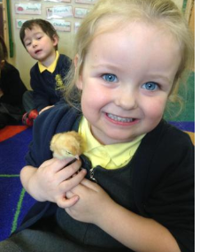
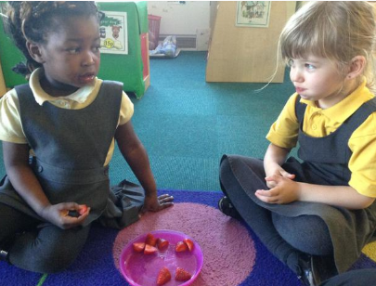
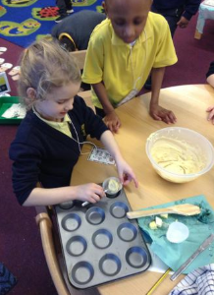
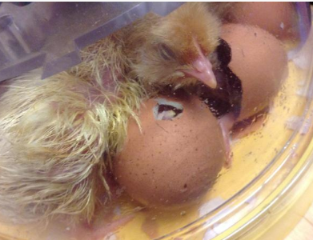
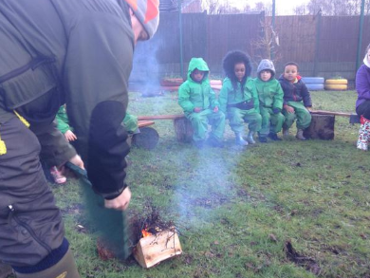
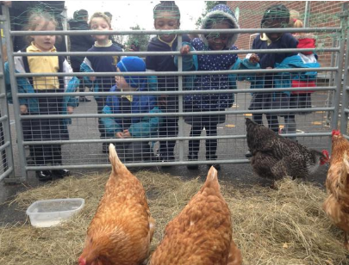
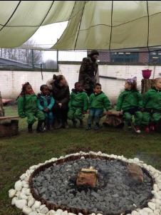
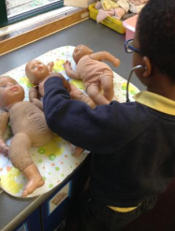
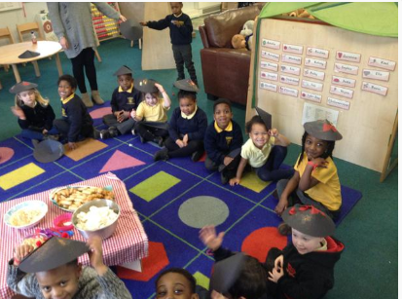
St Thomas of Canterbury
Reception Welcome Meeting

Slide 2

St Thomas of Canterbury
Key Reception Staff
Reception MT – Mrs McGuire & Mrs Tuson
Reception L – Miss Leveridge
With the support of:
HLTA – Mrs Taylor (Speech & Language)
HLTA – Miss Clarke
TA3 – Mrs Lee
TA1 – Mrs Donley
TA1 – Mrs Olisa
TA1 – Miss Jedrach
EYFS Lead – Mrs McGuire

Slide 3
Transition into Reception
  Moving up to Reception is an important step in your child’s learning journey.
  It builds on the foundations of learning made in their Nursery year and prepares the children for their move into Key Stage 1 at the end of the year.
  Learning sessions become slightly longer and the pace of learning within sessions increases.
  For this reason, we must ensure that the children are both attentive, looking and listening (we call this Fantastic Listening). Children should be engaged and motivated to take part.
  Having an early night, restful sleep and healthy breakfast will help them to achieve this level of focus each day.

Slide 4
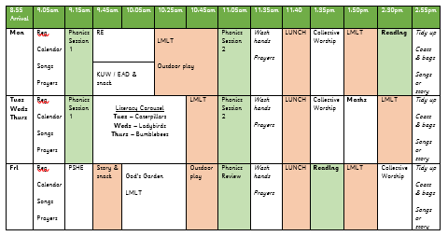
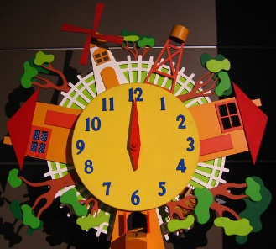
A Busy Day!
  Every day in Reception is a busy one! Please make sure your child arrives on time so they don’t miss any of their learning.
  A bell will ring to notify parents on the playground that the register will be taken at 8:45am.
  After the register we will spin a wheel - if it lands on a child’s name who is on time, they will win a treat. Your child must be on time to be in with a chance of winning!
  Our first lesson is Phonics which begins promptly at 8:50am. It is vital that your child does not miss this.
  Children who are late can often be unsettled and distracted during the morning as they have not started the day off with their normal school routine.

Slide 5


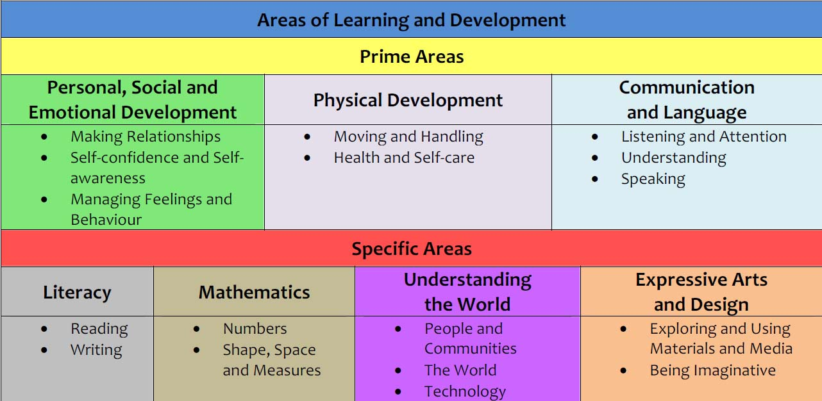
The curriculum

Slide 6
What your child will need for Reception
  Wellington Boots – names in please!
  Coat for coming to and from school (waterproof clothing used in school throughout the day)
  PE Kits – PE kits are not required in Reception but will be worn from Year 1 onwards.
  Water bottles – water only, no juice. We do provide cups for children to drink water, but a bottle from home is preferred.
  Children will not need a book bag whilst they are in Reception, all letters will be handed to parents at the door.
  NAMES IN EVERYTHING!
  If you do not have a marker for writing your child’s name, please let a member of staff know and we can write it in.

Slide 7
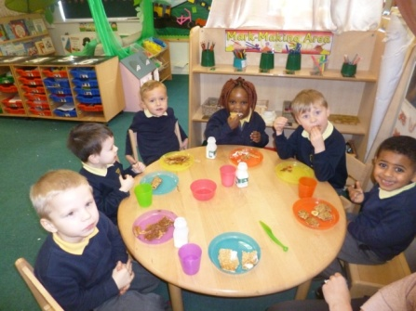
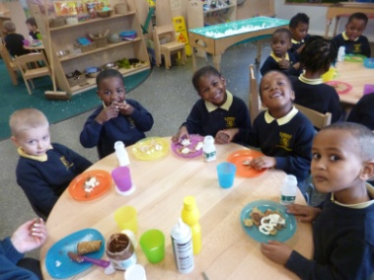
School Meals
Universal free school meals are provided for all children in Reception,
Y1 & Y2, regardless of income.
All children eat on the unit and are offered a hot meal with vegetarian options available. If there is a certain food that you know your child will not eat, please let a member of staff know.
Reception children are also provided with a daily morning snack along with milk. All children are offered fruit at home time. A small charge of £1 per week is payable via ParentPay.

Slide 8
Parent Pay
ParentPay is the school online payment system that lets you make secure online payments by credit and debit card.
Hundreds of thousands of parents use ParentPay to pay school online. It’s used to make cashless payments in schools for dinner money and activities like trips, clubs and music lessons.
You will have a secure online account, activated using a unique activation username and password; you will be prompted to change these and to keep them safe and secure as your Username and Password for future logins.
If you have two or more children at a ParentPay school, you only need to activate one account to create your ‘main account’ and then add your other children via the Add a child tab on your home page
Please visit www.parentpay.com and activate your account via the Account login area on the home page of the site.
If you need any support with using this system please speak to a member of the office staff.

Slide 9
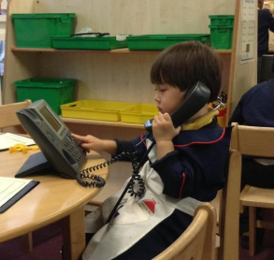
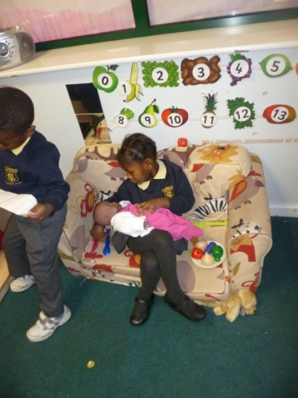
Speaking & Listening
  The most important skills to help your child succeed in their education are speaking and listening skills.
  It is vital that your child is able to speak to others using vocabulary appropriate to their development. It is equally important that they listen to others and can process what is being said to them
  You can help your child by:
  Playing simple games like guess who, eye spy
  Reading stories together
  Looking at you child and getting down to
  their level before you speak to them
  Reminding your child to give eye contact when your
  speaking (pause mid sentence to prompt them to look back)
  Modelling correct language at all times

Slide 10
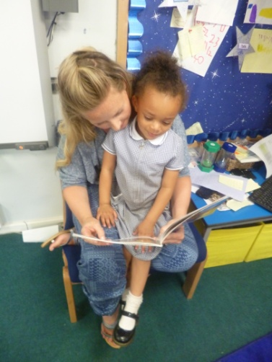
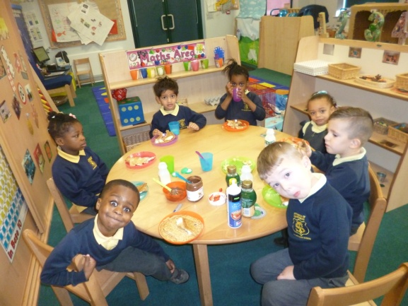
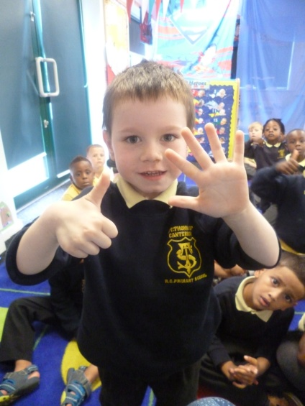
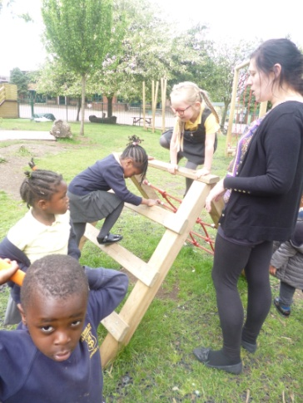
Key skills to support your child
  Getting dressed and undressed on their own.
  Feeding themselves with a knife and fork.
  Washing their hands properly before meals and after using the toilet or blowing their nose.
  Listening attentively to stories and singing familiar nursery rhymes.
  Counting objects by touching or moving them.
  Recognising, naming and matching colours.
  Using pencils and scissors with increasing control.
  Playing outside, climbing, running, jumping and balancing.
  Riding a bike if possible.
  If there are any concerns for your child’s sight, hearing or health, get in touch with your health visitor or GP and inform your child’s teacher.

Slide 11
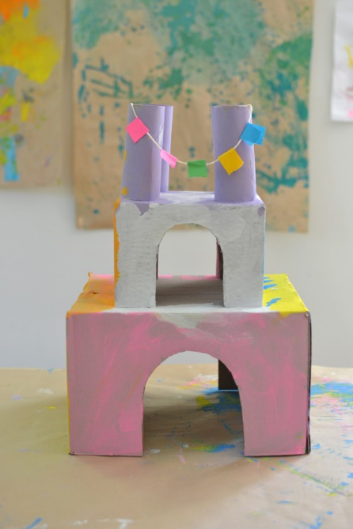

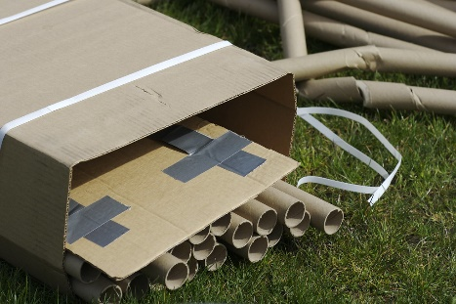
Parent Partnership
Recycling & Junk Modelling
Each week we will be requesting different recycling items to support us with our Expressive Arts & Design curriculum. The children can choose to use these items for junk modelling in our creative areas.
The schedule for what we are collecting will be uploaded to the Class Page on our school website and sign-posted outside the classroom doors.
Cardboard boxes (large and small!)
Cardboard tubes (no toilet roll tubes)
Plastic bottles and lids
Plastic tubs / pots and lids

Slide 12
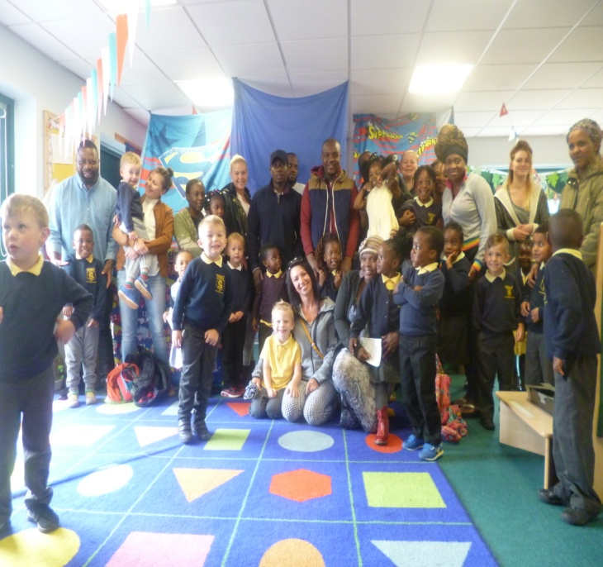

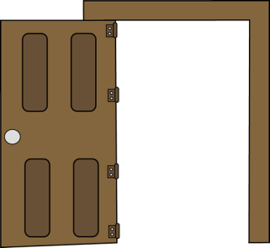
Parent Partnership
Monday / Friday Morning Read
From Autumn 2 we will be inviting parents to come into the classroom during morning drop-off to listen to their child read aloud.
We will provide phonics books related to your child’s reading ability so that they feel successful sharing their reading skills with you.
This will run from 8:40am and finish promptly in time for the start of phonics at 8:50am.

Slide 13
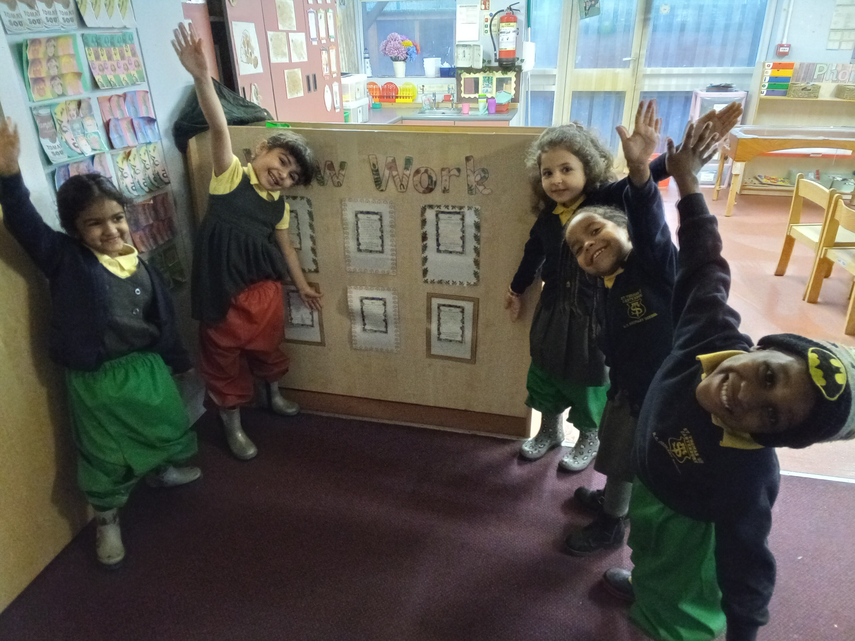
Parent Partnership
Home – School Communication & Wow Slips
Please ensure that you invest time in the weekly home – school communication letters as this consolidates your child's learning in school. We do not always expect homework to be physically returned to school, but we do encourage you to take some time to complete the activities with your child.
Going forward, we will be attaching a 'Wow Slip' to every Friday letter. Please look for opportunities where your child is demonstrating new learning, trying new things or showing helpfulness that you can include on a Wow Slip. We will then discuss and celebrate this in class.

Slide 14

Birthdays
We love to celebrate your child’s birthday with the class!
You are under no obligation to bring any treats in for the class when it is your child’s birthday. However, if you choose to do so we please ask the following:
No lollipops
Halal friendly
No balloons in party bags
Cake to be cut up and wrapped in napkins in advance

Slide 15
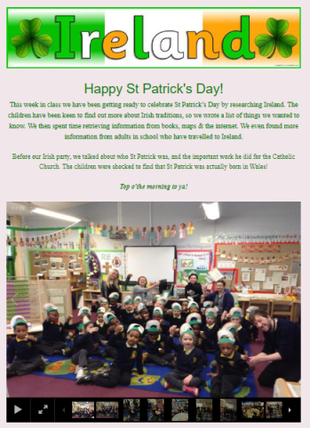
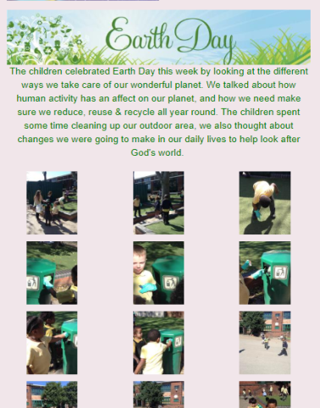
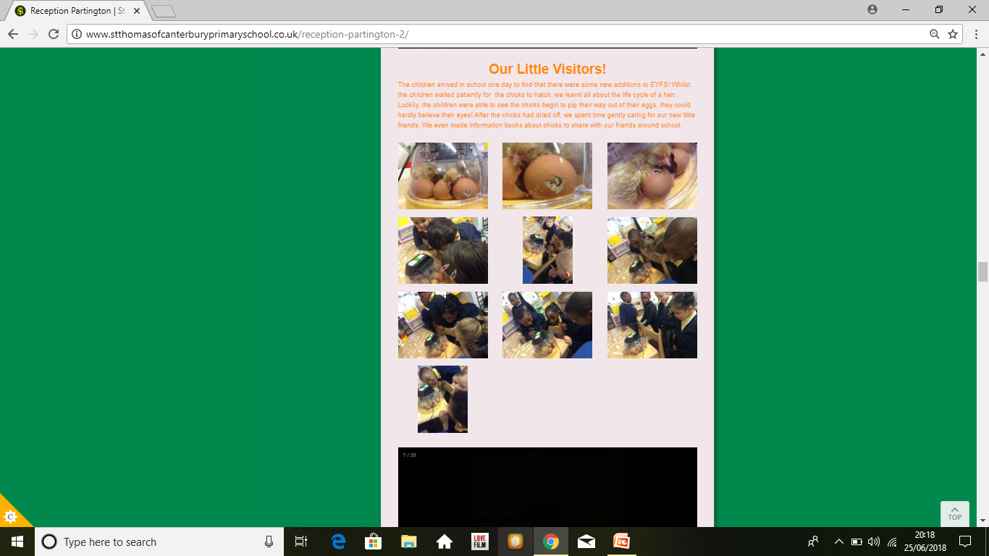
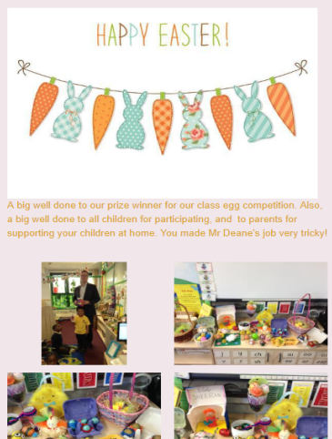
School Website
Our school website is a valuable tool for parents, pupils and teachers.
It gives up to date information about all that us happening in school and has the Parent Pay link.
We include parent help sheets, games, songs and recommended stories and videos and lots of photographs – the children love to see themselves on the computer at home!
http://www.stthomasofcanterburyprimaryschool.co.uk

Slide 16



School Website - EYFS
Below are the areas of the website where you can find information relating to the Early Years Foundation Stage:
http://www.stthomasofcanterburyprimaryschool.co.uk

Slide 17
Thank you for your time
If you have any questions just ask a member of staff either today or any day after school.
Our next meeting will be the Phonics Meeting.
When the date has been confirmed, we will send a letter on ParentPay.
http://www.stthomasofcanterburyprimaryschool.co.uk

