Slide 1
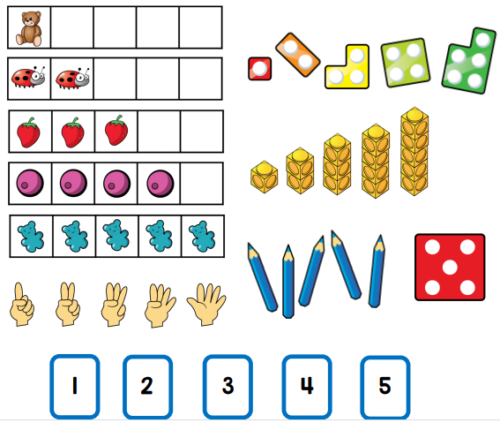
Early Mathematics
Supporting children with early number & Shape
Notes:
Amanda

Slide 2
The Maths Journey – Early learning Goals
Notes:
Amanda

Slide 3
The Maths Journey in Reception
Notes:
Amanda

Slide 4
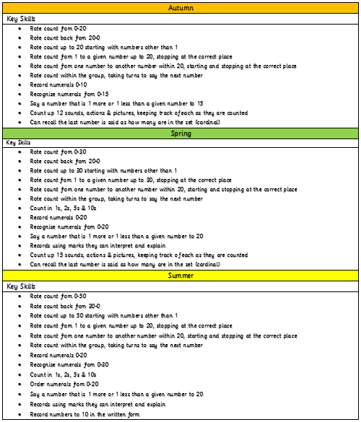
The Maths Journey in Reception – Mental & Oral
Notes:
Amanda

Slide 5
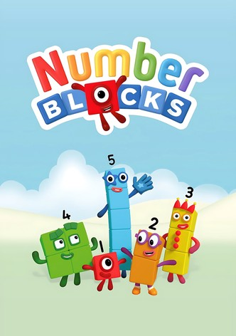
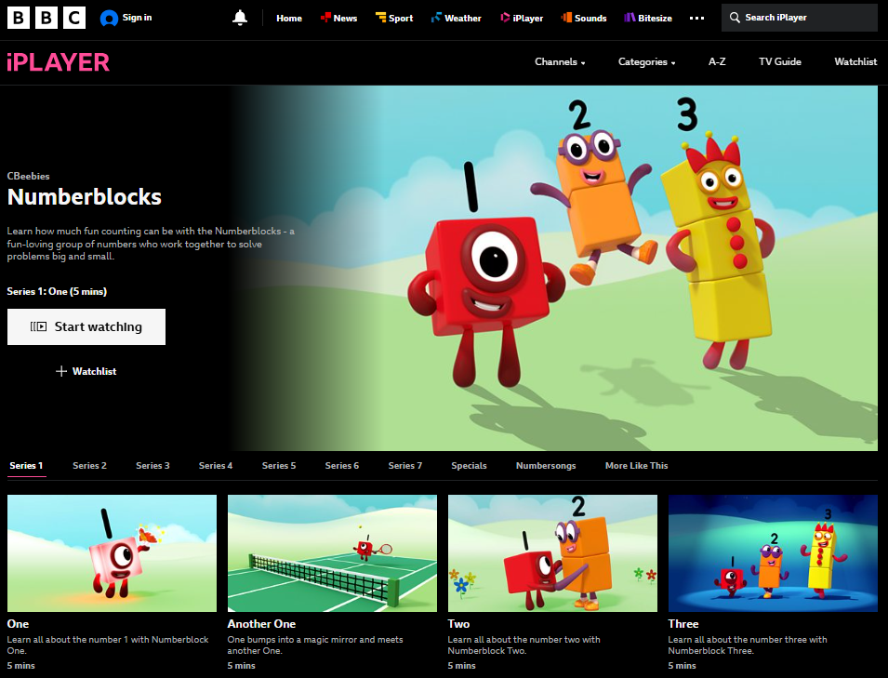
Series 1 & 2 only
Notes:
Amanda

Slide 6
Key Skills during the Reception Year
Subitising
Notes:
Jade

Slide 7
Key Skills during the Reception Year
Subitising
Notes:
Jade

Slide 8
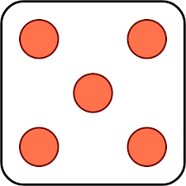
Key Skills during the Reception Year
Subitising
5 +5 = 10
Or double 5 is 10
Notes:
Jade

Slide 9
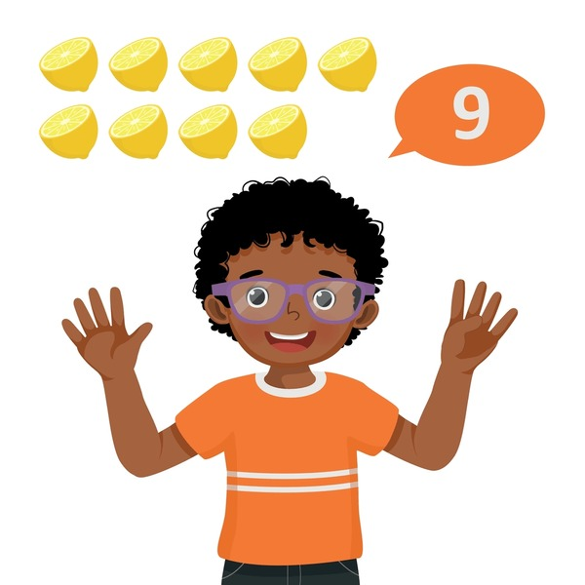
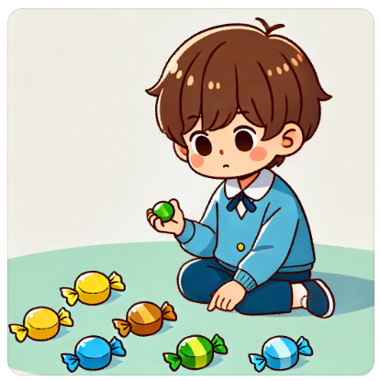
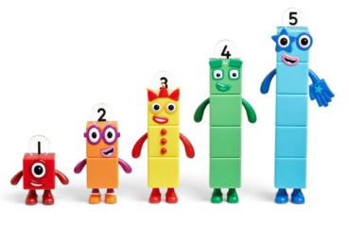
Key Skills during the Reception Year
Counting, ordinality & cardinality
1,2,3,4,5,6,7…I have 7
Notes:
Jade

Slide 10
Key Skills during the Reception Year
Composition
4 and 3 make 7
Notes:
Jade

Slide 11
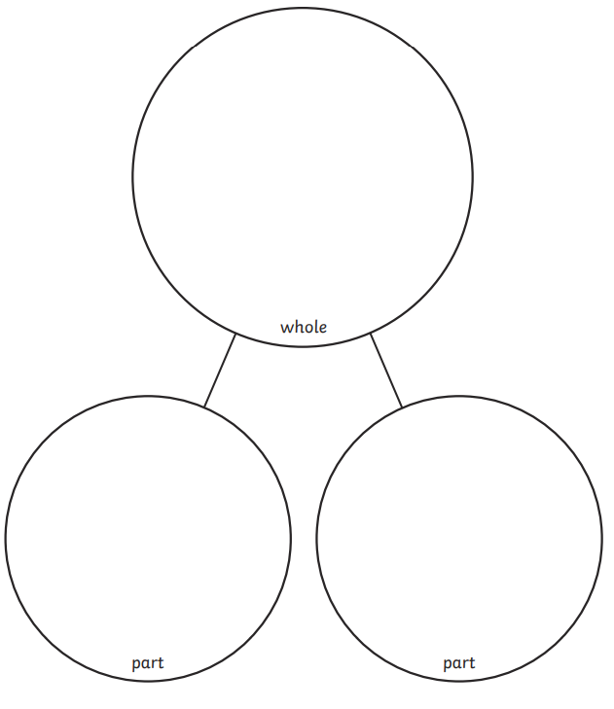
Key Skills during the Reception Year
Composition
6
Part whole Model
Notes:
Jade

Slide 12
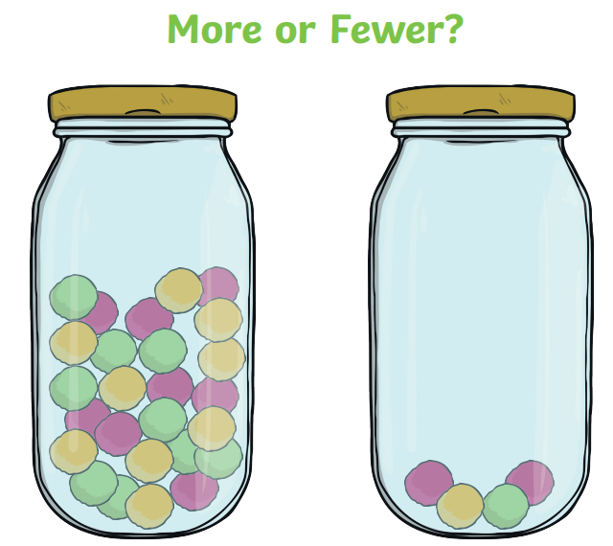
Key Skills during the Reception Year
Comparison
More or less?

Slide 13
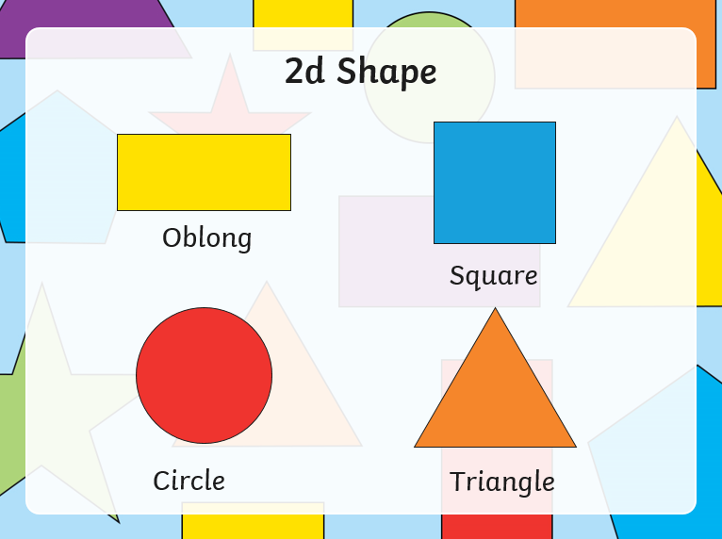
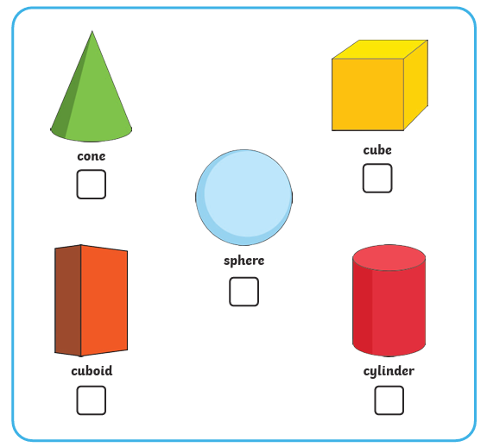
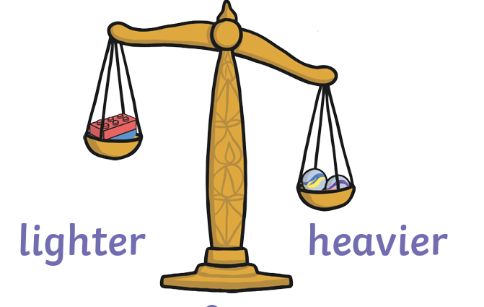
Key Skills during the Reception Year
Shape, Space & Measure
Notes:
Jade

Slide 14
What does Maths look like in Reception?
Adult led learning
Maths sessions
Mental & oral Counting sessions
Daily Calendar Maths
Learning through play
Develops a Strong Foundation for Mathematical Thinking
Encourages Critical Thinking and Problem-Solving
Makes Maths Fun and Engaging
Supports Real-World Application
Enhances Social and Communication Skills
Notes:
Loni

Slide 15
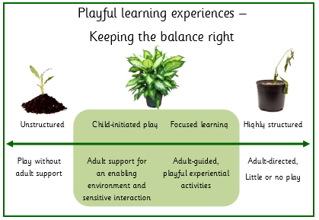
What does Maths look like in Reception?
Notes:
Loni

Slide 16
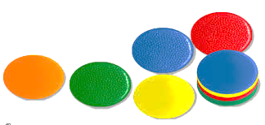
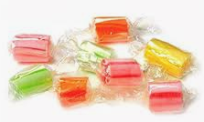
The Counting Principles
Move it to prove it !
Notes:
Loni

Slide 17
1:1 Correspondence
Move it to prove it !
Use your eyes…
1,2,3!
..and your counting voice!
Notes:
Loni

Slide 18
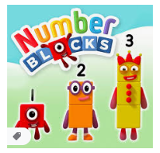
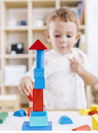
Supporting with Maths at home
Creating a positive culture around Maths
Developing children’s awareness of number sense
Follow the children’s interests and encourage learning through play
Incorporating number into everyday tasks
Demonstrate your own curiosity of Maths ‘I wonder…’
Home learning activities
Notes:
Amanda

Slide 19
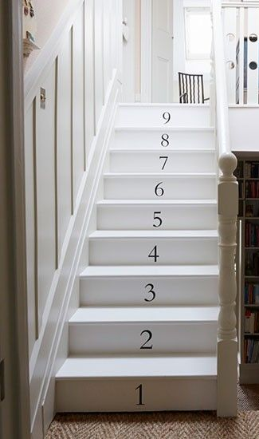
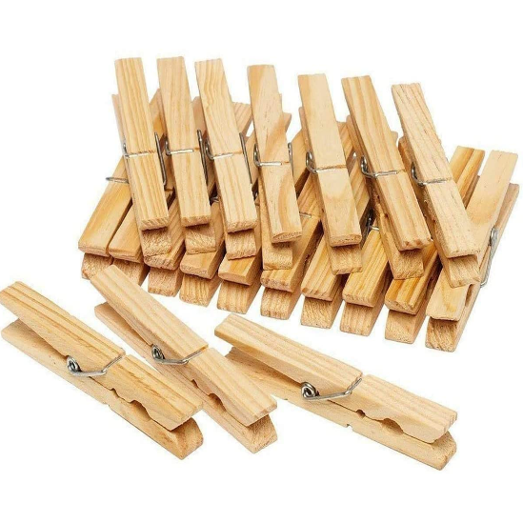
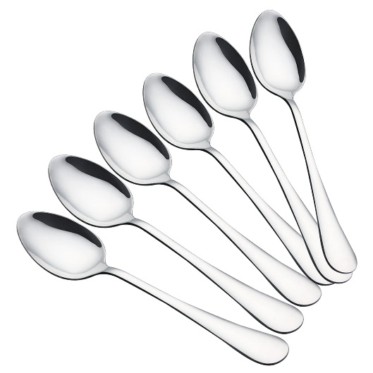
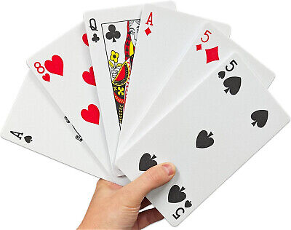
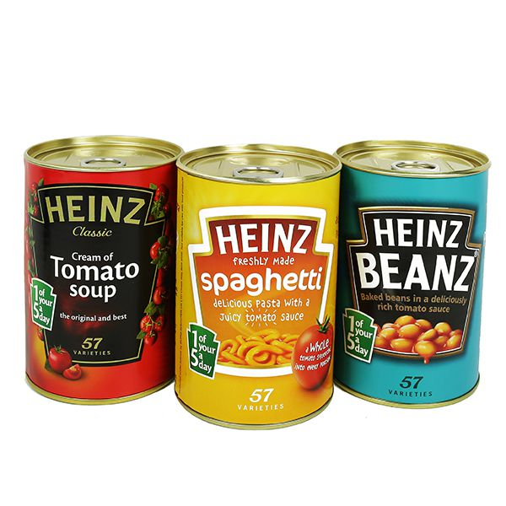
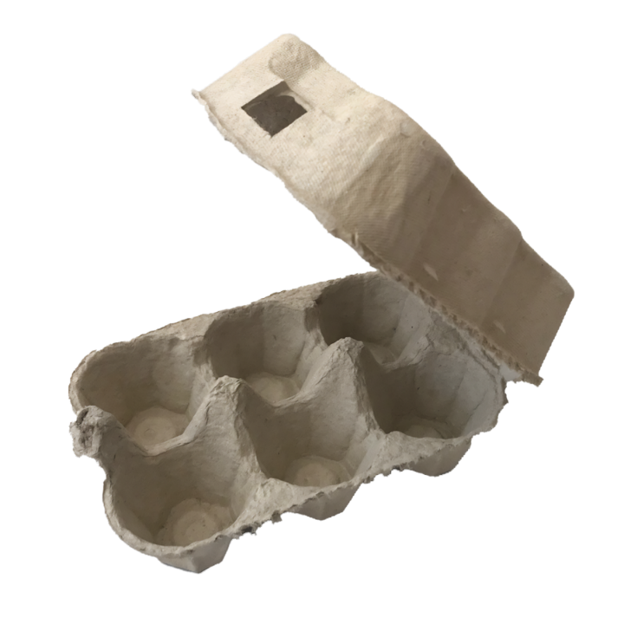
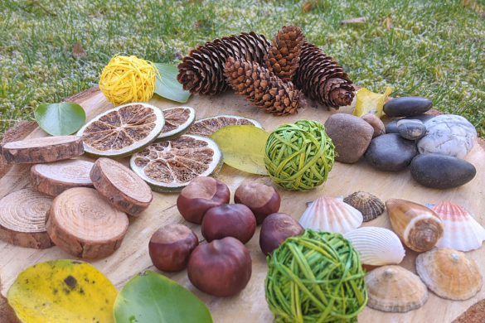
Supporting with Maths at home
Notes:
Amanda

Slide 20
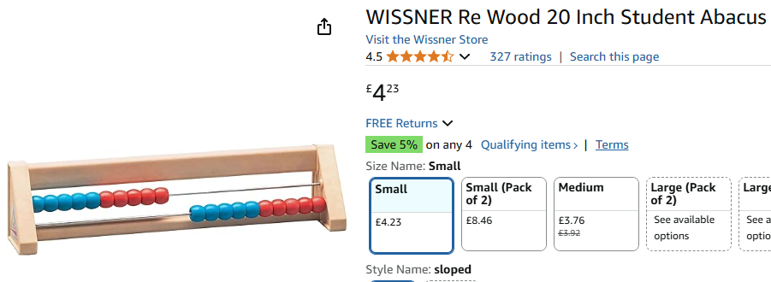
Supporting with Maths at home
Notes:
Amanda

Slide 21
Maths Stay & Play
9.30-10.00am
Challenge frames
Vocabulary to model throughout the activity
Suggested comments/questioning to support the learning
task
Notes:
Jade

