Slide 1
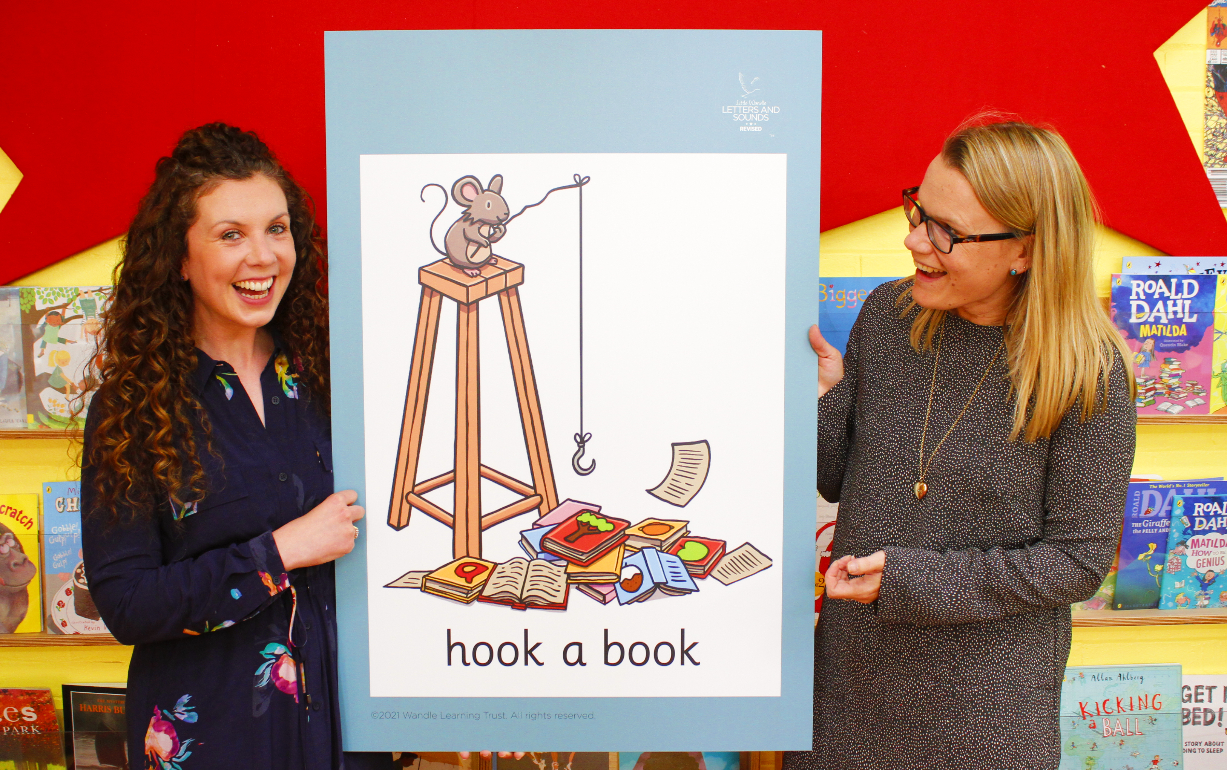
Little Wandle Letters and Sounds Revised
Our school has chosen
Little Wandle Letters and Sounds Revised as our Systematic Synthetic Phonics (SSP) programme to teach early reading and spelling.

Slide 2
Phonics is:
making connections between the sounds of our spoken words and the letters that are used to write them down.

Slide 3
Terminology
Phoneme
Blend
Grapheme
Segment
Digraph
Trigraph

Slide 4
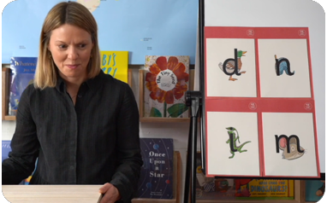
This term we are teaching Phase 2
These are the first group of letters and sounds your child will learn.
We start teaching from week 2 of Reception.
The lessons are fun, interactive, engaging and have been designed to gradually build over time.

Slide 5
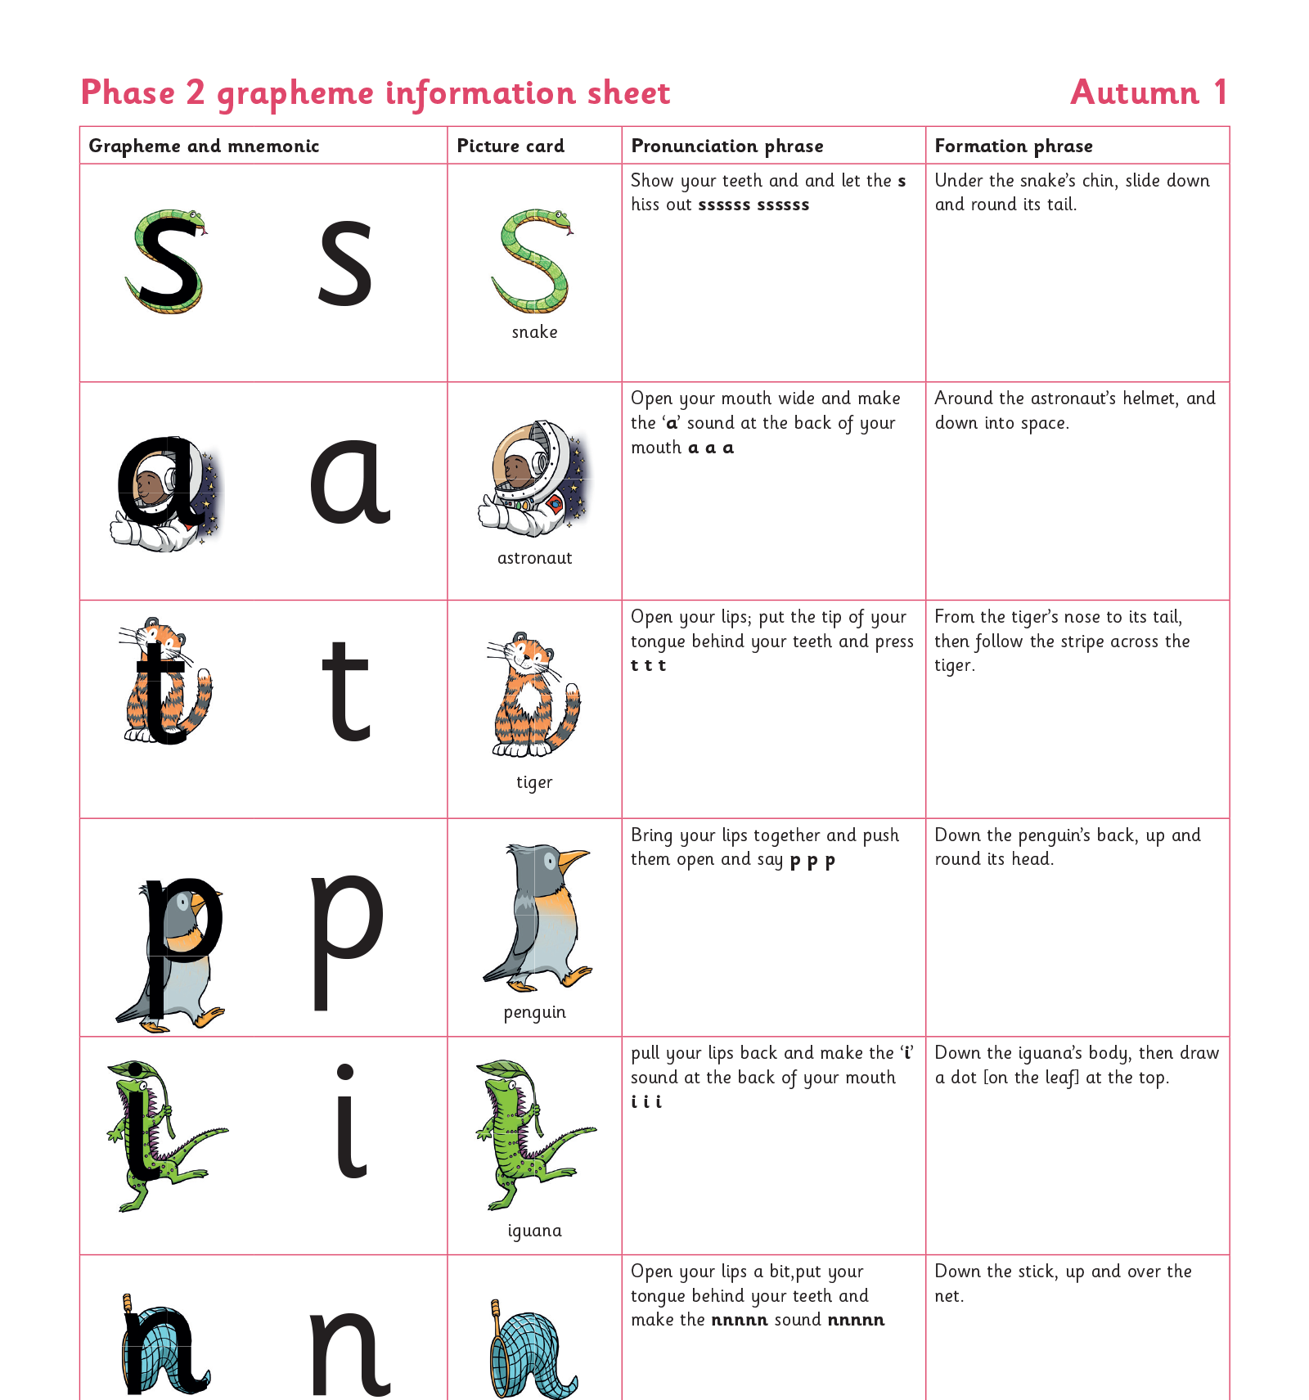
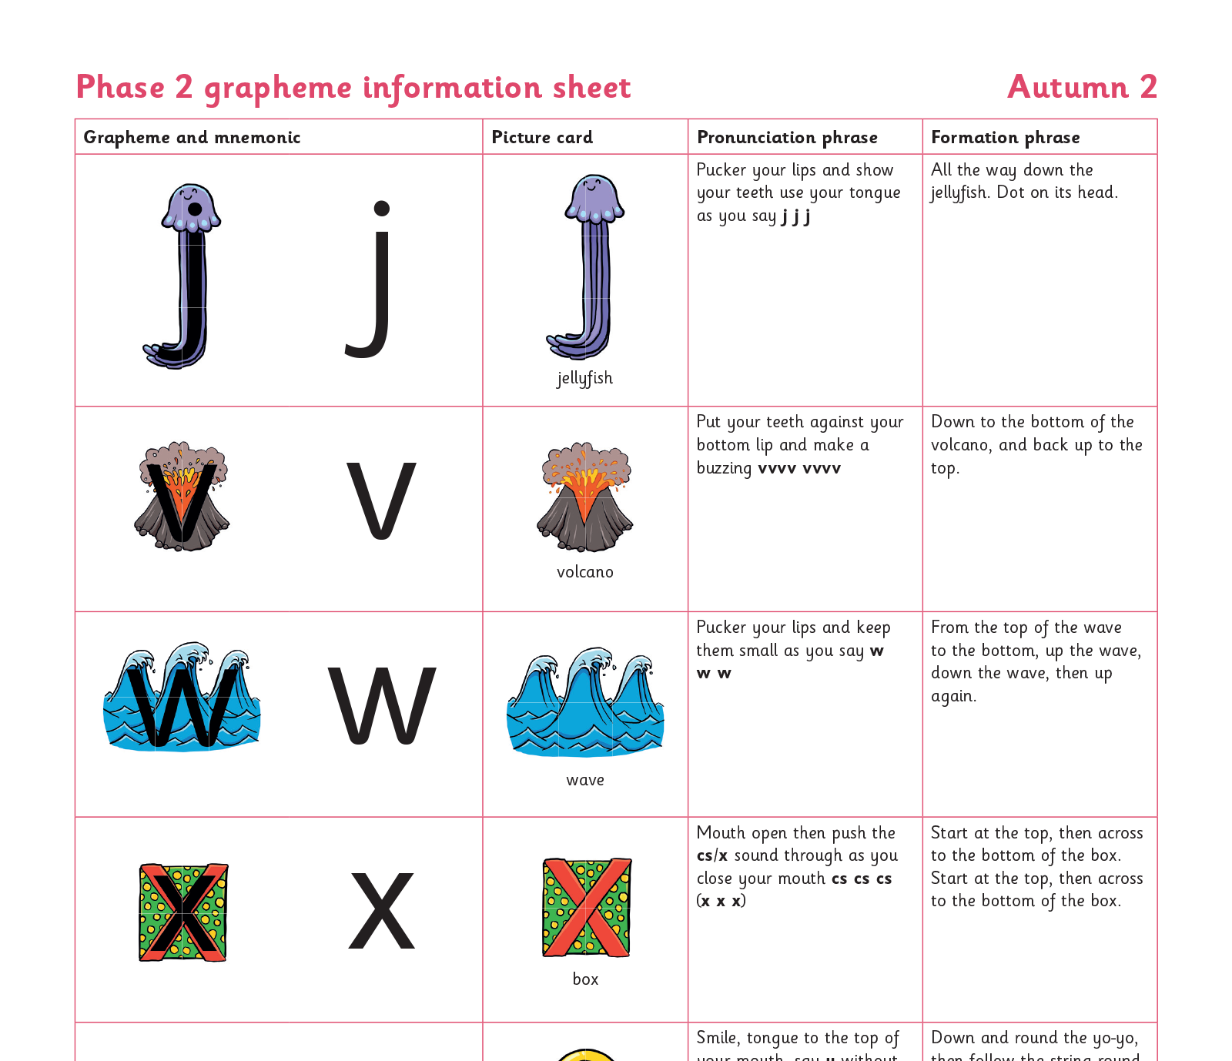
We teach Phase 2 in this order

Slide 6
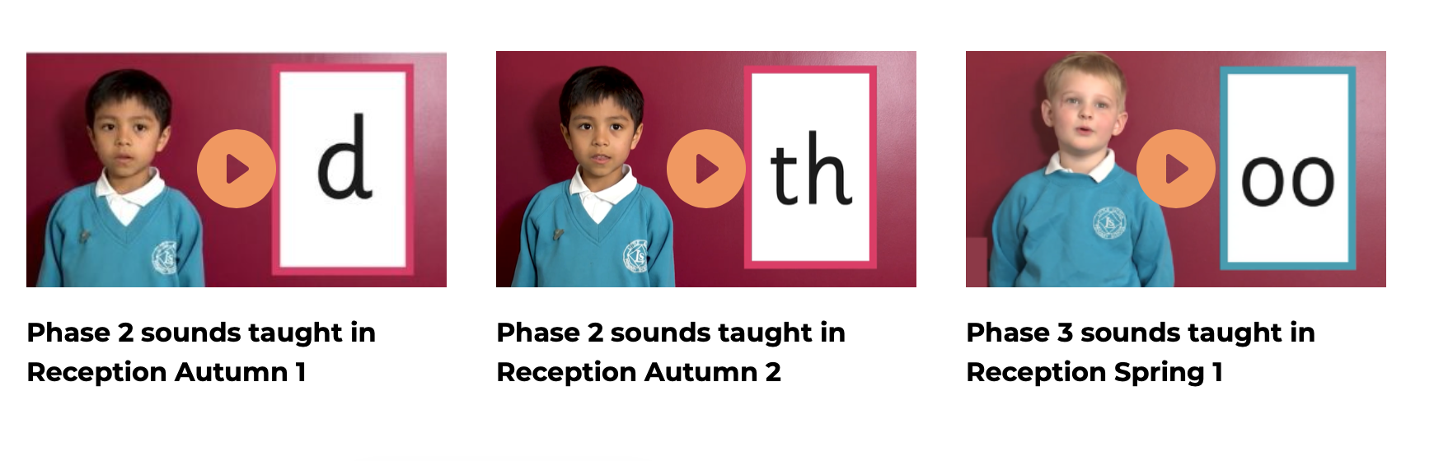
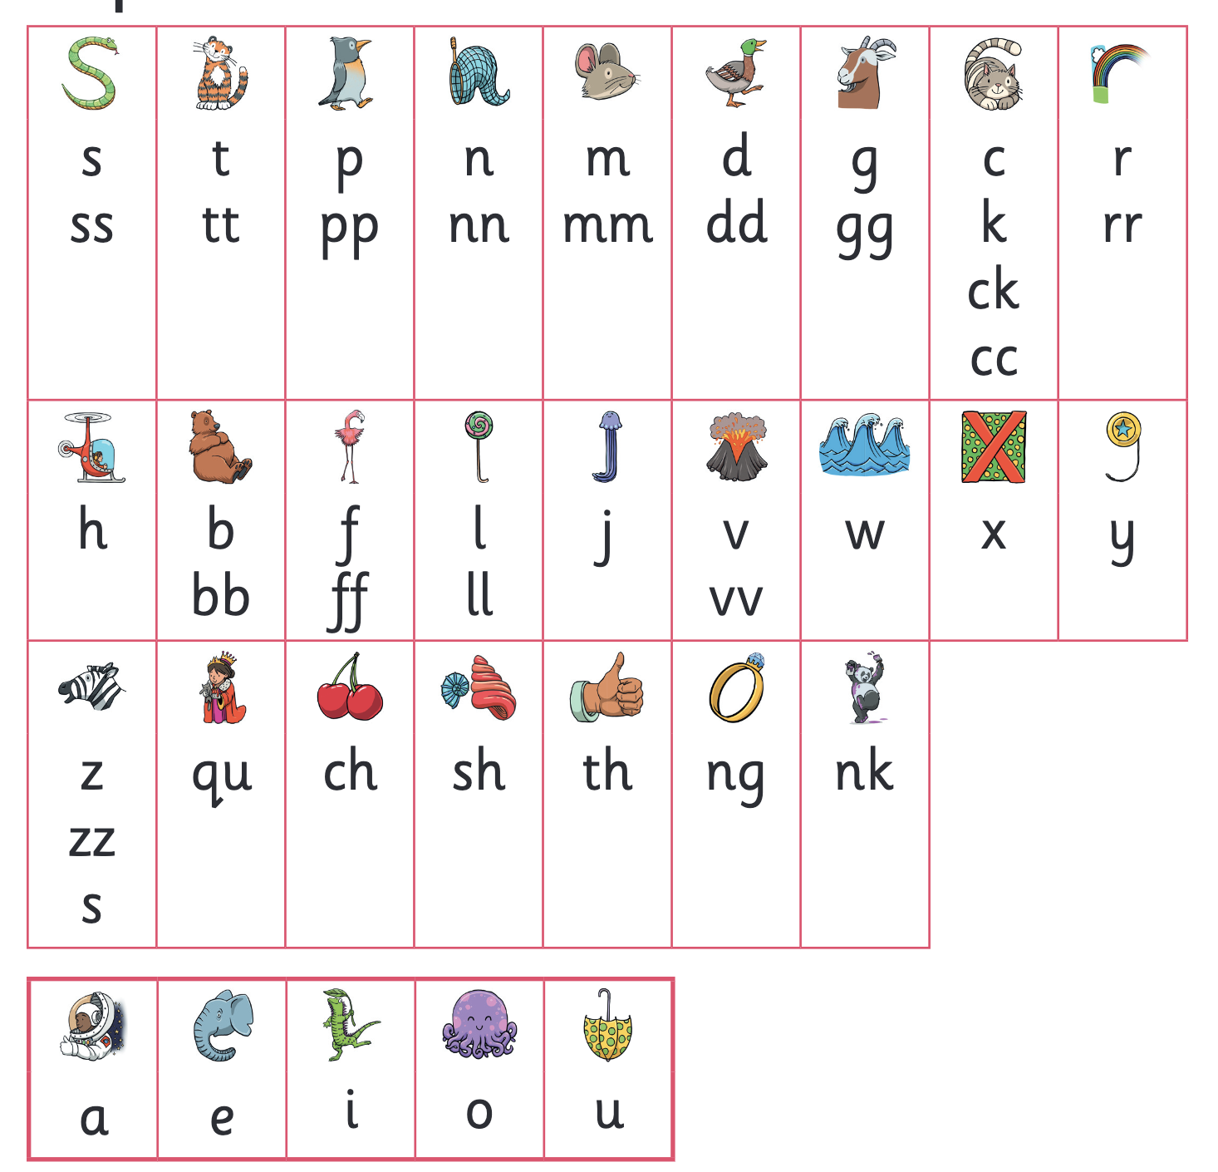
Let’s say the Phase 2 sounds

Slide 7
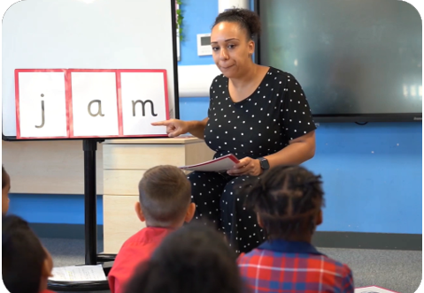
We teach blending so your child learns to read
Teacher-led blending is taught throughout Phase 2.
Our aim to is to teach every child to blend by Christmas.
We will inform you if your child needs additional practice.

Slide 8
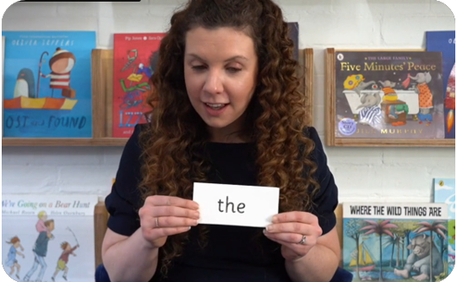
Tricky words
These words have unusual spellings e.g. he, the, was.
They are taught in a systematic way.
Children are now learning to read the Phase 2 tricky words: is, I, the, put, pull, full, as, and, has, his, her, go, no, to, into, she, push, he, of, we, me, be.

Slide 9
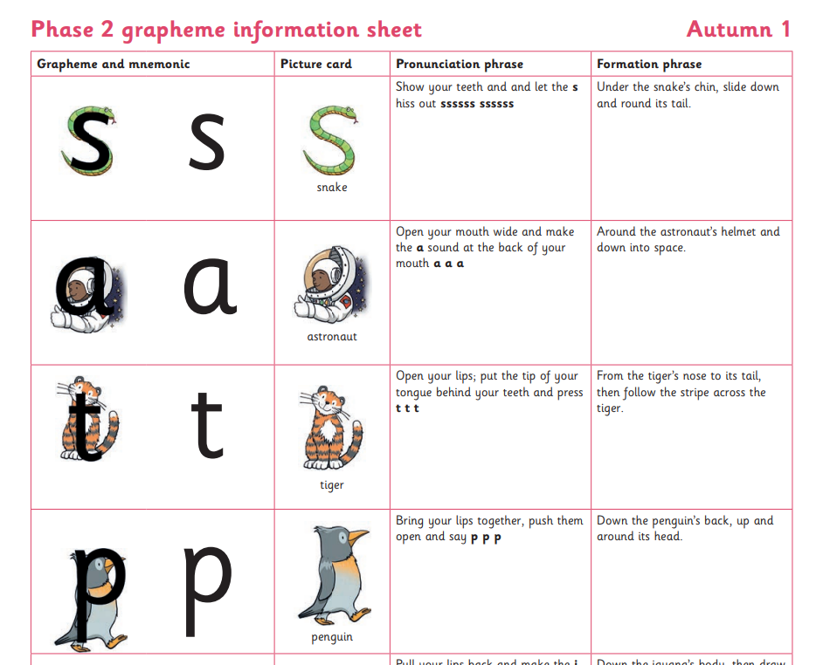

Spelling
Your child will be taught how to spell simple words, using the graphemes they have been taught.
They will practise the correct formation of letters. They will also have handwriting lessons.

Slide 10

How do we teach spelling?
Say the word.
Segment the sounds.
Count the sounds.
Write them down.

Slide 11
How do we practise reading in books?
Reading practice sessions are:
Every week
taught by a trained teacher/teaching assistant
taught in small groups
children in Reception will have access to two online phonics book every week to read at home. These are uploaded on a Friday.

Slide 12

Books going home

Slide 13
Listening to your child read their phonics book
Your child should be able to read their book without your help.
They might sound out words and blend them before they read them fluently.
If they can’t read a word, read it to them.
Talk about the book and celebrate their success.

Slide 14
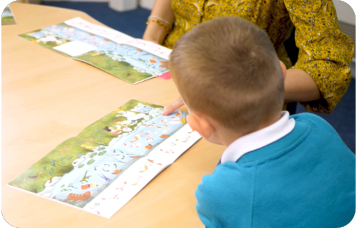
Reading a wordless books
Wordless books are invaluable as they teach reading behaviours and early reading skills to children who are not blending – yet!
Talk about the pictures.
Point to the images in the circles and find them on the page.
Encourage your child to make links from the book to their experiences.

Slide 15

Read to your child
The lending library book is for YOU to read:
Make the story sound as exciting as you can by changing your voice.
Talk with your child as much as you can:
  Introduce new and exciting language.
  Encourage your child to use new vocabulary.
  Make up sentences together.
  Find different words to use.
  Describe things you see.

Slide 16
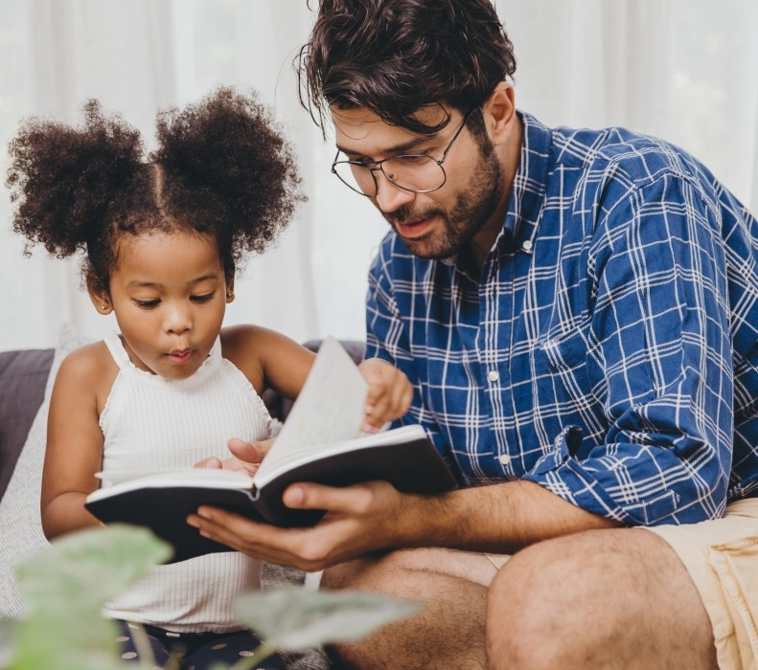
The most important thing you can do is read with your child
Reading a book and chatting had a positive impact a year later on children’s ability to…
understand words and sentences
use a wide range of vocabulary
develop listening comprehension skills.
The amount of books children were exposed to by age 6 was a positive predictor of their reading ability two years later.
Parental involvement in the development of children’s reading skills: A five-year longitudinal study (2002) Senechal, M. and Lefvre, J

