Slide 1
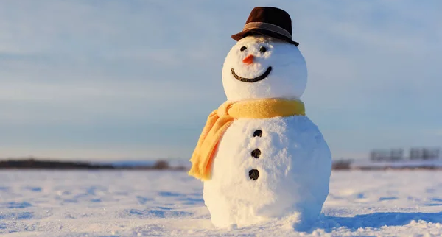
My Snowman Friend

Slide 2
I call him Mr Frosty Face. He brings us so much fun.

Slide 3
a carrot nose
With his…
black coal eyes
and a smile for everyone.

Slide 4
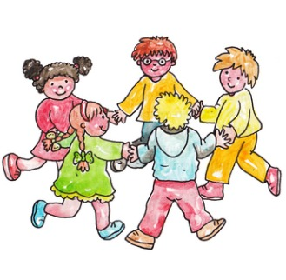
If we play Ring-a-Roses, Then all our friends join in.

Slide 5
But when the game is statues, He always knows he’ll win!

Slide 6
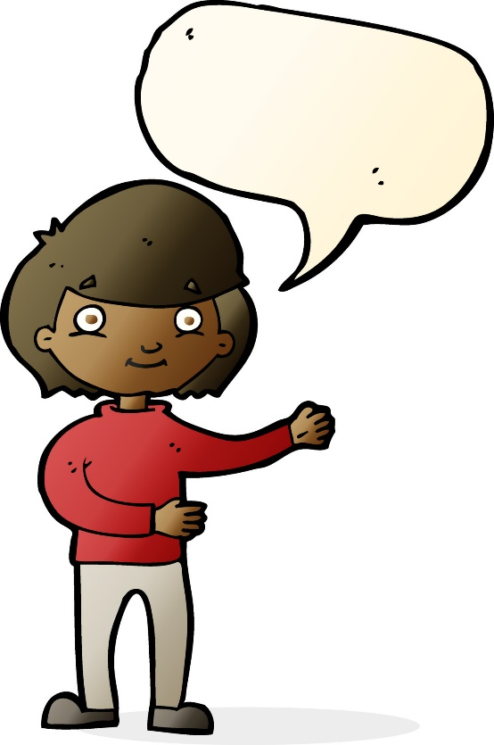
When I talk, I know he’ll listen to every word I say.

Slide 7
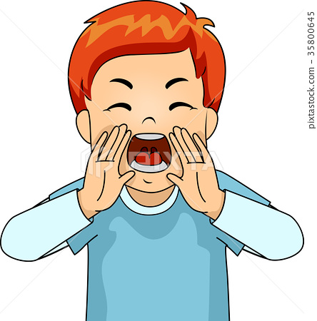
I can SHOUT or knock his hat off and he’ll never run away!

Slide 8
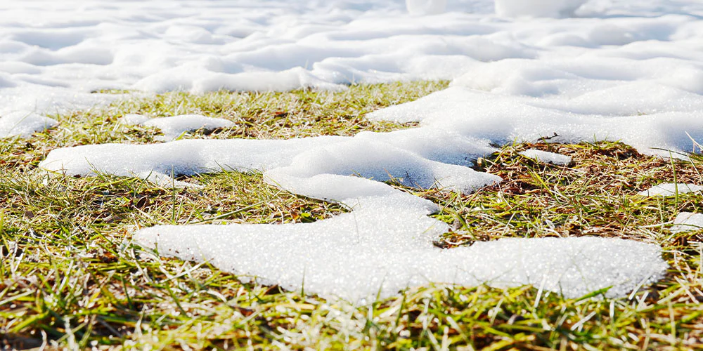
But when the weather’s warmer, Frosty Face must go…

Slide 9
Until the next time that he comes, with winter’s ice and snow!

