Slide 2
Select a Letter
Aa
Bb
Cc
Dd
Ee
Ff
Gg
Hh
Ii
Jj
Kk
Ll
Mm
Nn
Oo
Pp
Qq
Rr
Ss
Tt
Uu
Vv
Ww
Xx
Yy
Zz

Slide 3
Letter Aa
Back
A
apple
a

Slide 4
Letter Bb
Back
B
ball
b

Slide 5
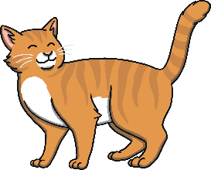
Letter Cc
Back
C
cat
c

Slide 6
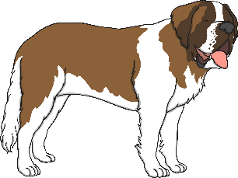
Letter Dd
Back
D
dog
d

Slide 7
Letter Ee
Back
E
egg
e

Slide 8
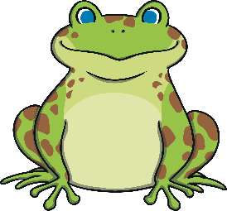
Letter Ff
Back
F
frog
f

Slide 9
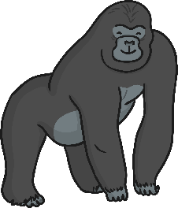
Letter Gg
Back
G
g
gorilla

Slide 10
Letter Hh
Back
H
hat
h

Slide 11
Letter Ii
Back
I
igloo
i

Slide 12
Letter Jj
Back
J
j
jam

Slide 13
Letter Kk
Back
K
koala
k

Slide 14
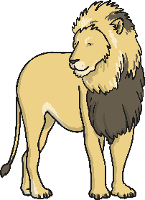
Letter Ll
Back
L
lion
l

Slide 15
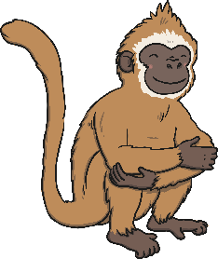
Letter Mm
Back
M
monkey
m

Slide 16
Letter Nn
Back
N
nest
n

Slide 17
Letter Oo
Back
O
orange
o

Slide 18
Letter Pp
Back
P
pineapple
p

Slide 19
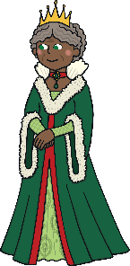
Letter Qq
Back
Q
queen
q

Slide 20
Letter Rr
Back
R
robot
r

Slide 21
Letter Ss
Back
S
sun
s

Slide 22
Letter Tt
Back
T
t
tiger

Slide 23
Letter Uu
Back
U
umbrella
u

Slide 24
Letter Vv
Back
V
vase
v

Slide 25
Letter Ww
Back
W
watch
w

Slide 26
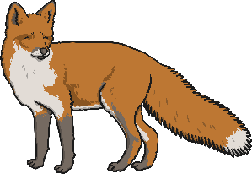
Letter Xx
Back
X
fox
x

Slide 27
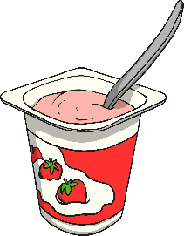
Letter Yy
Back
Y
yoghurt
y

Slide 28
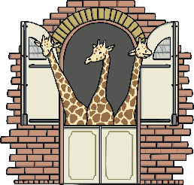
Letter Zz
Back
Z
zoo
z

