Slide 1
Disclaimers
We hope you find the information on our website and resources useful.
Adult Guidance
This PowerPoint refers to the Chinese zodiac. This is often referred to as the Chinese zodiac but it is used in many countries in East and South East Asia and can also be referred to as the zodiac for that particular country, such as the Vietnamese zodiac.
The zodiac can be slightly different depending on which country is using it. For example, the Vietnamese zodiac replaces the ox with a water buffalo and the rabbit with a cat. The Korean zodiac replaces the goat with a sheep.
Animations
This resource has been designed with animations to make it as fun and engaging as possible. To view the content in the correct formatting, please view the PowerPoint in ‘slide show mode’. This takes you from desktop to presentation mode. If you view the slides out of ‘slide show mode’, you may find that some of the text and images overlap each other and/or are difficult to read.
To enter slide show mode, go to the slide show menu tab and select either from beginning or from current slide.
You may wish to delete this slide before beginning the presentation.

Slide 3
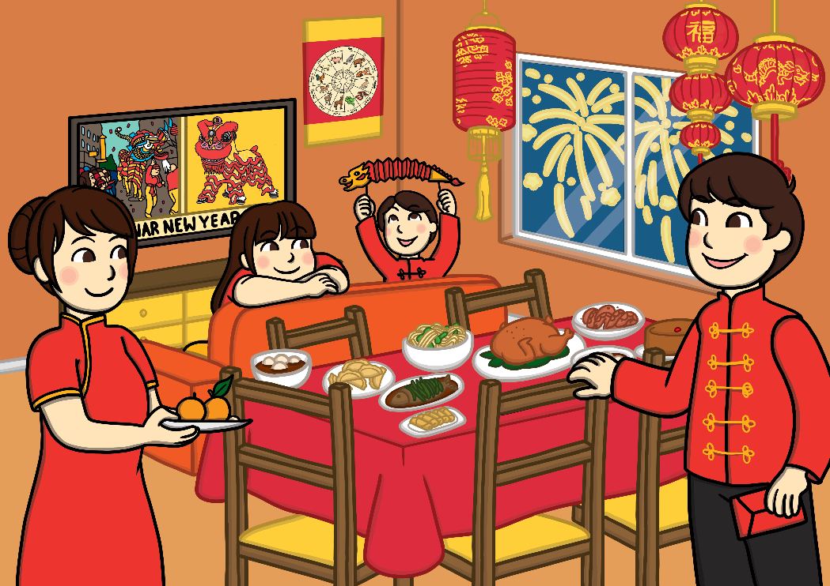
What is Chinese New Year?
Chinese New Year is the start of the new year in the Chinese calendar. As it is celebrated by other countries too, it is often called the Lunar New Year or Spring Festival.
Chinese New Year is celebrated on a different date each year.
It can be celebrated between 21st January and 20th February.
This is because it starts at the beginning of the first new moon.

Slide 4
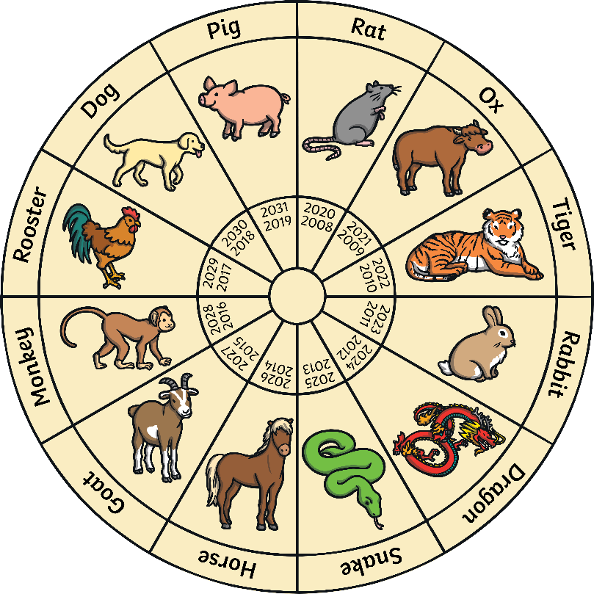
The Chinese Zodiac
Each new year is named after an animal from the Chinese Great Race story.
Which animal was it on the year that you were born?

Slide 5
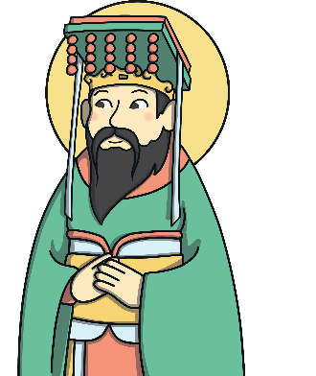
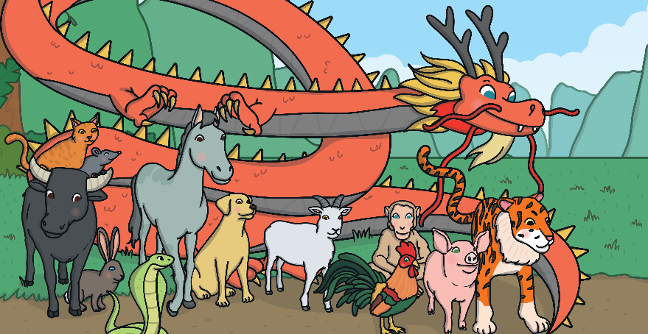
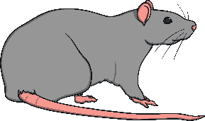
The Chinese Zodiac
The Chinese New Year story suggests how the animals in the Chinese zodiac might have been chosen. The story says that many years ago, the Jade Emperor (who was in charge in China), decided that he wanted to start a way of measuring time by introducing a calendar. He wanted to name each year after an animal.
He invited lots of animals to enter a race to cross the river. The first 12 animals to finish the race would have a year named after them.
The rat was the first animal to cross the river, so the first year was named after the rat. The rabbit came fourth in the race, so the fourth year was named after the rabbit.

Slide 6
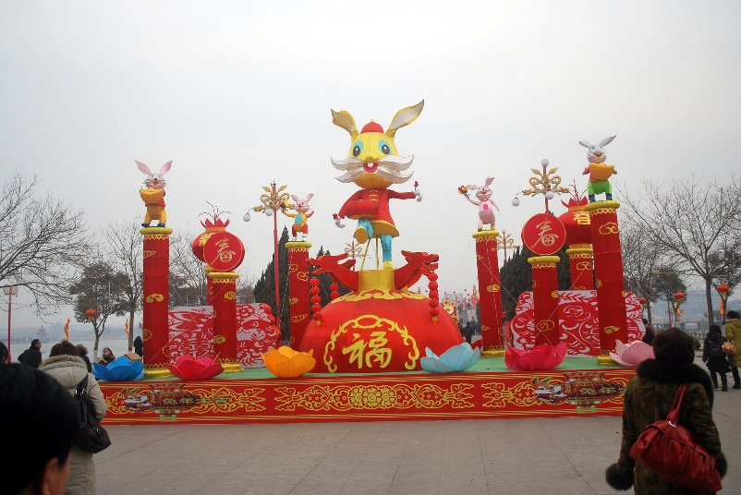
Rabbits in Chinese Culture
For a long time, people in China have admired rabbits for their elegance and beauty. Rabbits are also a symbol of a long life in Chinese culture.
In Chinese culture, rabbits can also symbolise the moon.
A long time ago, some people in China believed a rabbit lived on the moon and it was called the Jade or Moon Rabbit.
They believed it lived with the Moon Goddess who never grew old.

Slide 7
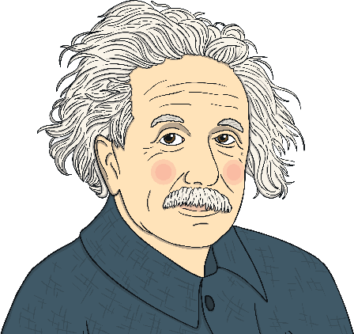
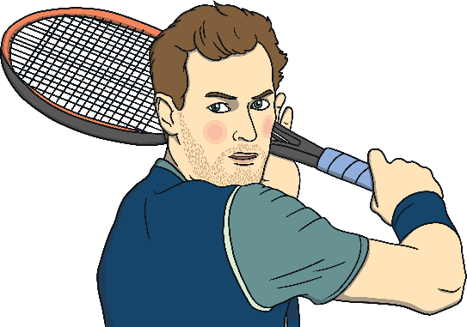
Year of the Rabbit
There are lots of famous people born on the year of the rabbit.
Albert Einstein
Andy Murray
Michelle Obama
People born in the year of the rabbit are said to be calm, quiet and excellent listeners.

Slide 8
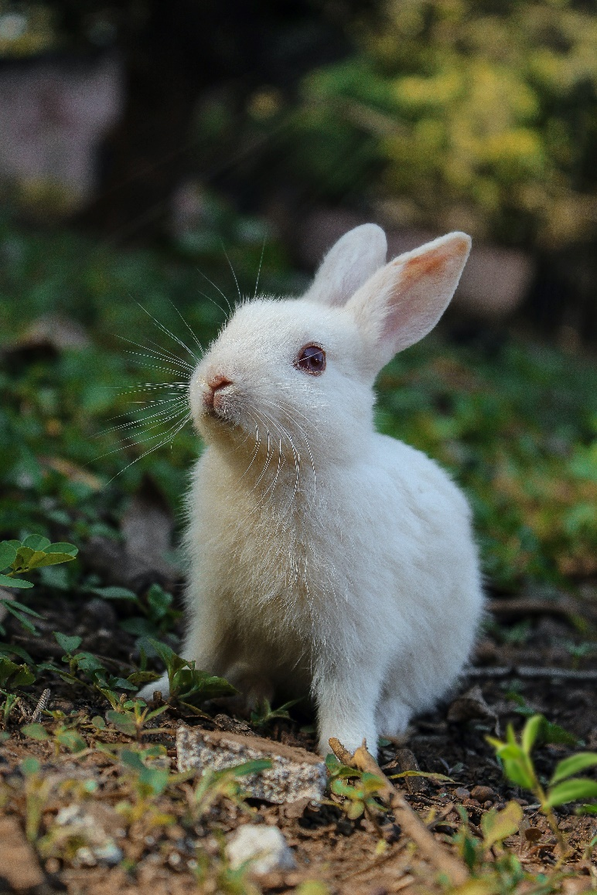
Year of the Rabbit
Do you know any facts about rabbits?

Slide 9
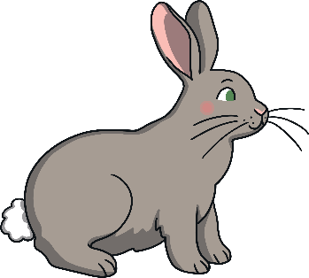
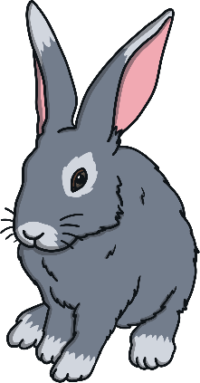
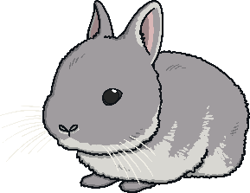
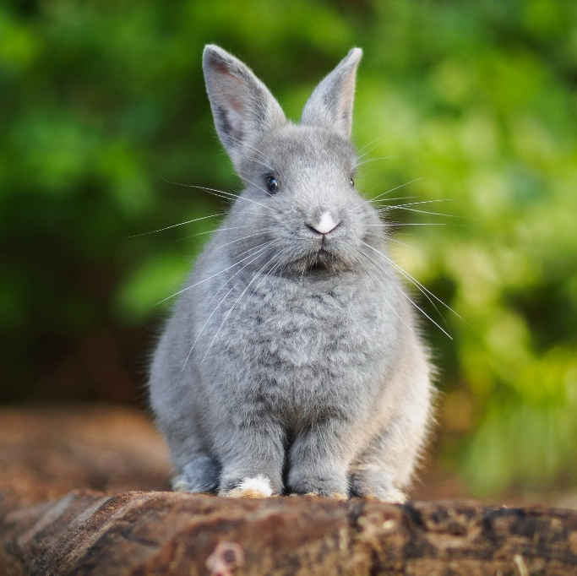
Rabbit Facts
A female rabbit is called a doe.
A baby rabbit is called a kit.
A male rabbit is called a buck.

Slide 10
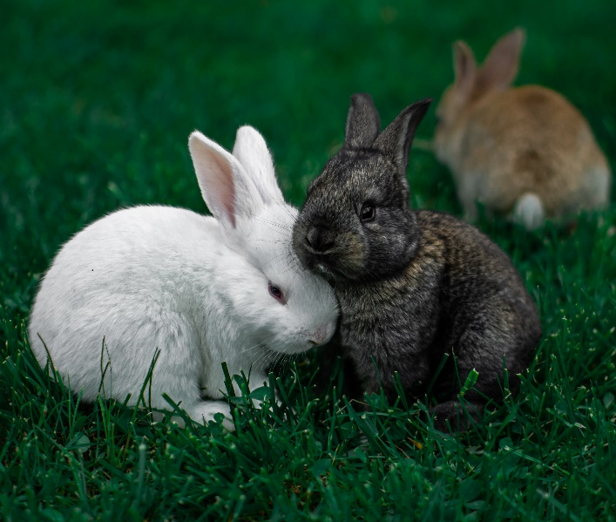
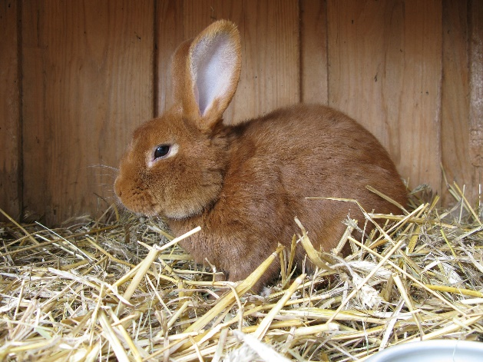
Where do Rabbits Live?
Rabbits live in groups as they like to be with their friends and families. They are a very sociable animal. Wild rabbits live in warrens underground. These are tunnels and rooms that the rabbits have dug underground.
Rabbits can also make fantastic pets. They can live indoors or in a dry, secure shelter outside. They need lots of exercise and plenty of space.

Slide 11
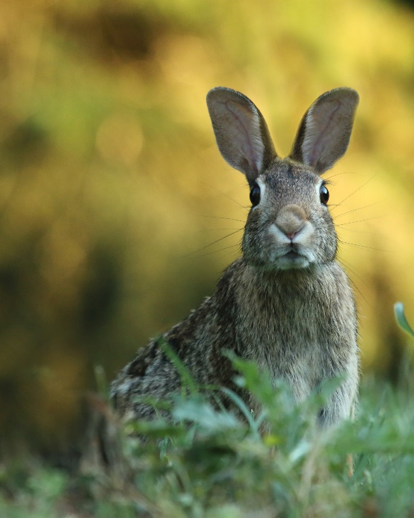
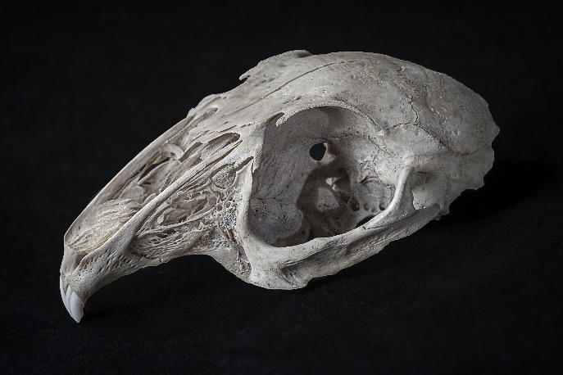
Rabbit’s Features
Rabbits have very long ears! They can be as long as 10cm and they can turn their ears so that they can listen out for predators. They are excellent at hearing things and can pinpoint exactly where a sound has come from.
Rabbit’s eyes are on the sides of their head. This makes it easier for them to watch out for predators because they can almost see the whole way around them.
Did You Know…? Rabbit’s teeth never stop growing! They never get too long because the rabbit wears them down by chewing on grass, wildflowers and vegetables.

Slide 12
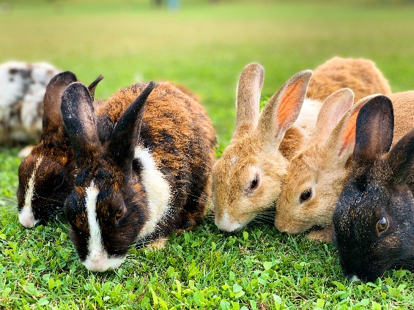
Rabbits and Exercise
Rabbits are very fast. They are also excellent at jumping. They can jump as high as 90cm in one leap!
When rabbits are happy, they do something called a ‘binky’. This is when they hop, jump and twist in the air as well as kicking their feet.
Did You Know…? Rabbits eat their own poo! This may not sound very nice, but they have a really clever digestive system so it is good for them to eat certain parts of their poo called caecotrophs.

Slide 13
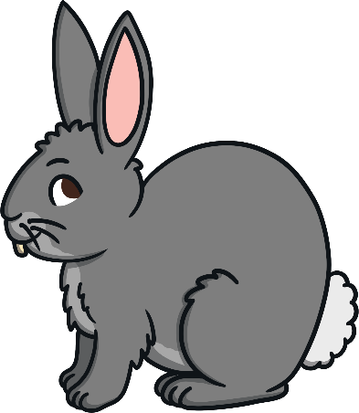
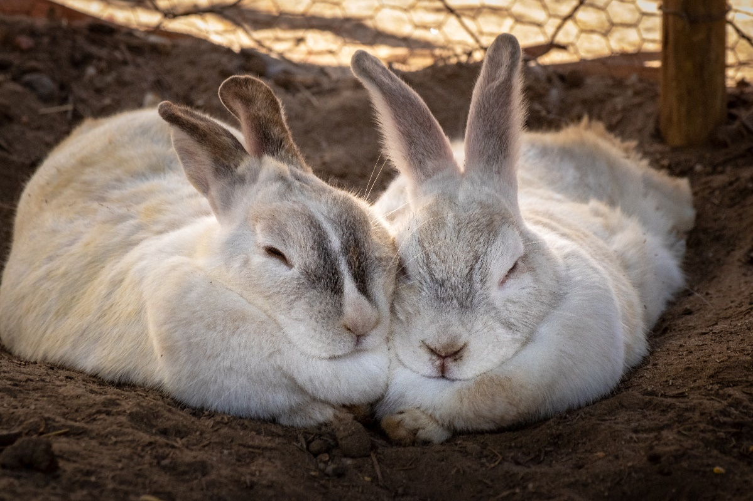
The Year of the Rabbit
Can you tell a friend something you’ve learnt about rabbits?
What was your favourite rabbit fact?

