Slide 2
What Is Lent?
Lent begins on Ash Wednesday, which is the day after Pancake Day. It is the start of a very important time in the Christian Calendar.
Lent begins on Ash Wednesday, which is the day after Pancake Day. It is the start of a very important time in the Christian Calendar.
What does Lent lead up to?
Lent leads up to Easter, the time that Christians remember Jesus’ death and resurrection.
Lent is 40 days long (not including Sundays).
Why is Lent 40 days long?

Slide 3
Jesus Goes into the Wilderness
Before Jesus began his teaching, he spent 40 days and 40 nights in the desert, to be with God. During this time, he had no food. Whilst Jesus was in the desert, the Devil appeared, trying to tempt Jesus.

Slide 4
Jesus Goes into the Wilderness
The Devil knew that Jesus was hungry, so he told him that if he was indeed the Son of God, to turn the rocks nearby into bread. The Devil knew Jesus could do this, but Jesus knew it was a trap and told him ‘No!’.
No!

Slide 5
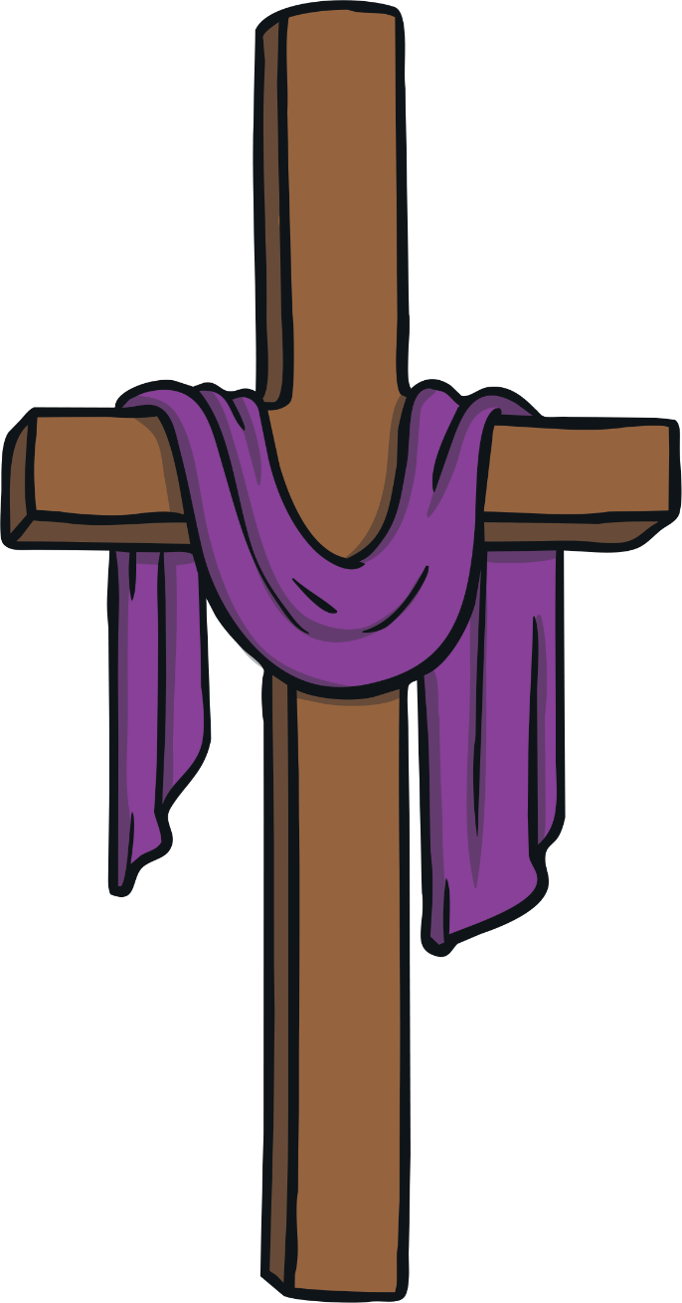
Jesus Resisted Temptation
Jesus spent 40 days and 40 nights in the desert. He had no food. Whilst he was in the desert, the Devil tried to tempt him with food. The Devil made Jesus many promises, but each time Jesus told him ‘No!’.
Lent lasts 40 days, to remind Christians of Jesus’ sacrifices when he was in the desert and also of his refusal to be tempted by the Devil.

Slide 6
What do Christians Do During Lent?
In the past, Christians would give up all ‘rich’ food and drink during Lent. This meant food such as meat, eggs, fats and milk products weren’t eaten. People used up their ‘rich’ foods before Lent began, by making pancakes; this is why we have Pancake Day.

Slide 7
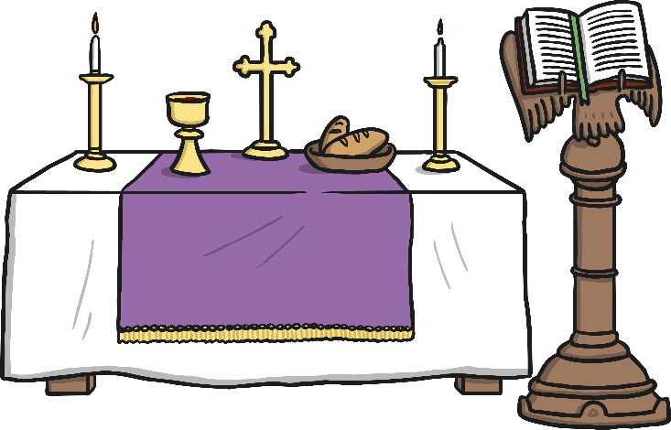
What do Christians Do During Lent?
Today, many Christians mark Lent by trying to ‘give up’ something they like. It might be chocolate or something like video games. They do this to remember Jesus’ sacrifice when he was in the desert and to test their own self-discipline: to see if they can say no to temptation, just as Jesus did.
Lots of churches hold special Lent services.

Slide 8
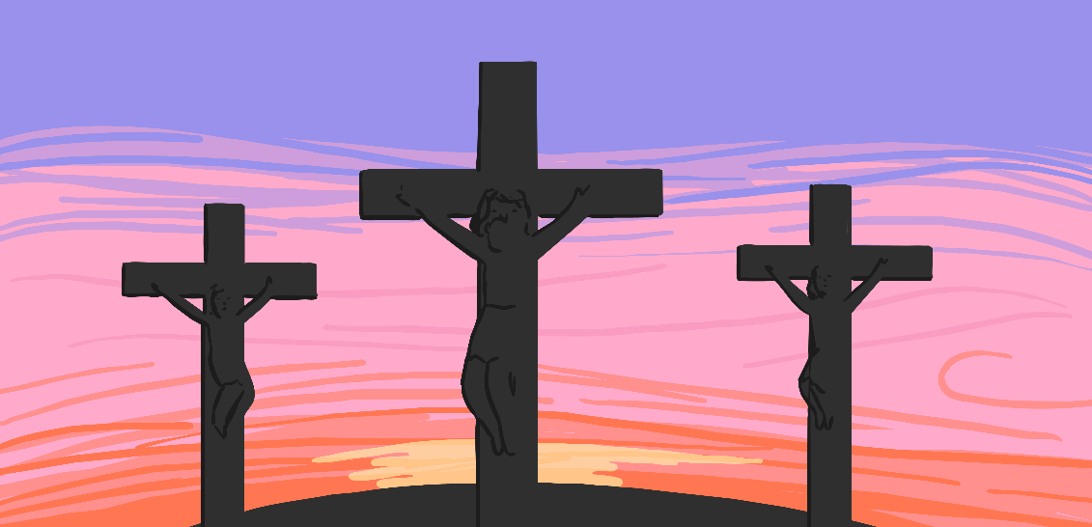
When Does Lent Finish?
Lent ends at Easter, when Christians remember Jesus’ death on the cross and his resurrection.

Slide 9
What Would You Give up for Lent?
Lent is a time for Christians to remember Jesus’ sacrifice and how he resisted temptation.
If you were giving up something for Lent, what would it be?
Why would it be difficult for you to give it up?
?
?
?

